Slide 1
Utility Supply Chain Issues Roundtable
And Current Events in Metering
Tuesday July 23, 2024
3:15 PM – 4:30 PM
Tom Lawton

Slide 2
The Issue
Seems like everything is on back order and everything has extended lead times
The world went on hold for an extended period
E-commerce exploded as the world ordered everything on-line for at home delivery
Businesses were often in limbo as to whether they were essential or non-essential, manufacturing slowed to a crawl
Transportation and distribution infrastructure was damaged and additional regulations that had been in the works.
Truckers lives made more difficult during the pandemic and their livelihoods impacted with higher fuel prices and new, more draconian regulations after the pandemic
Small disruptions that occur from time to time were magnified.
New container ships arriving in ports that had not been upgraded to receive them

Slide 3
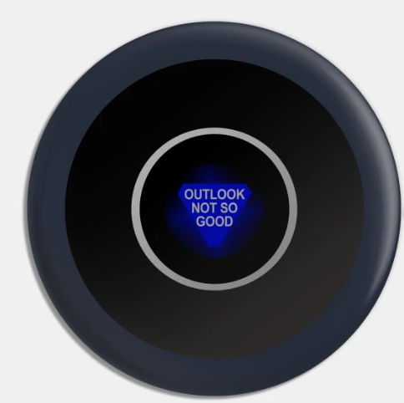
The Forecast
Magic Eight Ball says: Outlook Not So Good

Slide 4
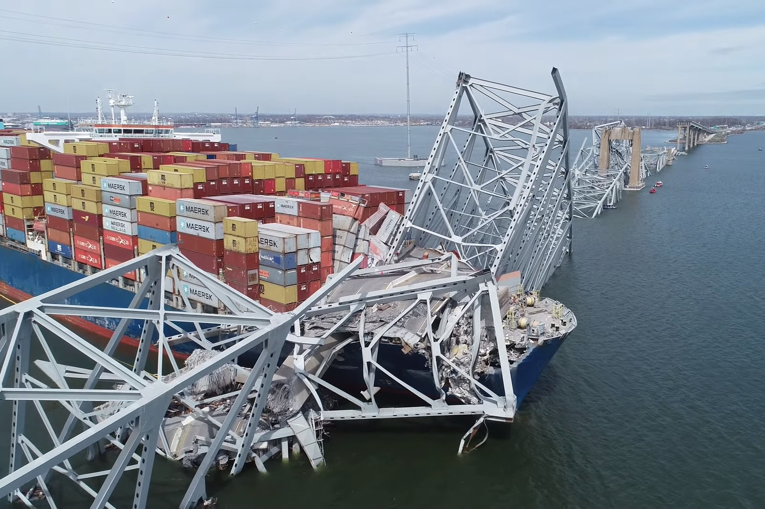
The Forecast

Slide 5
Strategies
Prior to 2020 typical inventories were two to three months at most or 50% to 100% longer than lead times
Now we are all ordering for first six months and then twelve months. We have several items that have always been long lead where we have two years of parts in stock or on order.
Down side – we are all doing this so the demand continues to increase as supply remains tight
Vertical Integration and a return to JIT principles
Keep your suppliers close
Bring the supply chain in house whenever you can

Slide 6
Strategies
Reinforce Partnerships
Your customers and your suppliers vendors have always been your partners. This has become much clearer to everyone over the past two years.
Look at designs to allow for additional options or eliminate difficult materials to source
Need to consider UL or other safety concerns with alternate materials or suppliers
Need to consider functional differences of alternate materials and suppliers
Take on sourcing issues for both your customers and your vendors
E-commerce
Logistics & Supply Chain Technology Upgrades
Logistics set-up and tracking in and out
ERP system upgrades and training
Data Is King…Or It Should Be.

Slide 7
Ideas?
What has your department done to address long lead items?
What items are you seeing as the hardest to procure or having the greatest impact on your operation?
Is your Utility doing anything to change their approach to procurement?
What have you seen that has been effective? Ineffective?
Has your relationship with customers or your policies relating to customers changed?
Has your relationship with vendors changed?

