Slide 1
The Benefit of High Accuracy, Extended Range CTs
July 24, 2024
8:45 AM – 10:15 AM
Matt Green and Jonathan Clark

Slide 2




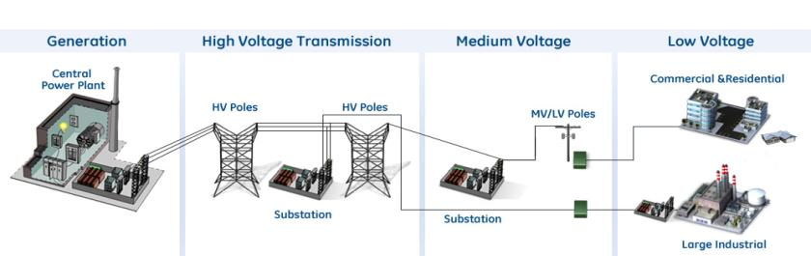
Where Would You Use High Accuracy CT’s?
Inside of…
Metering Panels
LV Switchgear, MCC’s
Generator
Transformers
Transformers
Switchgear
Installed at…

Slide 3
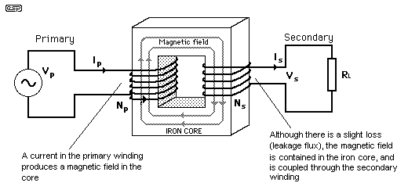
Current Transformers
Primary
(Input)
Core
Secondary
(Output)
Transform the voltage or current input into a standard 5 or 1 amp output

Slide 4
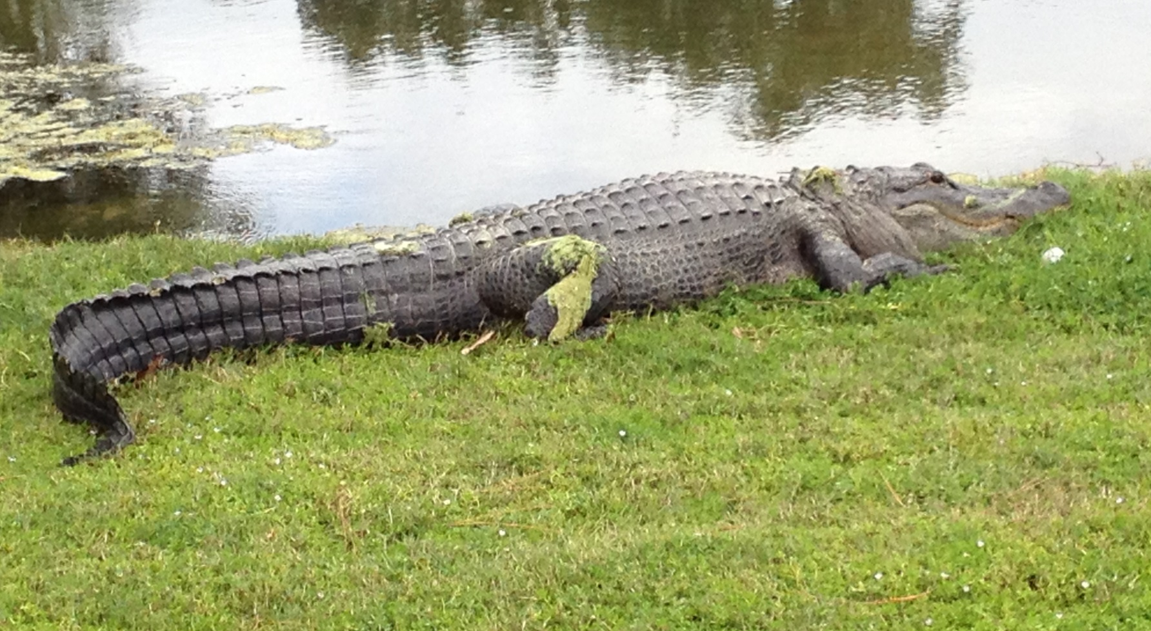
Accuracy – How close can you get it to the Gator Head.
Loser must retrieve balls.

Slide 5
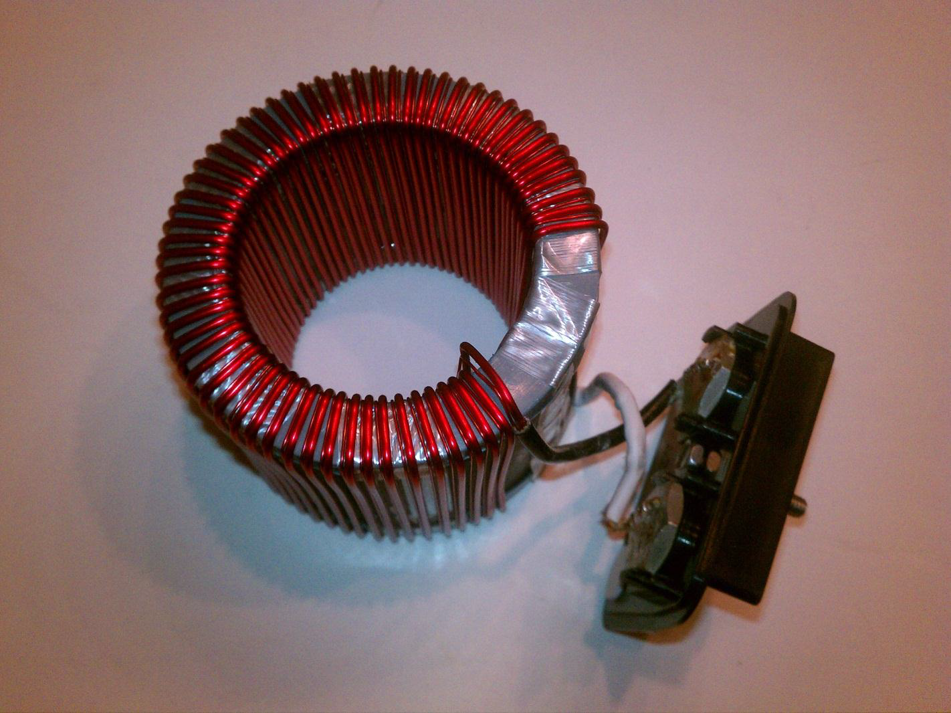
What Impacts Accuracy?
Number of Secondary Turns
Core material and/or cross section
Secondary Burden

Slide 6

Energy Required to Energize the Core
Secondary turns or core cross section
If
Then
energy required to energize core
secondary impedance
Courtesy of Electric Power Transformer Handbook

Slide 7
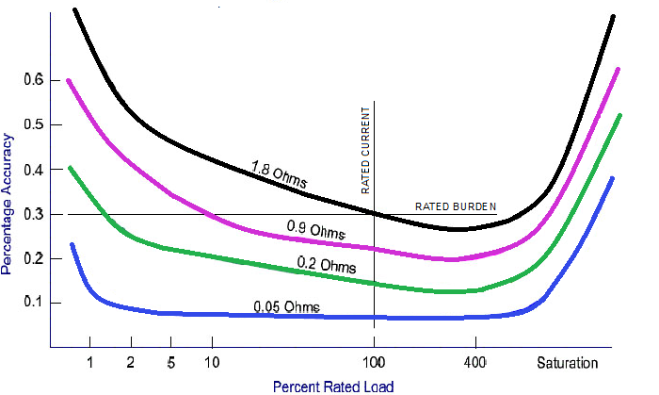
CT—Accuracy—Burden — Load
Core energy needed
Saturation
Graph: Bill Hardy – TESCO

Slide 8
CT Metering Accuracy
=
Actual secondary
current
Rated secondary
current
Difference in % is known as the “Accuracy”
of the CT
Definition: There are two sources of error in instrument transformers, namely ratio error and phase angle error. In a given transformer, the metering error is the combination of the two separate errors. This combination is called Transformer Correction Factor (TCF), IEEE has established accuracy classes for both current and potential transformers. The limit of permissible error in a potential transformer for a given accuracy class remains constant over a range of voltage from 10% below to 10% above rated voltage

Slide 9
Ratio Correction Factor (RCF)
IEEE C57.13 Terminology
RCF = True Ratio / Marked Ratio
Example: 500:5 CT
By test, CT Ratio = 100.1
RCF = 100.1 / 100 = 1.0010
What does this mean? How many amps is the meter seeing?
A. – With 500A through primary, only 4.995A is flowing on the secondary 4.995 x 1.001 = 5A. (Negative current error due to losses)

Slide 10
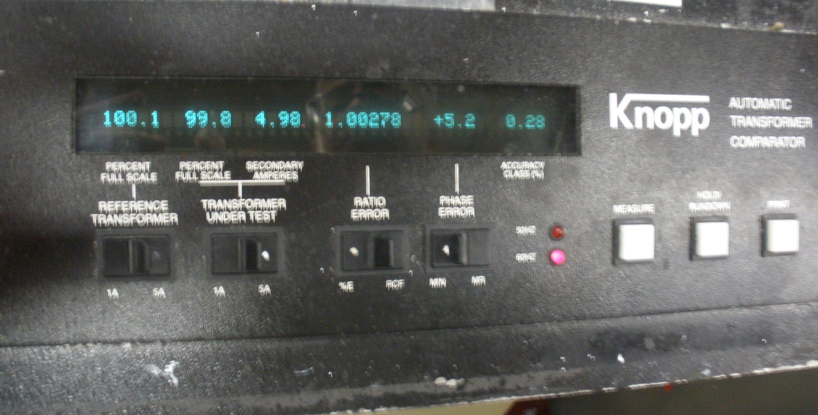
Ratio Correction Factor (RCF)
RCF on Knopp Comparator

Slide 11
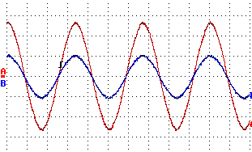
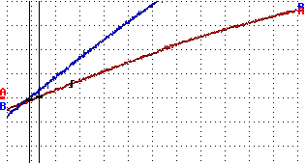
Phase Error
Red = Primary Current
Blue = Secondary Current
When Secondary Current (blue) leads the Primary Current (red), Phase Error () is defined as Positive.
Difference measured in minutes
1 minute = 0.77usec (60Hz)

Slide 12
Phase Error
Phase Error on Knopp Comparator

Slide 13
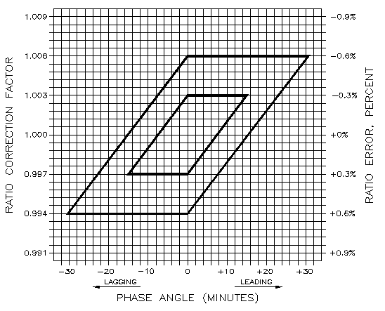
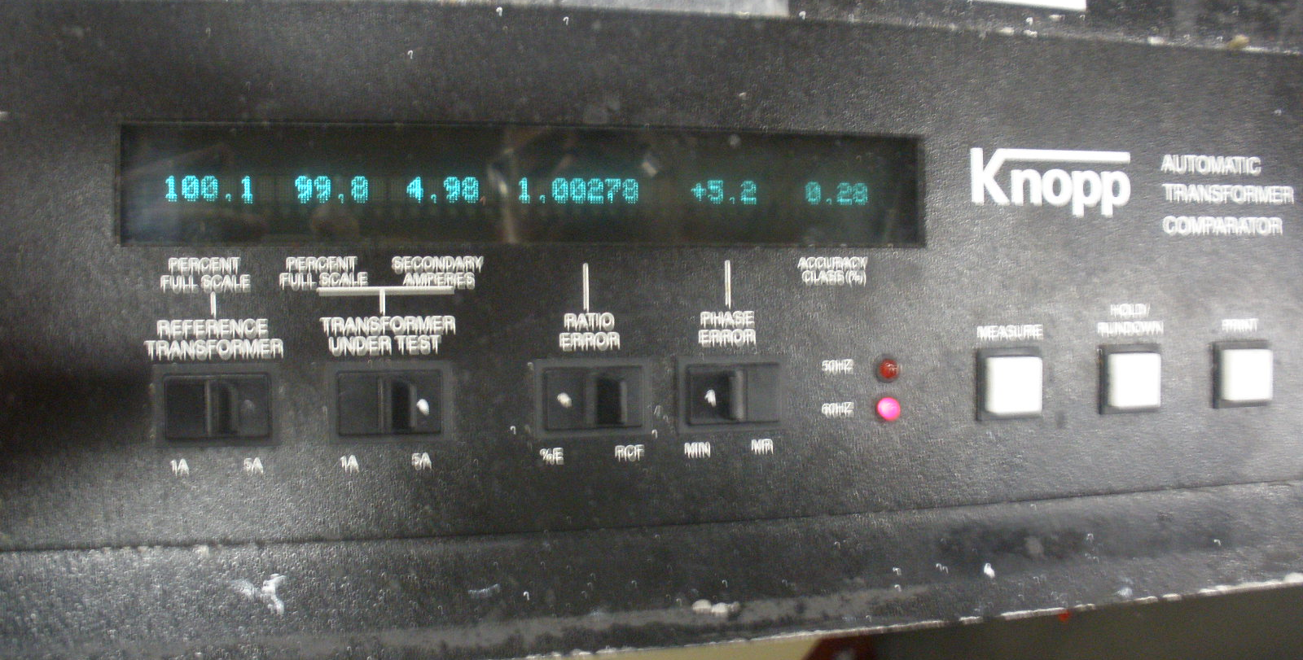
IEEE Std. C57.13 limits of accuracy class for current transformers for metering 0.3 accuracy class
CT PARALLELOGRAM
Recall the Knopp Comparator
The values were:
Ratio Error = 1.00278
Φ Angle Error = 5.2

Slide 14
CT PARALLELOGRAM
IEEE C57.13 – Accuracy Limits
Ratio Correction Factor (RCF)
Lagging Leading
Phase Angle, minutes

Slide 15
Accuracy Class Definitions

Slide 16
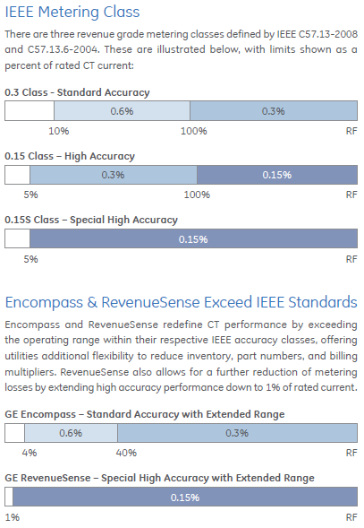

Slide 17
Standard 0.3 Accuracy Class
±0.6% Accuracy
from 10% to 100%
of rated current
IEEE C57.13 Accuracy
0.3 @ BX.X; RF = X.X
0.60
±0.3% Accuracy
from 100% rated current up to RF
0.30
Typical 0.3 CT Performance Curve
Accuracy Class - %
10%
100%
0.30
No accuracy guaranteed at current levels less than 10%
0.60
1.0
Rating Factor
RF

Slide 18
ITI Encompass
“Stretching” the rating factor
0.30 @ BX.X; RF 0.4-X.X
±0.6% Accuracy
from 4% to 40%
of rated current
0.60
±0.3% Accuracy
from 40% rated current up to RF
Typical Encompass
Performance Curve
0.30
0.15
Accuracy Class - %
4%
40%
100%
0.15
0.30
0.60
.4
1.0
Rating Factor
RF

Slide 19
0.15 High Accuracy Class
IEEE C57.13.6 Accuracy
0.15 @ BX.X; RF = X.X
0.60
±0.3% Acc. from 5% - 100%
0.30
±0.15% Accuracy
from 100% up to RF
Typical 0.15 CT Performance Curve
0.15
Accuracy Class - %
5%
100%
0.15
0.30
No accuracy guaranteed at current levels less than 5%
0.60
1.0
RF
Rating Factor

Slide 20
0.15S Special High Accuracy (Accubute)
IEEE C57.13.6 Accuracy
0.15 @ E0.04, E0.20; 0.15 @ BX.X; RFX.X
0.60
0.30
±0.15% Accuracy
from 5% up to RF
Typical CT Accubute™ Performance Curve
0.15
Accuracy Class - %
5%
100%
0.15
0.30
No accuracy guaranteed at current levels less than 5%
0.60
1.0
Rating Factor
RF

Slide 21
0.15S High Accuracy Extended Range
“Stretching” the rating factor
0.15 @ BX.X; RF X.X
0.60
0.30
±0.15% Accuracy
from 5% up to RF
Typical CT Accubute™ Performance Curve
0.15
Accuracy Class - %
1%
100%
0.15
0.30
No accuracy guaranteed at current levels less than 1%
0.60
1.0
RF
Rating Factor

Slide 22
Definitions
Standard Revenue Metering Accuracy (IEEE 0.3 Accuracy Class)
± 0.3% accurate from 100% Nameplate Rating, up to Rating Factor
± 0.6% accurate below 100% Nameplate Rating, down to 10% of Nameplate Rating
GE ITI Encompass CT’s
± 0.3% accurate from 40% of Nameplate Rating, up to Rating Factor
± 0.6% accurate below 40% Nameplate Rating down to 4% of Nameplate Rating
High Accuracy (IEEE 0.15 Accuracy Class)
± 0.15% accurate from 100% Nameplate Rating, up to Rating Factor
± 0.3% accurate below 100% Nameplate Rating, down to 5% of Nameplate Rating
GE Somersworth Accubute™ (IEEE 0.15S Accuracy Class)
± 0.15% accurate from down to 5% of Nameplate Rating, up to Rating Factor
GE RevenueSense High Accuracy Extended Range (IEEE 0.15S Accuracy Class)
± 0.15% accurate from down to 1% of Nameplate Rating, up to Rating Factor

Slide 23
Utility Metering CTs: What Do I Need to Know
B - Burden
R - Ratio
A - Accuracy
V – voltage class
E – Etc (window size, special requirements)
R – Rating Factor
Revenue metering application

Slide 24
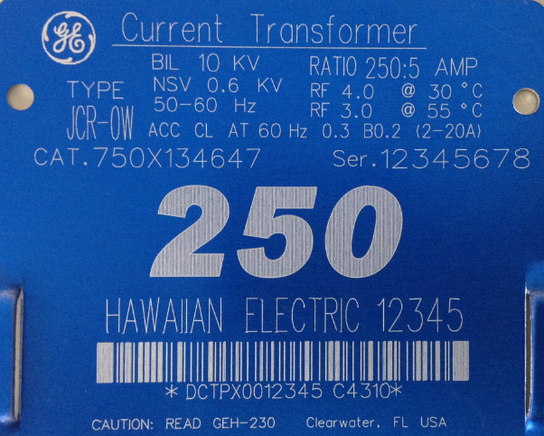
Name Plate Information: Burden
Definition: Load connected to CT secondary
Includes devices & connecting leads
Expressed in ohms
Standard values = B0.1, B0.2, B0.5, B0.9, B1.8
E0.04, E0.2

Slide 25
Standard CT Burdens
Standard IEEE CT Burdens (5 Amp)
(Per IEEE Std. C57.13-1993 & C57.13.6)
E0.2
E0.04
0.2
0.04
5
1
1.0
1.0

Slide 26
Standard Accuracy Extended Range

Slide 27


Low Voltage Encompass™ Series
System Current | 20A | 40A | 60A | 80A | 100A | 200A | 400A | 600A | 800A | 1000A | 1200A | 1400A | 1600A | 1800A | 2000A
200:5 JAK-0C (Rating Factor 4.0) | ±0.6% Accuracy |  |  |  |  | ±0.3% Accuracy
400:5 JAK-0C (Rating Factor 4.0) |  | ±0.6% Accuracy _ |  |  |  |  | ±0.3% Accuracy
1000:5 JAK-0C (Rating Factor 2.0) |  |  |  |  | ±0.6% Accuracy |  |  |  |  | ±0.3% Accuracy
500:5 JAK-0W Encompass™ (4% to 400%) | ±0.6% Accuracy |  |  |  |  | ±0.3% Accuracy
One Encompass CT offers equal to, or better accuracy class
over the range of multiple legacy CT’s

Slide 28
High Accuracy Extended Range

Slide 29
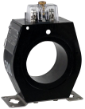
Low Voltage RevenueSense™ Series
System Current | 6A | 20A | 40A | 60A | 80A | 100A | 200A | 400A | 600A | 800A | 1000A | 1200A | 1400A | 1600A | 1800A | 2000A
200:5 JAK-0C (Rating Factor 4.0) |  | ±0.6% Accuracy |  |  |  |  | ±0.3% Accuracy
400:5 JAK-0C (Rating Factor 4.0) |  |  | ±0.6% Accuracy _ |  |  |  |  | ±0.3% Accuracy
1200:5 JAK-0C (Rating Factor 1.5) |  |  |  |  |  | ±0.6% Accuracy |  |  |  |  |  | ±0.3% Accuracy
600:5 JAK-0S High Revenue Sense (1% to 300%) | ±0.15% Accuracy
One RevenueSense™ CT improves accuracy over the range of multiple legacy CT’s, with significant improvement at low currents

Slide 30
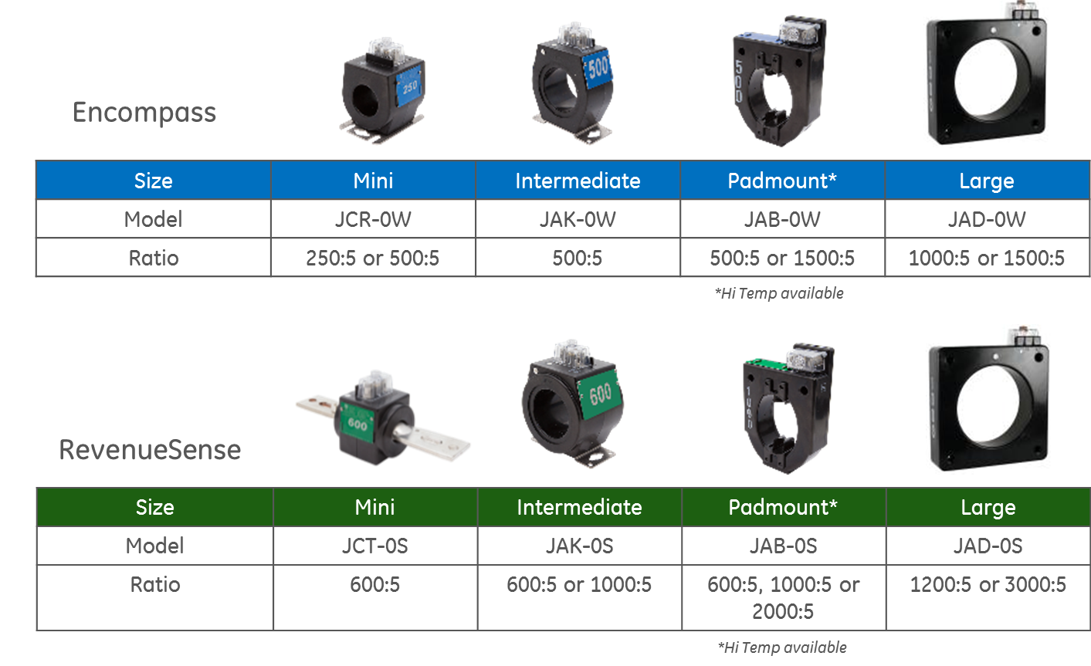
Product Line Summary
Tip: To navigate between the first level copy and the first level bullet, use the Indent and Outdent button on the Home Ribbon.
Once you are on the second, and third level bullets, you can Tab and Shift-Tab to go back and forth between the bullet levels.

Slide 31
Factors Influencing CT Accuracy
Current Ratio
“Low ratio” and “high accuracy” are not friends!!
Burden
“High burden” and “High Accuracy” are not friends!!
Physical Size
“Large windows, small cross-section”
and “High accuracy” are not friends!!
Notes:
What affects accuracy??

Slide 32
Sizing CTs for Metering
Use as low of a ratio as possible with the RF covering the maximum current level
CT error is almost always negative
Using a more accurate metering class will almost always result in higher revenue levels
Burden adversely affects accuracy, the lower the applied burden, the better the accuracy performance

Slide 33
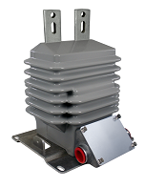
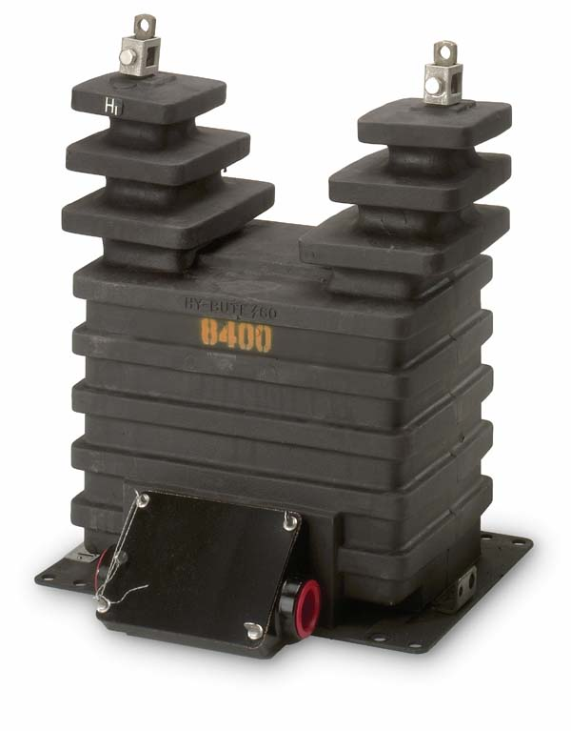
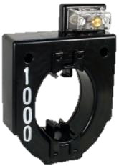
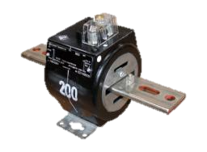
Thank You for Your Time

Slide 34

Questions and Discussion
Matt Green
Jonathan Clark
Alabama Power
This presentation can also be found under
Meter Conferences and Schools on the TESCO website: tescometering.com
ISO 9001:2015 Certified Quality Company
ISO 17025:2017 Accredited Laboratory

