Slide 1
Test Switch Operation & Accessories
Tuesday July 23
8:45 AM – 10:30 AM
Dan Hollow

Slide 2
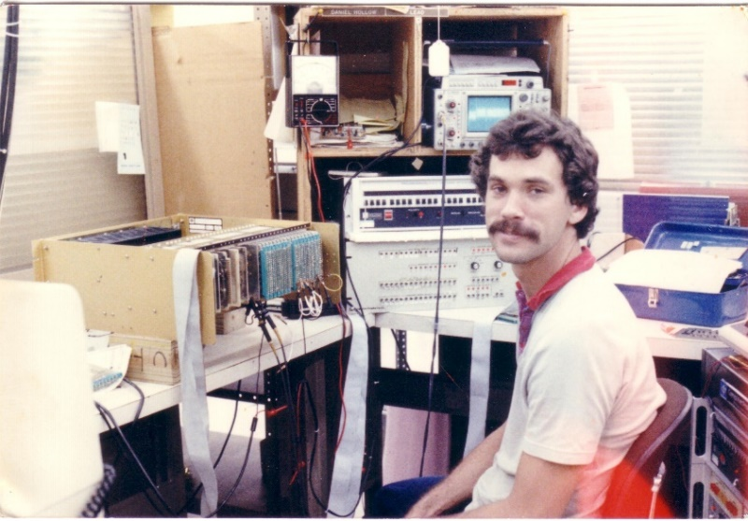
Bio: Dan Hollow
Rocky Mountain Regional Sales Manager for TESCO
Background in Micro Electronics. Have worked for TESCO as the Rocky Mountain Regional Sales Manager since 2015. Have worked in the utility industry since 1988. Began career in the utility industry as the Production Test Department Supervisor for Aptech and accepted an outside sales position with Aptech in 1992 and have been in outside sales ever since. Have also worked for companies such as UTS/Itron, Datamatic, and Metrum Technologies/Aclara.
Have worked in the technology industry since 1980 and have worked in other industries prior to working in the utility industry as an Electronics Technician and Test Department Supervisor for companies that manufactured products for Banking Equipment, Industrial CNC Controls, Process Controls and Flight Simulator Equipment.

Slide 3
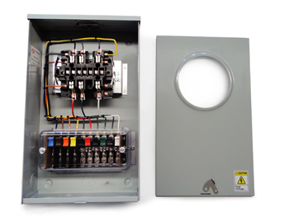
Purpose
To acquaint the attendees with the use and purpose of Meter Test Switches
Course Breakdown of Topics:
Using Test Switches
Meter Test Switch Specifications
Meter Test Switch Configurations
Meter Test Switch Accessories
Pre-Wired Transformer Rated Enclosures

Slide 4
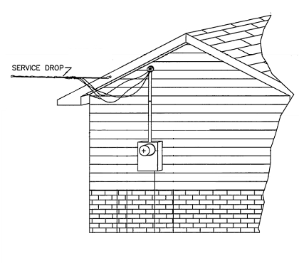
Typical Self Contained Service
Typically found in residential metering
Meters are capable of handling the direct incoming amperage
Meter is connected directly to the load being measured
Meter is part of the circuit
When the meter is removed from the socket, power to the customer is interrupted

Slide 5
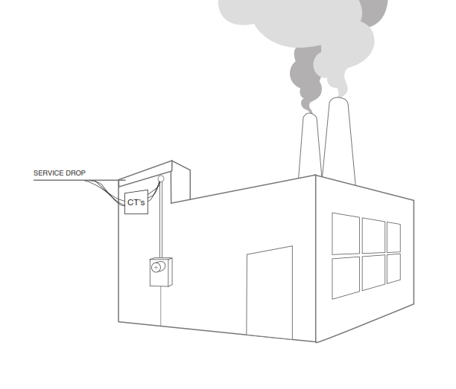
Transformer Rated Service
Meter measures scaled down representation of the load.
Scaling is accomplished by the use of external current transformers (CTs) and sometimes voltage transformers or PTs).
The meter is NOT part of the circuit
When the meter is removed from the socket, the customer does not lose power
Transformer Rated Service

Slide 6
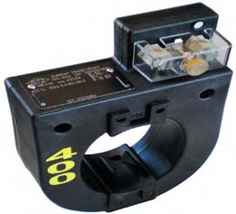
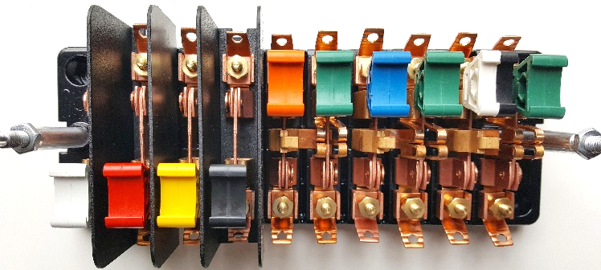
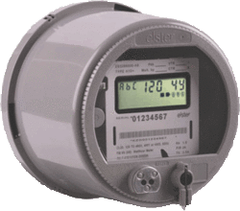
Transformer Rated Service
SOURCE
PHASE A
400A
PHASE B
400A
LOAD
PHASE C
400A
9S Meter
Installation
with 400:5 CT’s
5A
5A

Slide 7
Safety
Testing current transformers while they are in service can be a dangerous operation if certain safety procedures are not followed. The secondary loop of a current transformer must NEVER BE OPENED when service current is present in the primary. When there is current in the primary, and the secondary of a current transformer is open circuited, the voltage across the secondary can rise to hundreds and even thousands of volts, creating an extremely dangerous situation. The open CT secondary voltage magnitude varies with CT design and primary current flow.

Slide 8
Safety
The high voltage that is present on the open secondary of an energized current transformer generates two great hazards. The first hazard is ELECTRICAL SHOCK TO TESTING PERSONNEL. The second hazard is THE BREAKDOWN OF THE CURRENT TRANSFORMER INSULATION. Both hazards can be avoided provided that the secondary of the current transformer is never opened. The safest current transformer installations for testing are those that have a Test Switch as part of the secondary loop. A Test Switch is a device that will facilitate inserting instrumentation in the current transformer secondary loop without the danger of opening the circuit.

Slide 9
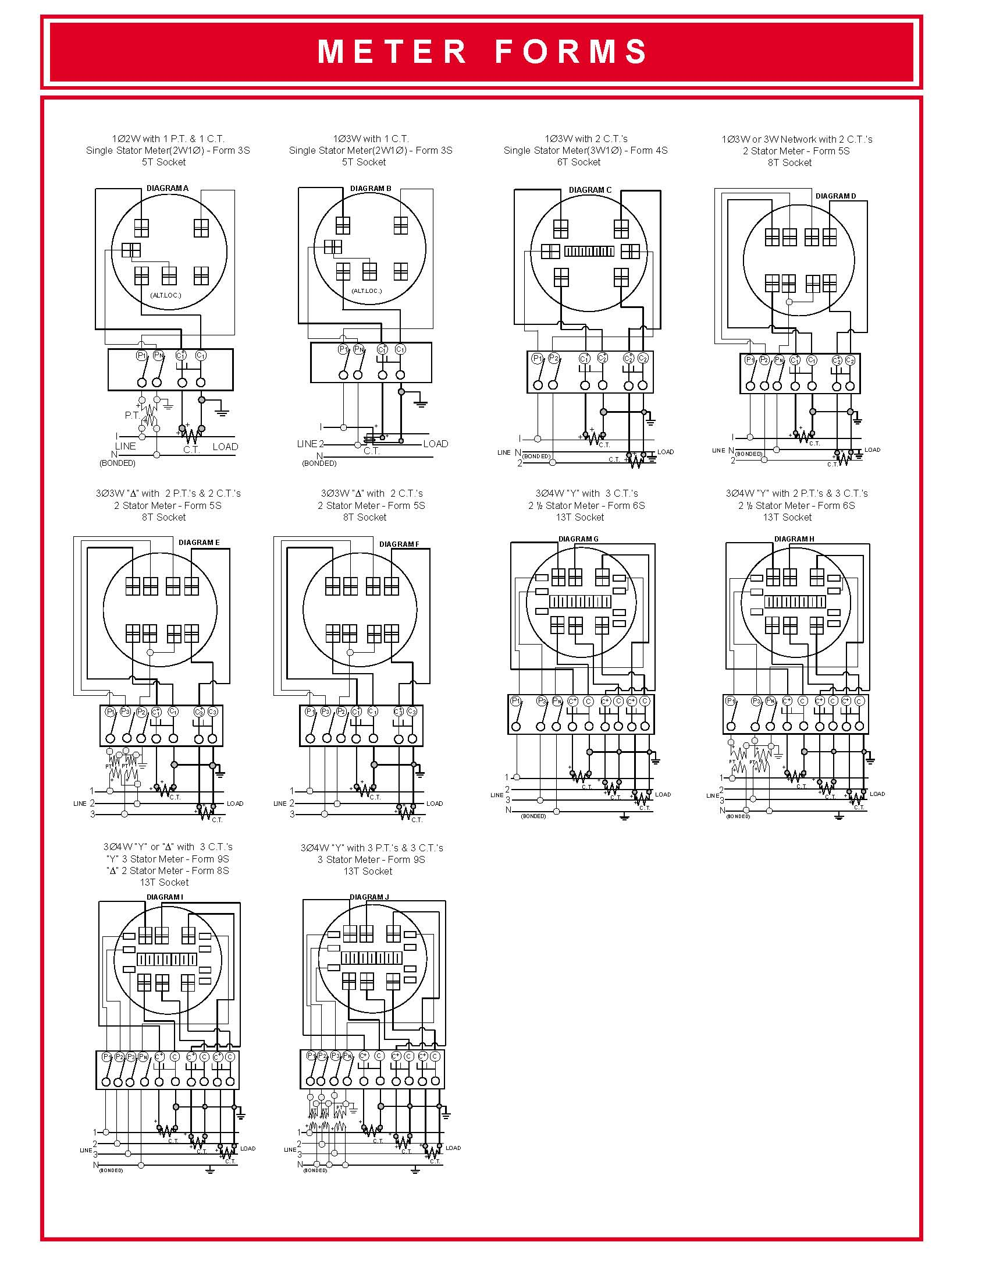
Typical Connections for Common Meter Forms

Slide 10
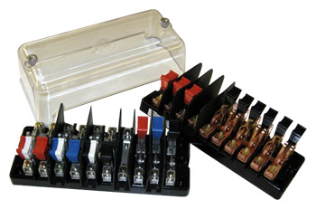
Test Switch Specifications
ANSI C12 Definitions
Test Switch Materials
Plating
Barriers
Wiring Connections
What to look for
Covers

Slide 11
ANSI C12.9
Test Switch Definitions

Slide 12
ANSI C12.9 Test Switches

Slide 13
ANSI C12.9
General
Test Switch
Specifications

Slide 14
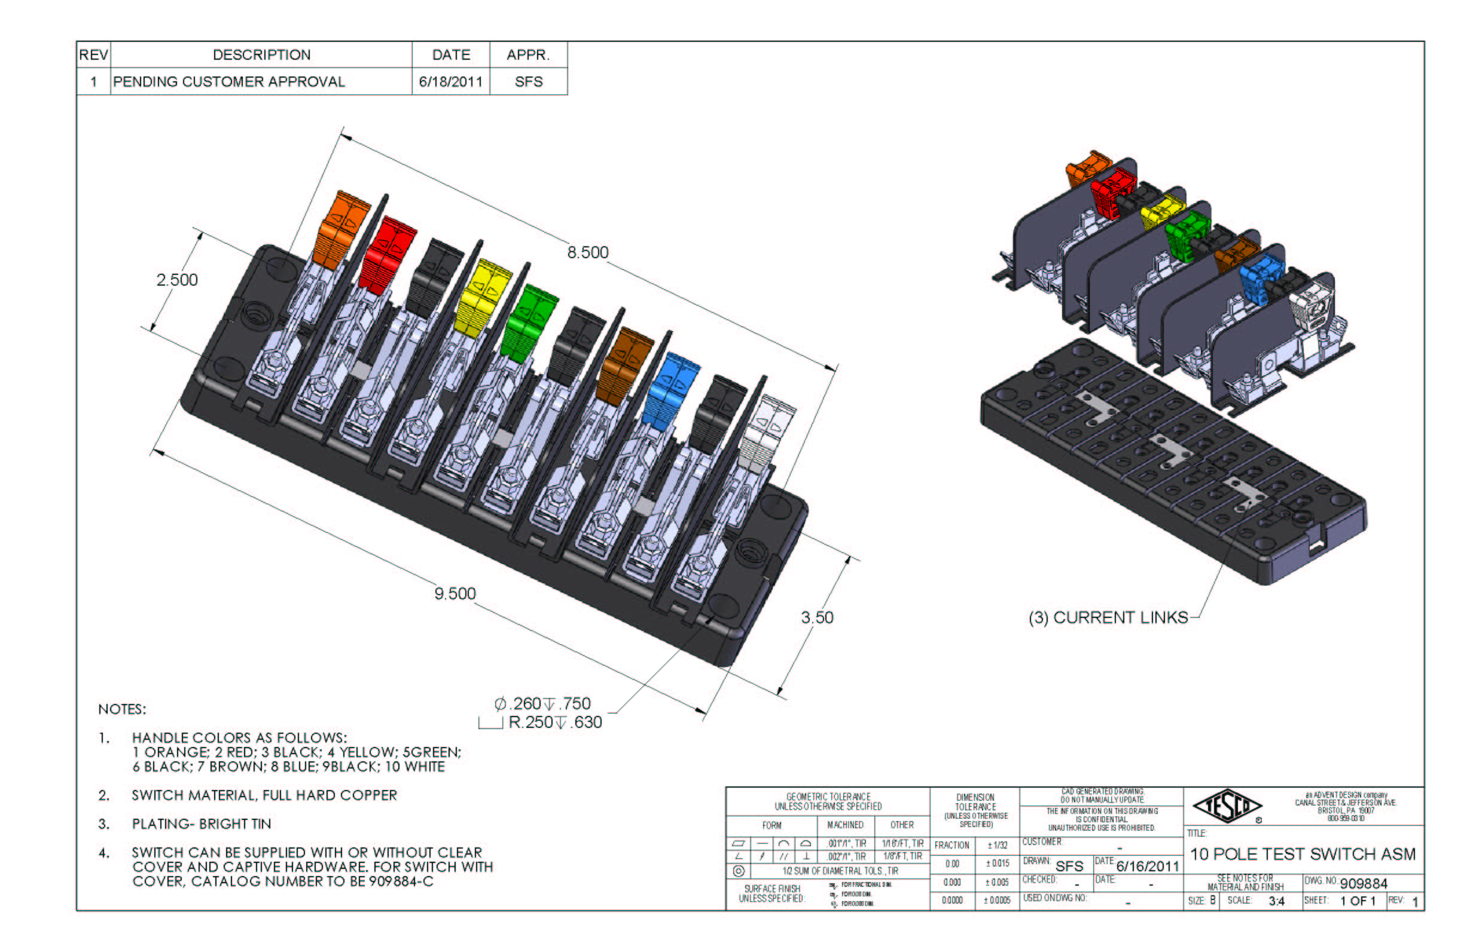
Test Switch Configurations
Layout
Handle Colors
Reversed vs. Normal Potentials
Current Links
Base Sizing
Barrier Locations

Slide 15
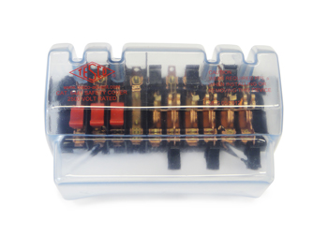

Test Switch Accessories
Test Plugs
Safety Covers
Test Switch Isolators
On installations that contain Test Switches, test leads terminated with a test switch
safety test probe (test plug) should be used for CT testing. This provides a “make-before-break” connection to prevent accidental opening of the current transformer secondary loop.

Slide 16
ANSI C12.9
Test Jack
Specifications

Slide 17
ANSI C12.9
Test Jack
Specifications

Slide 18
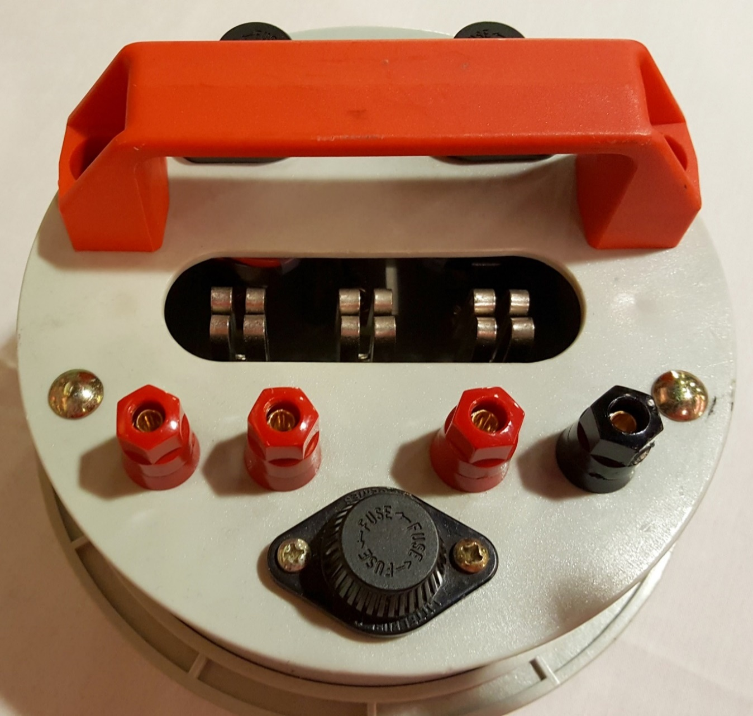
For Utilities not Currently
Using Test Switches To Test CTs

Slide 19
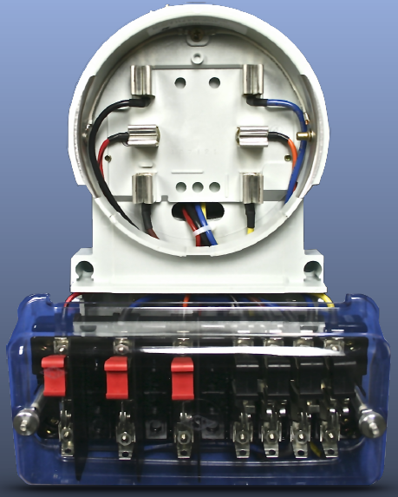
Test Switch Mounted Below Adaptor

Slide 20
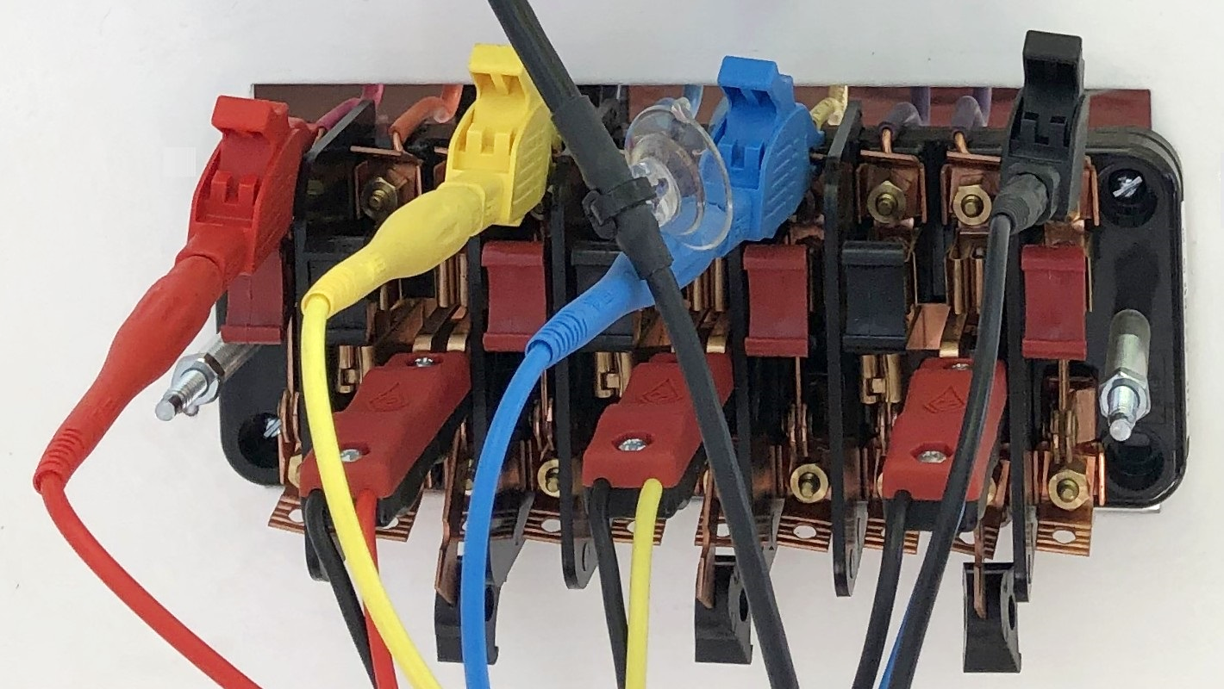
Test Switch Wired up and Ready for Test

Slide 21
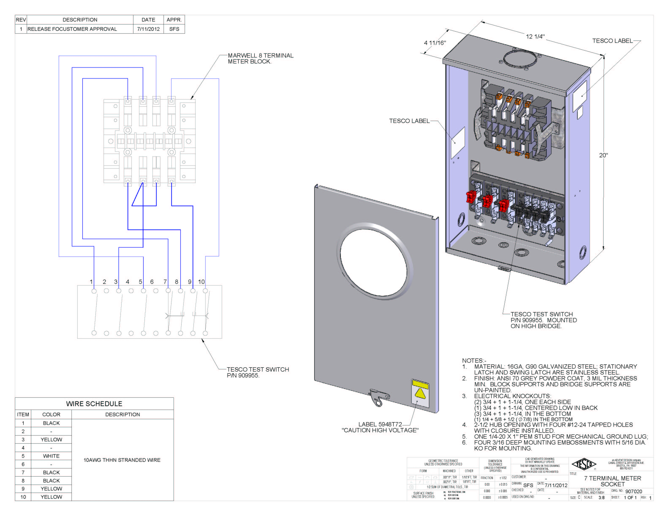
Pre-Wired Transformer Rated Enclosures
Cover Types
Wiring
Sockets

Slide 22

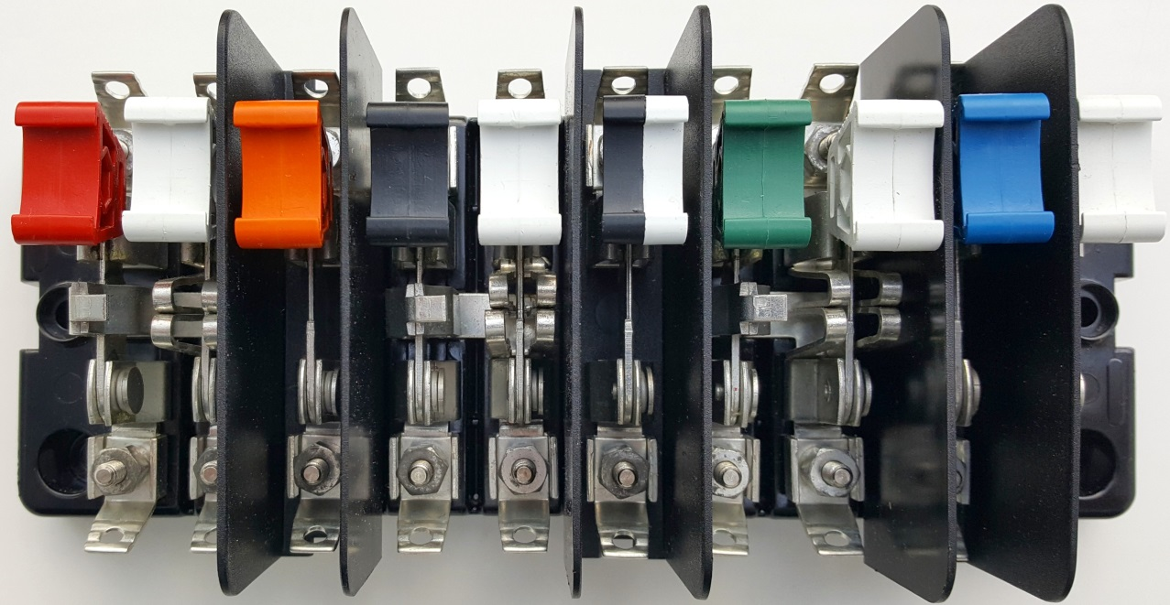
Questions?

Slide 23

3 Quiz Questions
  Why would you NOT want to open the test jack before opening the shunt/shorting switch first before testing a given CT on a transformer rated metering service?
        Because it could cause an arc flash
        Because you would power down the meter
        Because it would open circuit the secondary of the CT for that phase
        None of the above
  Which type of metering service would require a test switch?
        Self-Contained
        Single Phase
        Transformer rated service
        Net Metered Service
  What is the purpose of a test switch?
        To add cost to a transformer rated metering service.
        To prevent electrical shock
        To enable testing of the CTs and meter on a transformer rated service
        To cut power to the meter

Slide 24
Thank you!
Dan Hollow
Rocky Mountain Region Sales Manager
TESCO – The Eastern Specialty Company
Bristol, PA
303.810.6528
This presentation can also be found under Meter Conferences and Schools on the TESCO website: tescometering.com
ISO 9001:2015 Certified Quality Company
ISO 17025:2017 Accredited Laboratory

