Slide 1
Roundtable:
DC Metering
Tuesday July 23, 2024
10:30 AM – 12:00 PM
Tom Lawton

Slide 2
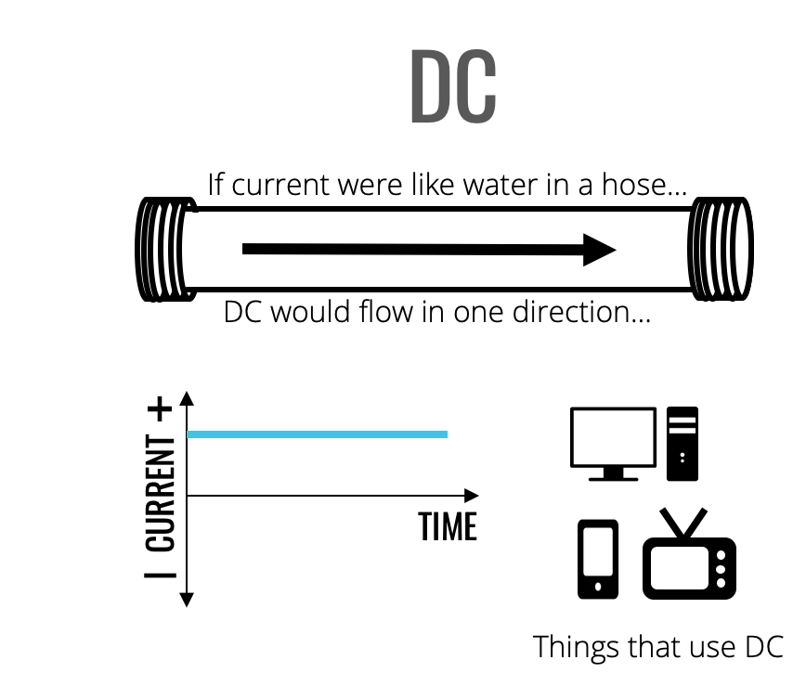
DC Current

Slide 3
AC vs DC
In DC theory we learned
  Ohm’s Law
    Voltage = Current x Resistance
    V = IR
  Power
    P = I²R = V²/R
For AC we would like the same equations to apply.
  Specifically we want to be able to say that a DC voltage of 10 Volts applied to a resistor of value R produces the same power dissipation as an AC voltage of 10 volts applied to the same resistor.

Slide 4
AC vs DC
V = IR
P = VI = I²R = V²/R

Slide 5
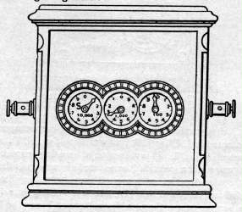
What about DC?
We have had DC Metering since the 1870’s.
The first patented meter was a DC meter in 1872, six years before the first AC meter.

Slide 6
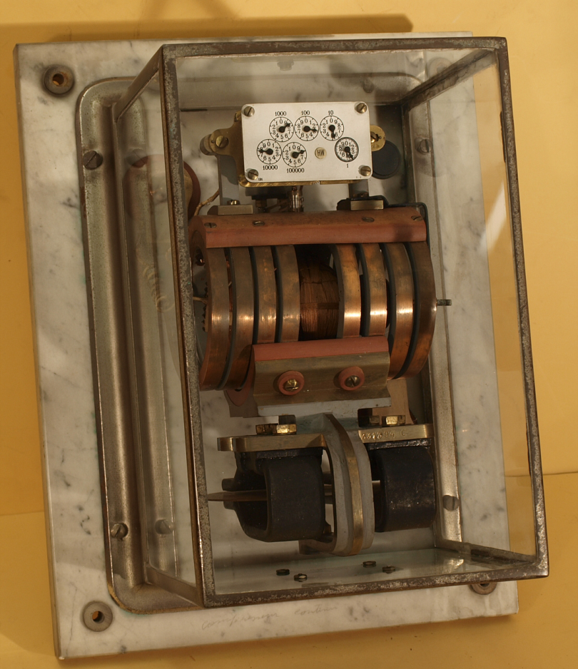
Elihu Thomson
1889 Thomson introduced his recording wattmeter (AC or DC – a commutator-type meter).
This was the first true watthour meter, and it was an immediate commercial success, many utilities adopting it as their "standard" model.
Although this meter was initially designed for use on AC circuits, it worked equally well with the DC circuits in use at the time.
The introduction and rapid acceptance of induction-type watthour meters in the late 1890s relegated the use of this commutator-type meter to DC circuits.

Slide 7
DC Theory?
No need for new definitions.
Power is simply VA.
If we can measure the fundamental Volt and the fundamental Amp then we can create a Standard to measure against and can effectively test our DC meter.

Slide 8
What about DC?
There are still a number of DC meters out on our systems, primarily in the larger, older urban areas such as San Francisco and New York City.
There has been no effective way to test these legacy meters for some time. This is shortcoming was highlighted as new DC metering applications have begun to make an appearance on the grid and are demanding we find a solution (e.g. DC superchargers)
Using labs with traceable Voltage sources and measurement capabilities and traceable Current sources and measurement capabilities we are now starting to do this.

Slide 9

Questions and Discussion
Tom Lawton
President
tom.lawton@tescometering.com
TESCO – The Eastern Specialty Company
Bristol, PA
215-228-0500
This presentation can also be found under Meter Conferences and Schools on the TESCO website: tescometering.com
ISO 9001:2015 Certified Quality Company
ISO 17025:2017 Accredited Laboratory

