Slide 1
Sizing Instrument
Transformers
for Accurate Performance
July 24, 2024
8:45 AM – 10:15 AM
Tim Hope

Slide 2
What are Instrument Transformers
Specialized transformers designed to operate measurement and control devices:
    Voltmeters
    Ammeters
    Watthour Meters
    & Relays
Transform high voltage or high current to lower values.
    Watthour meters may handle up to 320 amps and 480 volts.
IT's transform with a high degree of precision.
Also used to isolate high voltage or high available fault current from both the operator and end devices.

Slide 3
IT Selection Criteria
Nominal System Voltage
Basic Impulse Level
Environment
Accuracy Class
VT Considerations
  Burden
  Type of Circuit & Connection
  Physical mounting requirements
  Fusing
CT Considerations
  Burden
  Physical mounting requirements
  Expected Load Current
  Overcurrent Capability

Slide 4
IT Selection Criteria
Nominal System Voltage
  The insulation class is based on phase to phase voltage
Basic Impulse Level
  IT BIL must match or exceed the System BIL.
  Caution: More than one BIL may be available for a given Nominal System Voltage.
Environment
  Indoor or Outdoor installation.
  Contaminating atmosphere.
  High Altitude (Over 3300 feet above sea level, derate transformer insulation)

Slide 5
IT Accuracy Class
Accuracy Classes define an envelope of ratio accuracy and phase angle accuracy for defined burdens.
Separate accuracy envelopes are defined for Current Transformers and Voltage Transformers.
ANSI C57.13 defines 3 levels of performance:
    0.3 Revenue Metering
    0.6 Indicating Instruments
    1.2 Indicating Instruments
  Accuracy is defined for load power factors from 1.0 to 0.6 lagging.
VT Accuracy
  performance from 90% rated voltage to 110%.
CT Accuracy
  large performance envelope from 10% of rated current to rated current.
  smaller performance envelope from rated current to rating factor.

Slide 6
CT Rating Factor
Maximum Expected load current should approach the Thermal Rating Factor of the CT.
Rating Factor Example: 75:5, RF 3.0 @ 30°C
  maximum expected primary “load” current = 225 amps, and
  maximum expected secondary “meter” current = 15 amps,
  assuming that ambient temperature does not exceed 30°C.

Slide 7
CT Rating Factor
Maximum Expected Load Current
  Rating Factors are used to keep transformer winding temperatures below 85 degree C.
  Rating Factors may be given for:
    Outdoor applications 30 degrees C ambient
    Indoor applications 55 degrees C ambient
  Rating Factors may be adjusted for ambient temperatures other than 30 and 55 degree C.

Slide 8
Typical CT Application Range
ANSI C57.13
0.3 Accuracy Class
.60
.30
.15
Transformer Correction
Factor will plot within
this envelope
Percent Error
-.15
-.30
-.60
1% 5% 10% 50% 100% RF
Percent of Rated Current

Slide 9
Standard 0.3 Accuracy Class
±0.6% Accuracy
from 10% to 100%
of rated current
IEEE C57.13 Accuracy
0.3 @ BX.X; RF = X.X
0.60
±0.3% Accuracy
from 100% rated current up to RF
0.30
Typical 0.3 CT Performance Curve
Accuracy Class - %
10%
100%
0.30
No accuracy guaranteed at current levels less than 10%
0.60
1.0
Rating Factor
RF

Slide 10
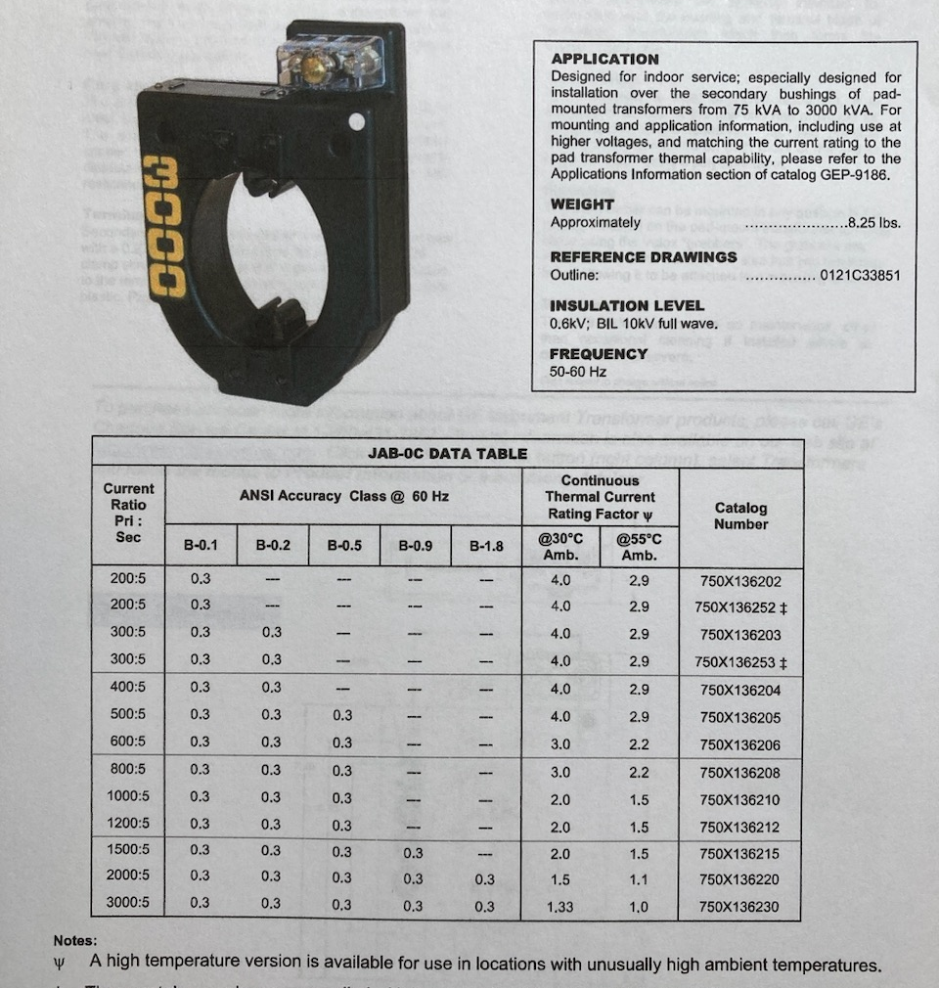
IT Catalog Sheet
JAB-0C Grecian Urn 600 Volt CT

Slide 11
IEEE CT METERING ACCURACY
Example 1:
0.3 accuracy CT, 200:5, RF 4.0 (Standard)
200 amps (rated amps) to 800 amps (RF 4.0) = 0.3% accuracy
20 amps (10% of rated amps) to 200 amps (rated amps) = 0.6%

Slide 12
Application Exercise
A commercial building is being built with a 4-wire wye main service, rated for 200 A at 12,470/7200Y. Your boss wants you to meter the building with an electronic polyphase watt-hour meter. The initial load is expected to average about 1000 kW, but may peak to 2000 kW on occasion.
Select the best CTs And PTs for the job
NSV
BIL
Type
Ratio

Slide 13
Current Calculations
Expected Current = 1,000,000W/7200volt x 3
Expected Current = 1,000,000W/(12,470volt x 1.732)
Expected Current = 46.3 amps
Peak Current = 2,000,000W/7200volt x 3
Peak Current = 2,000,000W/(12,470volt x 1.732)
Peak Current = 92.6 amps

Slide 14
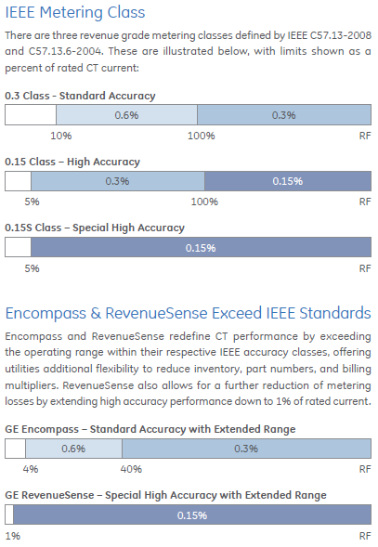

Slide 15
High Accuracy CT Application Range
ANSI C57.13
0.3 Accuracy Class
Extended Range
to 5% of rated
current
.60
.30
.15
Percent Error
High Accuracy Performance Standard
-.15
-.30
Typical Range of
Actual Load Currents
-.60
1% 5% 10% 50% 100% RF
Percent of Rated Current

Slide 16

Questions and Discussion
Tim Hope
Alabama Power
This presentation can also be found under Meter Conferences and Schools on the TESCO website: tescometering.com
ISO 9001:2015 Certified Quality Company
ISO 17025:2017 Accredited Laboratory

