Slide 1
Practical Use of Vectors in Electric Metering and Field Testing at Instrument Rated Services
July 23, 2024
8:45 AM -10:15 AM
Carl Chermak

Slide 2
Symbolic Representation
Electrical Quantities are Difficult to Visualize.
Written or Spoken work is inadequate.
Usually hard to explain in a universally understood way.
Would take a relatively long time to explain.
Employ Vector Diagram to Represent Electrical Quantities.
Saves time
Vastly more effective, once it is understood
2

Slide 3
Metering
The most basic statement of metering:
Watts = Voltage x Current x Power Factor Mathematically:
Watts = V × I × cosθ
What is a Vector?
A measurement that takes two numbers to represent.
BOTH a magnitude (size) and direction

Slide 4
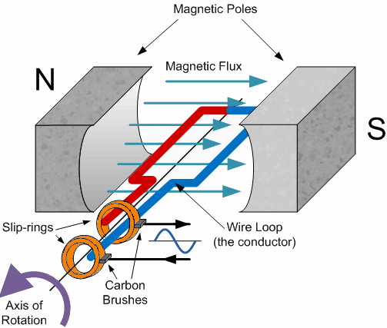
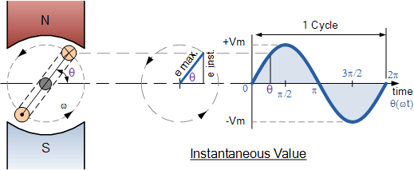
Origination of a Sinusoid
GENERATION OF A SINE WAVE
For Frequency f = 60 Hz
N rpm
By Electromagnetic Induction, a single wire conductor passing through a permanent magnetic field and cutting the lines of magnetic flux, will produce an ElectroMotive Force (EMF).
Due to the constant rotation, the EMF is different at each moment in time. The instantaneous value at each moment is considered the Instantaneous Voltage.Commonly, the symbol E and V are interchanged to represent voltage values.
N = 3600 rpm = 60 revs/sec
N
Angular frequency
ω
= 2πf rads/sec
= 120π rads/sec
Ø°
Period T = 1/f = 1/60 secs
arc = a
= 16.67 msec
Ø° or
V
β
rads
radius = r
S
β
π/
= a/r = Ø°x
/180 radians
90°= π/2 rads
k
An Elementary Alternator
60°
30°
t)
β
Coil Rotation, radians
°
ω
π/
π/

π
Ø
0°
or
2
π
3
2
2
–– radians
β,
30
60
90
180
270
360 –– degrees
°
Coil Rotation Ø

Time, t
16.67 –– milliseconds
V = k*Sin (Ø, or
4.17
8.33
12.5

Rotating Coil
Alternator Voltage
D.F.Bullock
- k
6/1/95
Reference: https://www.electronics-tutorials.ws/accircuits/sinusoidal-waveform.html
4

Slide 5
“Time” in Degrees
2
Voltage
1
Current
0
0
30
60
90
120
150
180
210
240
270
300
330
360
-1
Degrees
-2
Current lags Voltage by 30 degrees.
CCW
Voltage
30°
Current
.866 PF
6
5

Slide 6
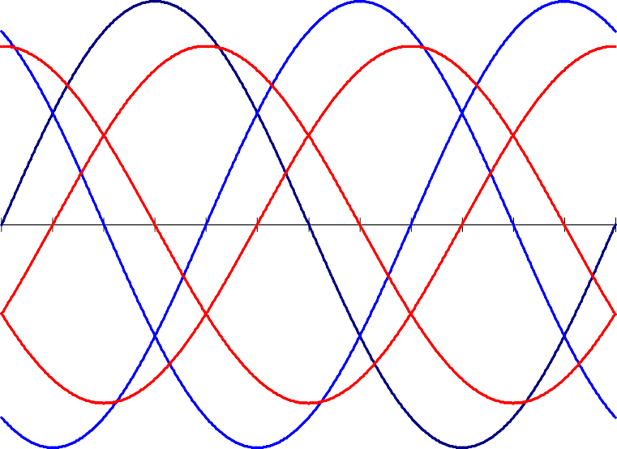
“Time” in Degrees
1
Voltage
1
Current
V volts or I amps
0
0
0
0 30 60 90 120 150 180 210 240 270 300 330 360
90
180
270
-1
-1
-2
Degrees
Phase Angle (Degrees)
2
270°
I
C
E_{A}
C
^{E}B 0°
180°
I
B
A
I
A
E
C
B
90°
6
6

Slide 7
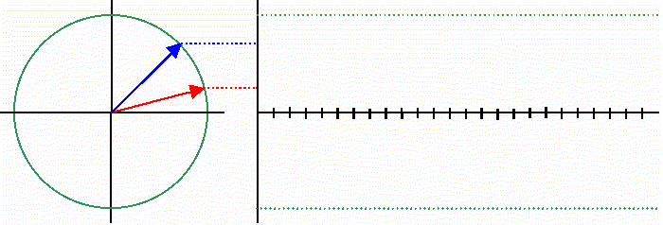
AC Voltage and Current

Slide 8
Vectors or Phasors are…
a Symbolic Representation of the relationship
of the voltage and current
Vectors & Vector Diagrams
SIMPLE. Used to Represent Electrical Quantities.
QUICK. Saves time.
Vastly more effective
Also referred to as “Phasors”

Slide 9
The Phasor Diagram
A phasor diagram is a method of expressing the magnitudes and time relationships (or phase angle relationships) between two or more sinusoidal quantities of the same frequency.
Each alternating quantity having the same frequency can be represented on the same diagram by additional lines. Their time relationship will determine the angle between the lines.
The phasor diagram is a “snap-shot” of the set of lines at an instant in time. The instant is generally chosen to be the time at which the voltage passes through zero in the positive direction. If there is more than one voltage, the instant at which phase A voltage passes through zero is chosen.
Notes:
Presenter
2019-08-21 16:57:42
--------------------------------------------
One Frequency, say 60 Hz, without harmonics

Slide 10
Representing Voltage(E) & Current (I) with Lines
Vectors all have MAGNITUDE and DIRECTION
Line length can represent MAGNITUDE.
Line with arrowhead in a given direction indicates that quantity’s relationship to any other quantity being represented.
DIRECTION: Angles between lines take on significance. They represent time (shown in degrees instead of seconds).
Notes:
Presenter
2019-08-21 16:57:41
--------------------------------------------
Representing Magnitude is optional and may be helpful

Slide 11
Placing Coils in Order
Delta Connection A
O
Wye Connection
120º
A
B
120º
120º
O
O
120º
120º
B
C
C
Coils connected together
O
120º
and placed on an alternator in order OA, OB, and OC
(Changing Coil order changes Sequence)
Notes:
Presenter
2019-08-21 16:57:41
--------------------------------------------
Even with labeled terminals, there is more than one way to connect the windings

Slide 12
Drawing the Phasor
General Guidelines
Complete circle (360 Degrees) equal one cycle of the frequency displayed.
One component (Usually Phase A voltage) becomes the reference and is placed at zero degrees.
Use “open” arrowhead on voltage line(s).
Use “closed” (or filled in) arrowhead on current line(s).
Label all voltages and currents by phase.
Indicate Phase Rotation (counter-clockwise assumed if not noted).

Slide 13
Watthour Metering
Watthour meter theory review:
– If we apply “V” volts and “I” amps to a meter, and the phase angle between the voltage and current is some angle θ, the meter speed will be proportional to:
Watts = V × I × cosθ
VECTORIALLY
V
θ
I

Slide 14
Analyzing the Phasor Picture
Both voltage & current are required in each meter element (stator) for that element to have an effect on registration.
Time relationship (degrees separation) between voltage & current acting together on each element will determine that element’s effect.
Only angles of less than 90 Degrees between the current and voltage on any meter element will cause positive watthour registration.
Notes:
Presenter
2019-08-21 16:57:42
--------------------------------------------
Two dots and an ellipse may be added to our phasor diagram to indicate voltage and current phasors that act together in a metering element.

Slide 15
The Phasor Diagram
270º
A-B-C
^{E}nc
I_{c}
^{E}na
180º
₀o
I_{a}
I_{b}
^{E}nb
90º
16
Notes:
Presenter
2019-08-21 16:57:42
--------------------------------------------
4 Wire Wye Service shown with balanced loading and unity power factor. A-B-C Phase Sequence.
Counter Clock-wise Phasor Rotation.
Circle is dimensioned to show how many degrees quantities lag the A-Phase Voltage.

Slide 16
Service & Meter Phasors
270º
270º
A-B-C
V_{C}
A-B-C
^{E}nc
I_{c}
I_{c}
V_{A}
^{E}na
₀o
180º
₀o
180º
I_{a}
I_{a}
I_{b}
I_{b}
^{E}nb
90º
90º
Meter Phasors 2 ½ Element
Service Phasors
Notes:
Presenter
2019-08-21 16:57:42
--------------------------------------------
If we are using a non-Blondel metering application, the meter phasors will be different than the service phasors.

Slide 17
Load Caused Phase Angles
V
0
I90
180
270
360
450
540
630
720
I
V
V
V
0
I
90
180
270
360
450
540
630
720
I
I90
V
180
I
0
270
360
450
540
630
720
V
Notes:
Presenter
2019-08-21 16:57:42
--------------------------------------------
Time Domain plots and phasor diagrams for the basic electrical components:
Resistors
Inductors
Capacitors

Slide 18
Effect of Power Factor
We represent energy as:
Energy = E × I × cos θ × t
θ is the angle between V and I
Cos θ is also known as Power Factor
What θ values give with these lagging Power Factors?
Power Factor Phase Angle
0.50 | 0.70 | 0.85 | 0.90 | 0.95
60° | 45.6° | 31.8° | 25.8° | 18.2°
Notes:
Presenter
2019-08-21 16:57:46
--------------------------------------------
What power factors might we encounter while verifying meter connections.
Note that even at the “good” 95% power factor, we have significant angle between the voltage and current.

Slide 19
Three Wire Delta Source
^{I}Line C
C
^{E}CB
^{E}AC
^{I}Line A
B
A
^{E}BA
^{I}Line B
With pure resistance balanced three-phase load, the current in each supply transformer is in phase with the voltage across each transformer.
Notes:
Presenter
2019-08-21 16:57:46
--------------------------------------------
While the meter phasors for a 4 wire wye are easily visualized, the expected phasor diagram for a 3 wire delta may be more difficult to visualize. It is worthwhile to review the phasors we expect for a 3 wire delta service.

Slide 20
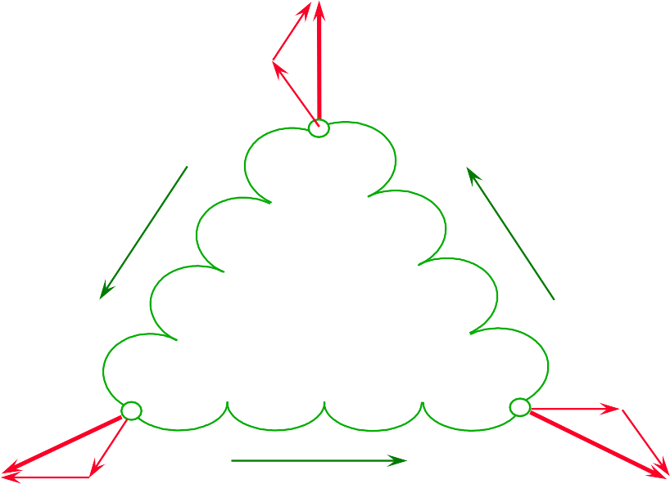
Drawing Source Phasors
Phasor diagram for delta-connected three-phase system with three-phase delta-connected resistance load
^{I}Line C
^{E}AC
(30° +
θ)
I
C
C
^{E}CB
^{E}AC
^{E}BA
I_{B}
(30° + θ)
(30° + θ)
I_{A}
B
A
^{I}Line B
^{I}Line A
^{E}CB
^{E}BA
Phase voltages = E_{BA}, E_{CB}, & E_{AC} Line currents = I_{A}, I_{B}, & I_{C}
Notes:
Presenter
2019-08-21 16:57:46
--------------------------------------------
The voltages are assumed to have a positive sign as they go counter clockwise around the windings. The currents are assumed to have a positive sign as they flow from the source to the load.
The C phase current is composed of a current component from the AC winding and in phase with Eac and a current component from the CB winding and in phase with Ecb. Note the 30 degree spacing between voltage phasors and current phasors when we have unity power factor.

Slide 21
Phasors for Source & Meter
I_{C}
+
A-B-C
C
C
+
B
B
A
+
A
I_{A}
+
(30° + θ)
I
^{E}AC
I
C
^{E}BC
C
(30° - θ)
^{E}BA
^{E}BA
I_{B}
(30° + θ)
(30° + θ)
(30° + θ)
I_{A}
Meter
I_{A}
^{E}CB
^{E}CB
Source
Notes:
Presenter
2019-08-21 16:57:46
--------------------------------------------
Source and meter phasors for A-B-C phase sequence.

Slide 22
Phase Sequence CBA
I_{C}
+
C-B-A
C
C ₊
B
A
B
+
A
I_{A}
+
^{E}BC
(30° + θ)
C-B-A
Meter Phasors
I_{C}
E
BA
(30° - θ)
I_{A}
Notes:
Presenter
2019-08-21 16:57:46
--------------------------------------------
Meter Phasors for C-B-A phase sequence.

Slide 23
Common Distribution Circuits
Two-Wire Single Phase
 | 240 V |  | 240 V
240 V
Three-Wire Three Phase Delta
120V
120 V
Three-Wire Single Phase
120 V
240 V
Four-Wire Three Phase Delta
240 V
120 V
240 V
120 V
208 V
240 V
120 V
Three-Wire Network
120 V
208 V
208 V
Four-Wire Three Phase Wye
208 V
120 V
120 V
120 V
208 V
Notes:
Presenter
2019-08-21 16:57:47
--------------------------------------------
We can distinguish between service types just by measuring the magnitude of voltages between wires.

Slide 24
1ϕ Expected Meter Phasors
(BALANCED LOAD AT POWER FACTOR = 1, ABC PHASE SEQUENCE)
270°
270°
270°
A-B-C
V_{c}
I_{c}
I_{c}
0°
0°
180°
I_{a}
V_{a}
I_{a}
V_{a}
I_{a}
V_{a}
90°
2 Element
90°
1½ Element
90°
1 Element
3 wire, 1 ϕ
270°
0°
180°
I
V
a
a
2 wire, 1 ϕ
90°
1 Element
Notes:
Presenter
2019-08-21 16:57:47
--------------------------------------------
Form 2S and 4S are 1 1/2 element meters. Form 1S and 3S are 1 element meters.

Slide 25
2 Element Expected Meter Phasors
(Balanced load at Power Factor = 1, ABC Phase Sequence)
A-B-C
270
°
270
°
V
270
°
270
°
I_{c}
V
c
V
c
cI_{c}
I
c
V
c
I
a
I
0°
c
V_{a}
180
°
I_{a}
V_{a}
V_{a}
I
V_{a}
I_{a}
a
90°
90°
90°
90°
4 wire, wye
4 wire, delta
3 wire, delta
3 wire, network
Notes:
Presenter
2019-08-21 16:57:47
--------------------------------------------
Form 45S & Form 56S meters (transformer rated) expect to be used on: 4 wire, wye; 4 wire, delta; or 3 wire delta Form 12S & Form 13A meters (self contained) expect to be used on: 3 wire delta; or 3 wire network

Slide 26
Expected Meter Phasors
(AT POWER FACTOR = 1, ABC PHASE SEQUENCE)
270
°
A-B-C
I_{c}
V_{c}
180
°
0°
V_{a}
I_{a}
90°
2 Element
3 wire, delta
270
°
V_{c}
I_{c}
180
°
0°
I
a
V_{a}
90°
3 wire, network
2 Element

Slide 27
3 Element Expected Meter Phasors
(at Power Factor = 1, ABC Phase Sequence)
270°
270°
270°
270°
A-B-C
V_{c}
I_{c}
V_{c}
V_{c}
V_{c}
I_{c}
I_{a}
V_{b}
V_{a}
V_{b}
V_{a}
I_{b}
I_{b}
I
a
V
V
I
b
I
a
V
a
a
I
I_{a}
b
b
V_{b}
90°
Balanced Polyphase Load
90°
Single phase Load
Connected A to B
90°
Balanced Polyphase Load
90°
Single phase Load
Connected A to B
4 wire, wye
4 wire, delta
Notes:
Presenter
2019-08-21 16:57:47
--------------------------------------------
3 Element meters may be used on 4 Wire, Wye or 4 Wire, Delta services.
Wide Voltage range 3 element meters are available as Form 9S, 16S, 10A or 48A.
Note that the current phasors are very different for single phase loading vs. polyphase loading.
The single phase loading on the wye service could be a control circuit or system on a 480 volt self contained service the feeds a predominantly motor load. The single phase loading on the delta service could be lighting load on a 240 volt delta service.

Slide 28
Expected Meter Phasors
(AT POWER FACTOR = 1, ABC PHASE SEQUENCE)
270
°
V
c I_{c}
270
°
V
c I_{c}
270
°
A-B-C
I_{c}
V
c
I
a
I_{b}
I_{a}
V_{a}
I_{a}
V_{a}
V_{a}
V
b
I_{b}
90°
90°
2½ Element
90°
2 Element
4 wire, wye
3 Element
270
°
270
°
V
cI_{c}
V
c
I_{c}
V
V
a
180
°
b
0°
180
°
0°
I_{a}
V_{a}
I
b
I_{a}
90°
3 Element
90°
2 Element
4 wire, delta

Slide 29
Let's Talk about Why We Need to Understand
Vectors.

Slide 30
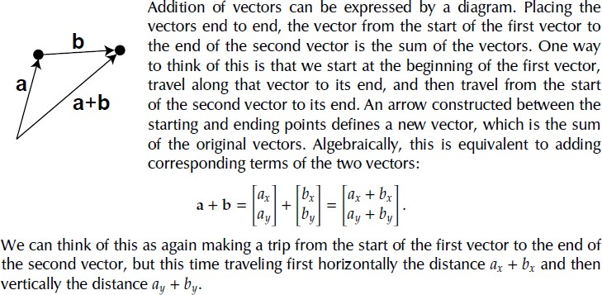
Vector Addition

Slide 31
Vector Subtraction

Slide 32
AC Powers
Phasor (S)
Reactive (Q*)
Active (P)
*Not the “Q” of Q-hour metering
34
3

Slide 33
AC Powers
Phasor (S)
Reactive (Q*)
Apparent (U)
Distortion (D)
Active (P)
*Not the “Q” of Q-hour metering
3

Slide 34
How is 3ϕ Apparent Power calculated?
To calculate Apparent power (U), first add the components for the phases together,
U
3
Notes:
Presenter
2019-08-21 16:57:48
--------------------------------------------
This 3 diagram shows that the length of the 3 U vectors (Arithmetic Apparent power) is longer than the U vector for the 3 system.
The U vector for the 3 phase system is the vector addition of the 3 single phase U vectors.
Adding the magnitudes of the U vectors, we get Arithmetic Apparent power (U’ is not show in the diagram).
Using Vector addition to sum the U vectors, we get Apparent power.

Slide 35
How is 3ϕ Apparent Power calculated?
To calculate Apparent power (U), first add the components for the phases together,
U
U
3
Notes:
Presenter
2019-08-21 16:57:48
--------------------------------------------
This 3 diagram shows that the length of the 3 U vectors (Arithmetic Apparent power) is longer than the U vector for the 3 system.
The U vector for the 3 phase system is the vector addition of the 3 single phase U vectors.
Adding the magnitudes of the U vectors, we get Arithmetic Apparent power (U’ is not show in the diagram).
Using Vector addition to sum the U vectors, we get Apparent power.

Slide 36
How is 3ϕ Apparent Power calculated?
To calculate Apparent power (U), first add the components for the phases together, then solve for U.
^{U}3ϕ
₎2
₎2
₎2
(
+ P_{B} + P_{C} + (Q
+ (D + D + D
U
=
P
+ Q + Q
3ϕ
A
A
B
C
A
B
C
S = (P + P + P + (Q
)
2
+ Q + Q
)
2
A B C A B
C
U(arith) = UA + UB + UC
3
Notes:
Presenter
2019-08-21 16:57:48
--------------------------------------------
This 3 diagram shows that the length of the 3 U vectors (Arithmetic Apparent power) is longer than the U vector for the 3 system.
The U vector for the 3 phase system is the vector addition of the 3 single phase U vectors.
Adding the magnitudes of the U vectors, we get Arithmetic Apparent power (U’ is not show in the diagram).
Using Vector addition to sum the U vectors, we get Apparent power.

Slide 37
Apparent Power vs. Arithmetic Apparent Power
To calculate Apparent power (U), first add the components for the phases together, then solve for U.
₎2 ₎2
₎2
(
+ (Q + (D
U
=
P_{A} + P_{B} + P_{C}
+ Q
+ Q
+ D + D
3ϕ
A
B
C
A
B
C
U_{C}
U_{B}
U
3ϕ
U_{A}
To calculate Arithmetic Apparent power, add the Apparent power magnitudes of the three individual phases.
= _{UA} + _{UB} + _{UC}
UArithmetic
3
Notes:
Presenter
2019-08-21 16:57:48
--------------------------------------------
This 3 diagram shows that the length of the 3 U vectors (Arithmetic Apparent power) is longer than the U vector for the 3 system.
The U vector for the 3 phase system is the vector addition of the 3 single phase U vectors.
Adding the magnitudes of the U vectors, we get Arithmetic Apparent power (U’ is not show in the diagram).
Using Vector addition to sum the U vectors, we get Apparent power.

Slide 38
All KVAs are not Created Equal
Power Calculations POWERS Phase A Phase B Phase C Total Active (P) 3626.4 2880.0 2833.0 9339.4 Reactive (Q) 317.3 2146.0 2112.0 4575.3 Distortion (D) 0.0 1102.6 1784.5 2887.1 Apparent (U) 3640 3757 3959
PHASOR (S) | (VA)Total | = | 10,400 | PF = 89.8
APPARENT (U) | (VA)Total | = | 10,793 | PF = 86.5
ARITH. (Uarth) | (VA)Total | = | 11,356 | PF = 82.2
3

Slide 39
Modern Reactive Metering
Which “kVA” calculation method is correct?
They all are “correct”, by definition.
Each utility needs to decide which value is appropriate for their own needs.
Phasor Power is what results from calculations based on traditional kWh and kvarh meter readings, using a Phase- Shifting Transformer.
Apparent Power provides more complete picture of “cost of service”, expected answers under all conditions.
Arithmetic Apparent Power may provide unexpected results (low PF, high kVA) for asymmetrical or unbalanced conditions.
3

Slide 40
Phase “X” Formulae
H
2
Xh
RMS Potential,
E
=
∑
h=1
E
 |  | (Volts)
 |  | ( Amperes)
cos(_{α} | − β ) | (kVA) (kW )
sin(_{α Xh} − β ) (k var) Xh
X
H
2
Xh
RMS Current,
I
=
∑
I
X
h=1
Apparent Power,
U X ⁼ EX I X
Active Power,
P
H
= ∑
h=1
H
= ∑
h=1
E I
X
Xh Xh
Xh
Xh
Re active Power,
Q
E I
X
Xh Xh
_{− Q}2
D U
2
X
− _{P}
2
X
Distortion Power,
= ±
(kVA)
X
_{+ Q}2
X
Phasor Power,
S
= +
P
2
X
(kVA)
X
X
F U
N U
2
X
− _{P}
2
X
Fictitious Power,
= +
(kVA) (a.k.a." Fuzzy var s")
X
_{− Q}2
Nonreactive Power,
= +
2
X
(kVA)
X
X
E_{xh} and I_{xh} are the RMS voltage and amperage of harmonic h. α_{xh} and β_{xh} are the phase angles of the voltage and current of harmonic h with respect to the reference time-frame. H is the highest harmonic ordinal.
3

Slide 41
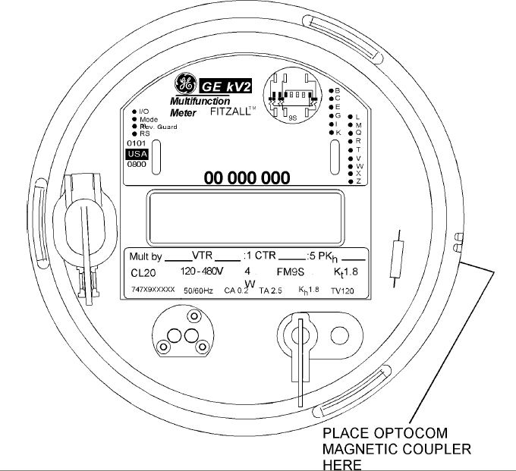
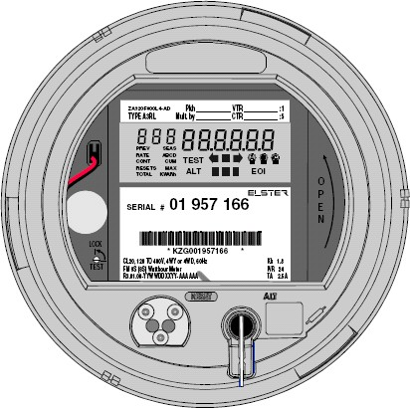
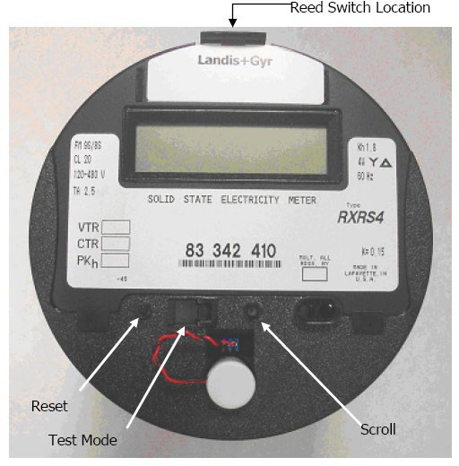
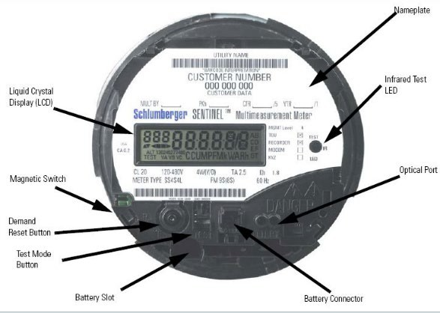
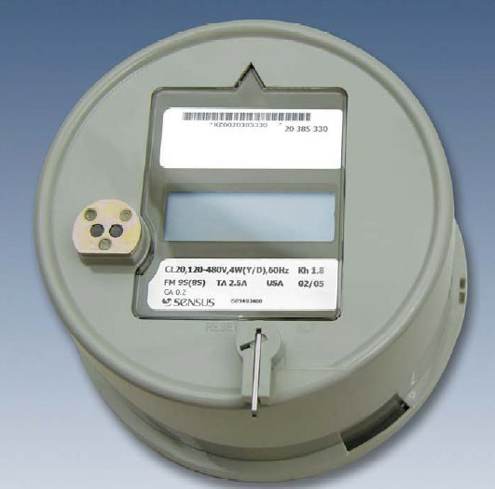
Different Meters
Aclara kV2c Meter
Honeywell A3
Landis + Gyr S4e
Sensus Icon APX
Itron Sentinel
3

Slide 42
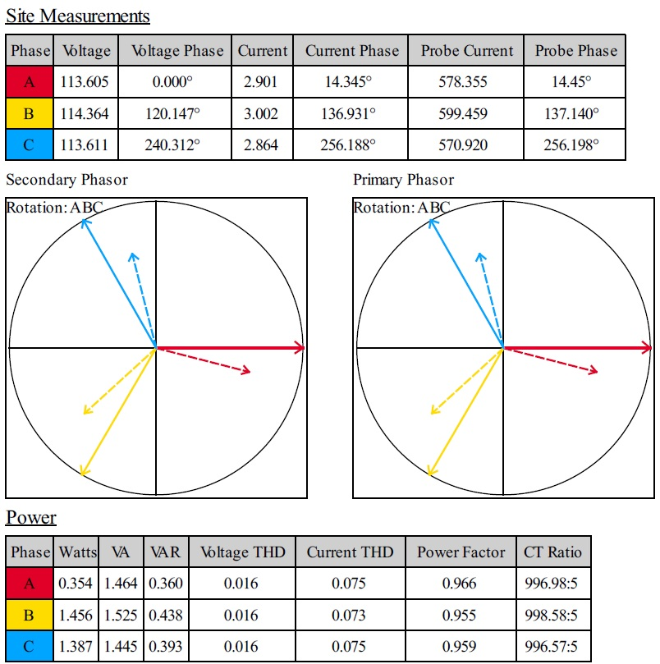
Phase Rotation & Site Measurements
Notes:
Presenter
2019-08-21 16:57:42
--------------------------------------------
The time domain representation becomes difficult to use when 3 phases are shown on one diagram. The Phasor representation shows the same 3 phase service and is easier to digest quickly.

Slide 43
Step 1: Draw Diagram for...
Power
Transformer
Meter Load
Phasor Construction
43

Slide 44
Step 2: Draw Diagram for...
Power
Transformer
Meter Load
C
B
A
Step 2: Label points of Power Transformer
Phasor Construction
44

Slide 45
Step 3: Draw and Label all Line Currents
Power Meter Load
Transformer
I_{C}
C
I_{B}
B
A
I_{A}
Draw line currents between power transformer and meter. Use arrows with closed points (
).
Assume all currents flow from transformer to load. Where necessary, draw power transformer coil currents and label with double subscript notation (I_{BA}, I_{AC}, etc.
Phasor Construction
45

Slide 46
Step 4: Mark Polarity on all Current Coils
Power Meter Load
Transformer
I
C
+
C
B
A
+
I_{A}
The polarity mark (+) goes on the line side of all current coils except: (a): For 2 1/2 stator Z-coil meters. The polarity “+” goes on the
load side of the Z-coil.
(b): For 3-wire, 1-phase meters and the 3-wire stator on the left side of a 4-wire delta meter, the “+” goes on the load side of the right hand coil of the single stator meter, and the “inside” coil of the left hand stator in the 4-wire delta meter.
Phasor Construction
46

Slide 47
Step 4: Polarity of Current Coils (cont.)
Power Meter Load
Transformer
I
C
+
C
B
A
+
I_{A}
If line current enters the “+” end of a current coil, the coil current is assumed to be in phase with the line current. If, however, the current enters the unmarked end of the coil, the current is assumed to be 180° out of phase with the line current.
Phasor Construction
47

Slide 48
Step 5: Mark Polarity on all Voltage Coils
Power Meter Load
Transformer
I
C
+
C
+
B
A
+
+
I_{A}
The polarity mark (+) goes on the end of the voltage coil that connects to the “+” end of the current coil.
Phasor Construction
48

Slide 49
Step 6: Draw Voltage Arrows at Power Transformer
Power Meter Load
Transformer
I
C
+
C
+
B
A
+
+
I_{A}
Draw open ended arrows to represent voltage at the power transformer.
Wye-connected: point away from the neutral.
Delta-connected: tracing tail-to-head-to-tail, etc., around the delta following a counter-clockwise direction.
Phasor Construction
49

Slide 50
Step 7: Establish Voltage & Current Relationships
I_{C}
+
C
+
B
A
+
I_{A}
+
Use Kirchoff’s Laws to establish the needed relationships between voltages and currents at the power transformer.
Phasor Construction
50

Slide 51
Step 8: Complete the “Source” Phasors
Power Meter Load Transformer
I_{C}
+
A-B-C
C
C
+
B
B
A
+
A
I_{A}
+
Complete the phasor diagram for the power transformer (source).
Phasor Construction
51

Slide 52
Step 8: Complete the “Source” Phasors
Power Meter Load Transformer
I_{C}
+
A-B-C
C
C
+
B
B
A
+
A
I_{A}
+
^{E}AC
I_{C}
Phasor Construction
^{E}BA
I_{B}
I
A
^{E}CB
52

Slide 53
Step 9: Construct Meter Voltage Phasors
Power Meter Load Transformer
I_{C}
+
A-B-C
C
C
+
B
B
A
+
A
I_{A}
+
Draw the voltage phasors for the meter, using the tracing method.
Starting at the polarity end of the voltage coil, trace through the voltage coil, back through the source, and return to the polarity end of the voltage coil.
The direction of the METER phasor is the direction traveled through the source transformer.
Phasor Construction
53

Slide 54
Step 9: Construct Meter Voltage Phasors
Power Meter Load Transformer
I_{C}
+
A-B-C
C
C
+
B
B
A
+
A
I_{A}
+
E_{A}
C
I_{C}
E_{B}
C
E_{B}
A
E_{B}
A
Phasor Construction
I_{B}
I
E_{C}
A
B
54

Slide 55
Step 10: Construct Meter Current Phasors
Power Meter Load Transformer
I_{C}
+
A-B-C
C
C
+
B
B
A
+
A
I_{A}
+
Add meter current phasors by using the relationships developed in step 8, and observing the polarity marks of the current coils. Make sure all voltage and current phasors are labeled,
and show the interactions between voltages and currents in the meter stators by connecting the appropriate phasors with elongated ellipses.
Phasor Construction
55

Slide 56
Step 10: Construct Meter Current Phasors
Power Meter Load Transformer
I_{C}
+
A-B-C
C
C
+
B
B
A
+
A
E_{A}
C
I_{C}
I
+
A
E
V_{C}
B
I_{C}
A
I
V_{A}
B
I_{A}
E_{C}
B
Phasor Construction
I_{A}
56

Slide 57
Step 11: Write Equation for Meter Watts
Power Meter Load Transformer
I_{C}
+
A-B-C
C
C
+
B
B
A
+
A
I_{A}
+
Show the expression for the Meter Watts.
V_{C}
I_{C}
Phasor Construction
V_{A}
I_{A}
57

Slide 58
Step 11: Write Equation for Meter Watts
Power Meter Load Transformer
I_{C}
+
A-B-C
C
C
+
B
B
A
+
A
I_{A}
+
Assuming balanced 3-phase load and balanced voltages
Show the expression for the Meter Watts.
MeterWatts = _{V A I A} cos(30 +_{θ A}) +_{V C I C} cos(30 −_{θ C} )
= _{V LL I L} cos(30 +θ ) +_{V LL I L} cos(30 −θ )
=_{V LL I L} [(cos 30 cosθ − sin 30 sinθ )+ (cos 30 cosθ + sin 30 sinθ )]
V_{C}
I_{C}
V_{A}
⎡⎛ ⎞⎤
⎞ ⎛
3 3
=_{V LL I L} ⎢⎜ ₂ cosθ ⎟ + ⎜ ₂ cosθ ⎟⎥
⎢⎣⎝
= _{3V LL I L} cosθ
⎠ ⎝
⎠⎥⎦
I_{A}
Phasor Construction
58

Slide 59
Step 12: Write Equation for Load Watts
Power Meter Load Transformer
I_{C}
+
A-B-C
C
C
+
B
B
A
+
A
I_{A}
+
Show the expression for the Delivered Watts, or Load Watts.
Phasor Construction
59

Slide 60
Step 12: Write Equation for Load Watts
Power Meter Load Transformer
I_{C}
+
A-B-C
C
C
+
B
B
A
+
A
I_{A}
+
Show the expression for the Delivered Watts, or Load Watts.
For a balanced 3-phase load:
Load Watts =
3_{V LL I L} cos(θ )
Phasor Construction
60

Slide 61
Step 13: Calculate “Percent Registration”
Power Meter Load Transformer
I_{C}
+
A-B-C
C
C
+
B
B
A
+
A
I_{A}
+
Calculate the percent registration of the meter by dividing the Meter Watts by the Load Watts, then multiplying the result by 100%.
Phasor Construction
61

Slide 62
Step 13: Calculate “Percent Registration”
Power Meter Load Transformer
I_{C}
+
A-B-C
C
C
+
B
B
A
+
A
I_{A}
+
Calculate the percent registration of the meter by dividing the Meter Watts
Meter Watts
by the Load Watts, then multiplying the result by 100%.
Percent Registration =
×100%
Load Watts
= ^{3V LL I L cosθ} ×100%
Phasor Construction
3_{V}
= 100%
LL I L
cosθ
62

Slide 63
Questions?
Carl Chermak
TESCO – The Eastern Specialty Company
Bristol, PA
215-228-0500
This presentation can also be found under Meter Conferences and Schools on the TESCO website: tescometering.com
64

