Slide 1
Meter Safety
July 24, 2024
10:30 AM -- 12:00 PM
Dan Falcone
Notes:
1

Slide 2

Meter Safety
YOU are responsible for your own safety on the job!

Slide 3
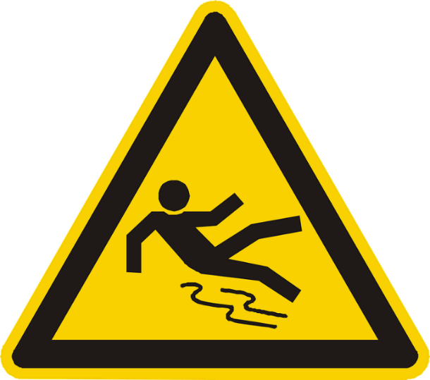
Hazards in the Workplace
Hazard #1: Falls and Falling Objects
Approximately 19,565 people die in the U.S. annually due to injuries caused by unintentional falls.
Slips, trip and fall injuries cost employers approximately $40,000 per incident.
About 9.2 million people were treated in emergency rooms for fall-related injuries last year.

Slide 4

Hazards in the Workplace
Hazard #2: Chemical Exposure
Breathing of contaminated air is the most common way that workplace chemicals enter the body.
The CDC estimates more than 32 million workers in the US are potentially exposed to chemicals that can be absorbed through the skin.
Roughly 860,000 illnesses resulting from chemical exposure occur in the workplace every year.

Slide 5
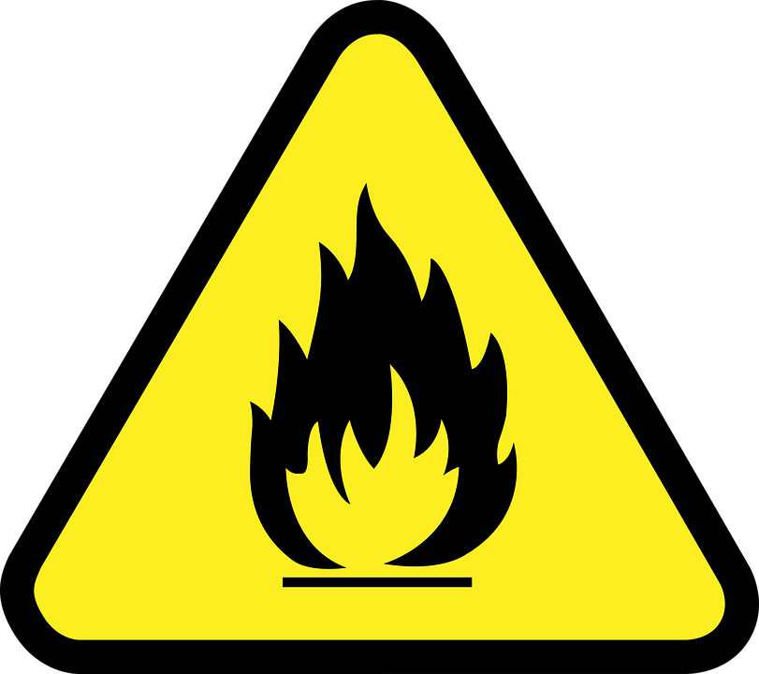
Hazards in the Workplace
Hazard #3: Fire Hazards
A structure fire is reported approximately every minute of every day and results in approximately $12 billion in property loss every year.
According to the National Fire Protection Association, there were an estimated 3,340 fires in U.S. office properties per year.

Slide 6
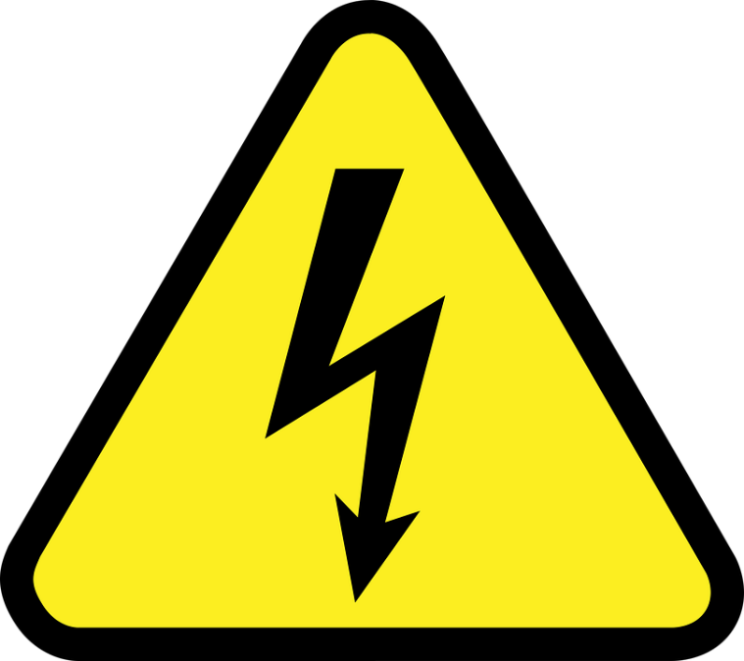
Hazards in the Workplace
Hazard #4: Electrical Hazards
The construction industry accounts for 52% of all electrical fatalities in the US workplace.
Most incidents and fatalities were caused by direct worker contact with overhead power lines and contact with machines, tools, and hand-carried metallic objects.
Engineers, electricians, and overhead line workers top the list of professionals who are most exposed to electrical hazards.
The most common type of work to result in an electrocution is routine work involving repair and maintenance.

Slide 7
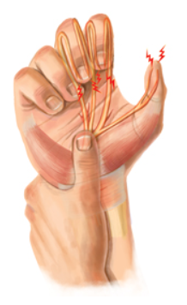
Hazards in the Workplace
Hazard #5: Repetitive Motion Injury
According to the Bureau of Labor Statistics, Repetitive Motion Injury cases accounted for 33% of all worker injury and illness cases
In the U.S., the costs associated with RMI’s are estimated at $20 billion every year according to OSHA

Slide 8
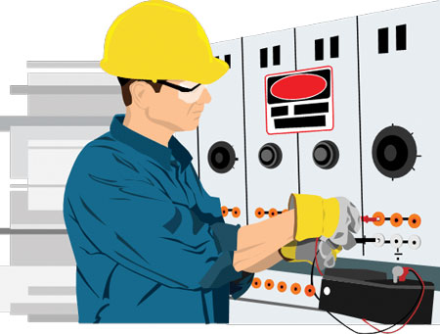
How Dangerous is Metering?
Electricity is Organized Lightning – George Carlin
Any Voltage without current will not kill you, but any voltage with current can kill you.

Slide 9

Electric Shock
What is Electric Shock?
Electric shock is a flow of electrical current through a person's body.
Damage to the skin or internal organs as a result of contact with electrical current is an electric injury.
Electric shock can cause a minor twinge, mild to serious injuries, or death, depending on the circumstances and voltage.

Slide 10
Electric Shock
What is Electric Shock?
The human body conducts electricity well, so it travels through the body with ease.
People can incur organ damage even if there is only a minor burn on the skin.
The most common areas injured by electric shock are the heart, muscles, and brain.

Slide 11
Electric Shock
Current | Effect
1 mA | Barely noticeable
16 mA | Maximum current before you can’t let go
20 mA | Paralysis of respiratory muscles
100 mA | Ventricular fibrillation starts
2 Amps | Cardiac standstill and organ damage

Slide 12
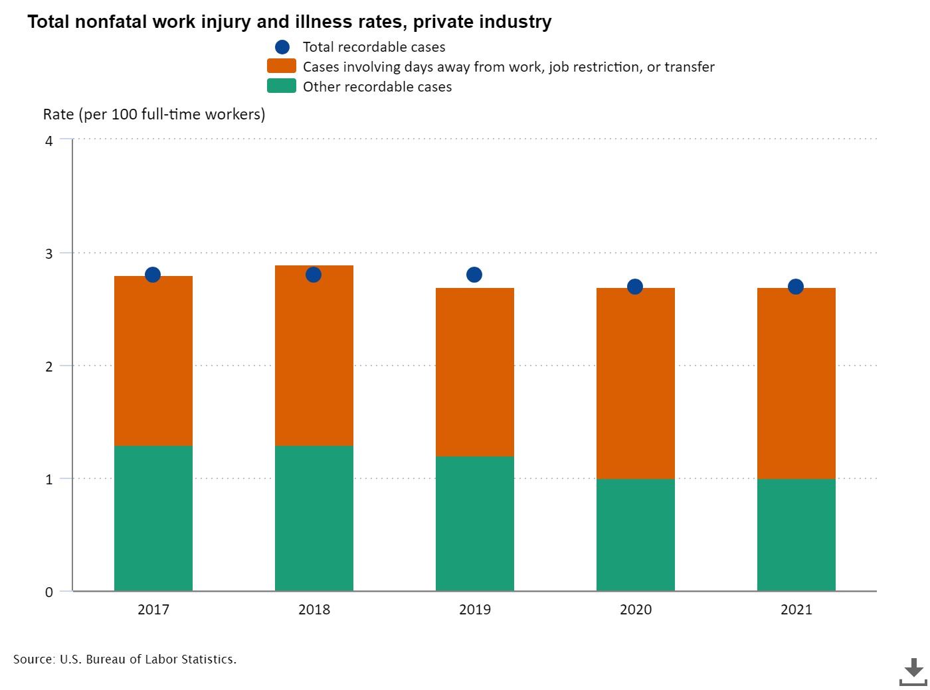
Work Injuries

Slide 13
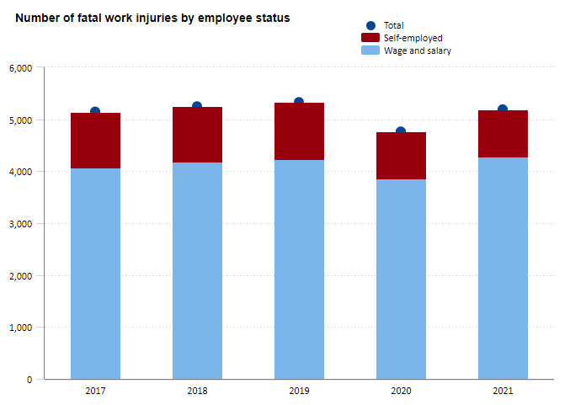
Work Injuries

Slide 14
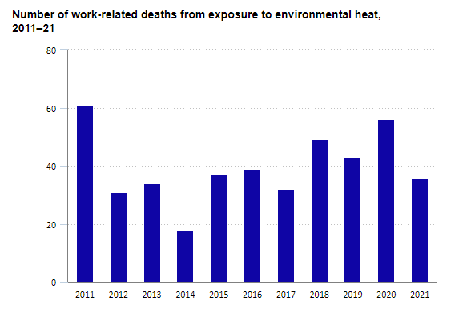
Heat Exposure

Slide 15

Arc Fault
What is an Arc Fault?
An Arc Fault is a type of electrical fault that that results from the breakdown of an insulating medium between two conductors where the energy is sufficient to sustain an arc across open air.
This Photo by Unknown Author is licensed under CC BY

Slide 16
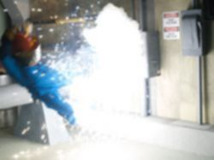
Arc Flash
What is an Arc Flash?
An Arc Flash in an event that occurs when electrical current flows through an air gap between conductors.
An arc flash can cause extreme amounts of light and immense heat of more than 19,000º C. This can result in an explosive pressure wave called an arc blast.
These forces combine to create a hazardous condition that can vaporize metal, destroy equipment, and pose a significant hazard to anyone in the vicinity.

Slide 17
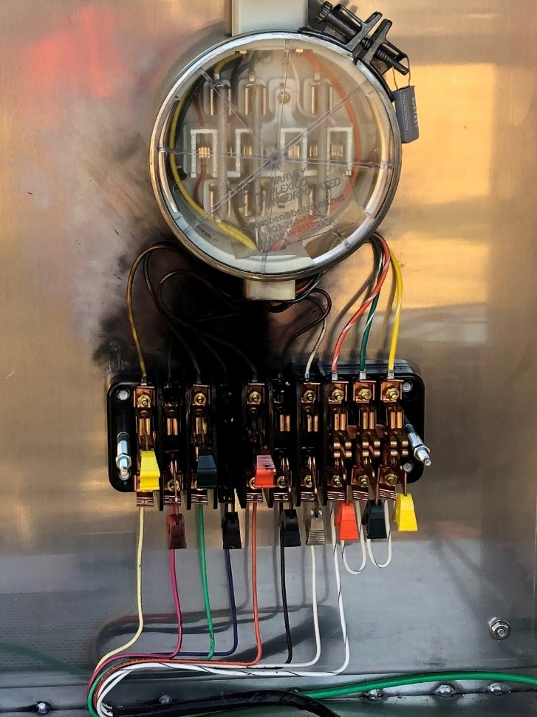
Arc Flash
Arc Flash can also be caused by:
Common causes are the accidentally touching of a test probe to the wrong surface or a slipped tool.

Slide 18
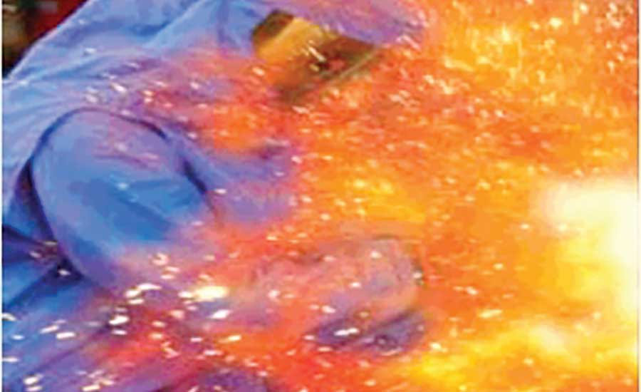
Arc Flash
Arc Flash can also be caused by:
Sparks due to breaks or gaps in the insulation of the conductors.
Equipment failure, improper insulation, substandard parts or substandard material.
Magnetic fields created by dust, corrosion and other impurities can cause ionization of the surrounding air creating a path for a resulting flash.

Slide 19


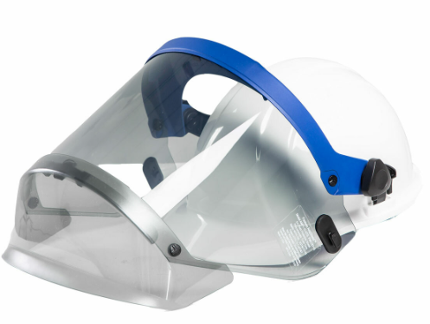
Personal Protection Equipment (PPE)
This is why we wear our PPE.

Slide 20
Personal Protection Equipment (PPE)
Personal Protective Equipment
Leathers
Rubber Gloves
Face Shield
FR Clothing
Safety Shoes
Insulated Tools

Slide 21
Personal Protection Equipment (PPE)
Arc Flash PPE categories range from 1 to 4
Arc Flash PPE Category level 1 is the lowest risk level.
Arc Flash PPE Category level 4 is the highest risk level

Slide 22
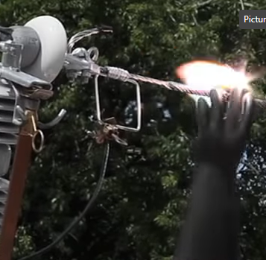
How Bad Can Things Get?
Many thanks to Dominion Power
https://youtu.be/2Xoyb9M5-EA
Rubber Gloves and FR 4:10
Meter enclosure shorted out 10:48
Back feed from generator 19:34

Slide 23
As You Approach the Service
Moisture or water inside the meter face and/or rust on the meter base, such as leaks at the service entry cable or other meter base components.
Missing knockouts on the meter base.
Broken or cracked conduit at the electrical meter or meter hubs.
Loose connections of the meter base, including meter pulling away from the building wall and loose mounting screws.
Evidence of tampering at the meter, missing meter seal.
We've seen house fires start when a screw from a loose meter box fell into the meter and caused a dead short.

Slide 24
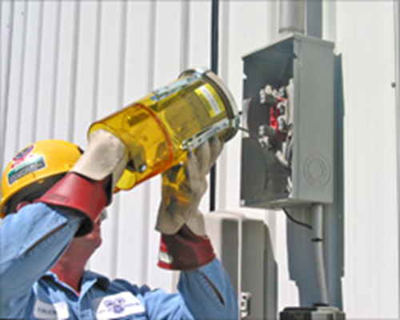
Field Audits/Troubleshooting/Testing
Always approach an electrical service with caution and while wearing your full PPE. Why?
Never stand directly in front of the meter when removing the meter
Before you even open the box or get the cover off….
  Live box
  Bees
  Other live animals
Broken Seal
Cover dropping off
Uneven terrain

Slide 25
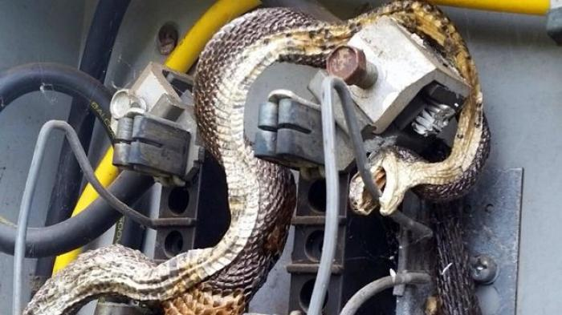
Field Audits/Troubleshooting/Testing

Slide 26
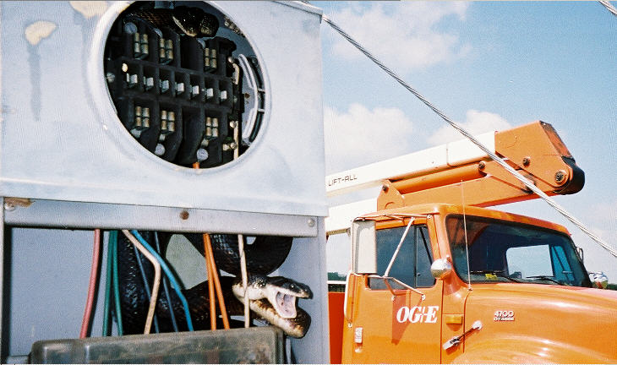
Field Audits/Troubleshooting/Testing

Slide 27
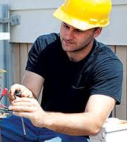
Issues to Look For Once the box is Open
Open line side connection to the meter socket.
Missing neutral connection to the center lug in the meter socket
Cross wiring between the test block and the meter socket.
Hidden jumper, line to load – diversion on both legs.
Dead short, phase to ground on the load side of one leg of the socket.
Partial short, phase to ground on the load side of one leg of the socket.
Evidence of burning or arcing at the meter base.

Slide 28

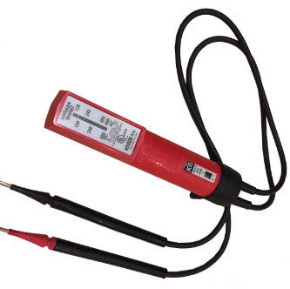
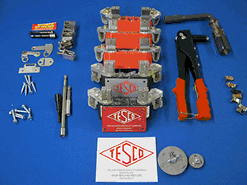
Tools
Socket Pullers
Volt meters
Insulated tools
Specialized tools

Slide 29
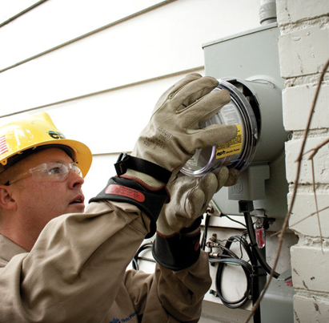
Summary
Be Careful
Assume the box is live
Assume there is something live in the box
Treat electricity with respect
Treat all meter boxes with respect

Slide 30
OSHA
As with any industry, adhering to and complying with OSHA standards and company safety policies is a vital step in preventing injuries. OSHA standards that apply to the utilities industry include:
Electrical – General Requirements (1910.303)
Electrical – Wiring Methods (1910.305)
Electric Power Generation, Transmission, and Distribution (1910.269)
Personal Protective Equipment, Subpart I (1910)
Fall Protection (1926.501)
Hazard Communication (1910.1200)
Respiratory Protection (1910.134)
Lockout/Tagout (1910.147)

Slide 31

Personal Protection Equipment
Issues that you may have seen in your service territory?
Do you have issues with non-metering personnel performing metering operations?
Unique issues in your service territory?
Safety Issues not discussed?
Are your meter techs typically putting safety first?

Slide 32
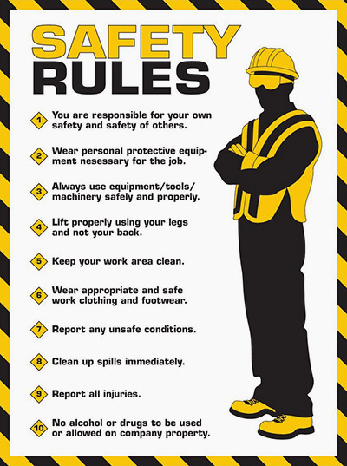
Basic Safety Rules

Slide 33

Questions?
Dan Falcone
ConnectDER
This presentation can also be found under Meter Conferences and Schools on the TESCO web site: www.tescometering.com

