Slide 1
Cyber Security
Standards and Securing Your Data
July 24, 2024
11AM – 12 PM
Alex Kobrenko

Slide 2
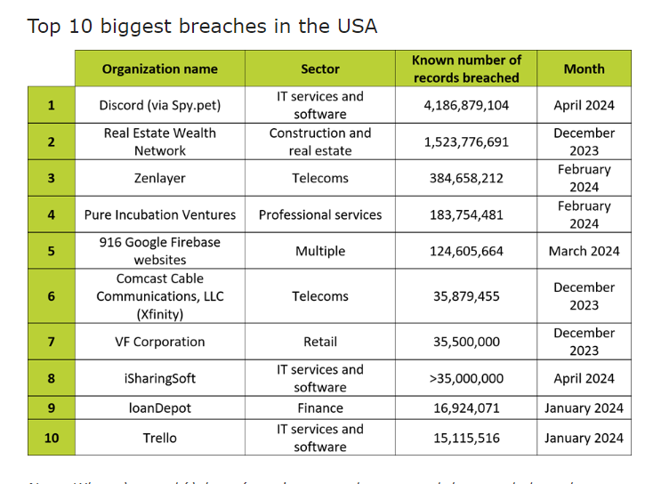
Cyber Security

Slide 3
Cyber Security
Cyber standards : ISO 27001, NIST 800-53r3, SOC 2
Knowing your organizations risks
Backup and Recovery
Reducing cyber risk with tools
Identifying attack vectors for your organization
Patch Management
Securing IOT and SCADA
Security first mindset
Staying informed with latest threats

Slide 4
Cyber Security Standards
NIST 800-53r3
ISO 27001
SOC 1 – 3
PCI
GDPR
UL 2900
NIST CSF
CISA Mandates
- Coop And Cyber Insurance
CIRCIA – Passed 2022, requires CISA to develop and publish rules for companies that provide critical infrastructure.

Slide 5
Protecting your Data
Knowing what kind of data you store, how its collected and accessed.

Slide 6
Data Security
Definition: Protecting digital data from unauthorized access, corruption or theft
Needed to safeguard sensitive information, maintaining privacy, and ensuring regulatory compliance

Slide 7
Backup and Recovery
How often can you take backups
Local backups
Off-Site backups
Type of Backups
Off-Line Backups
Encryption
How long can we afford to be down
How long will it take to recover your data
Where will you recover to

Slide 8
Knowing Your Risks
What kind of data is stored
Who is accessing your data
What methods are used to secure access to data or resources
Open incoming firewall ports
Web / SFTP / public facing servers
Data Exchange

Slide 9
Identifying Attack Vectors
Pen Testing
Email
Endpoint Scanners
End User
Vendors
Endpoints
Exposed SCADA

Slide 10
Patch Management
Get a baseline of devices
Assign Responsibilities
Patch Testing
Maintain Update Schedule
Software Standardization
CVE – Critical Vulnerability and Exposure

Slide 11
Tools and Resources
Firewalls
Anti-Virus , EDR , XDR
RMM
2fa whenever possible
Pen Testing
Nessus Scanner
cisa.gov
haveibeenpwned.com

