Slide 1
The Undeclared Cyber
World War:
Analyzing the growing risk from
Cyber Attacks
Capstone Project
James Tramel & Jason Rincon

Slide 2
Agenda
Introduction
Timeline
Methodology
Results
Conclusions
Additional considerations

Slide 3
I - Introduction

Slide 4
Introduction
Software and computing technologies have changed and will continue to change the world - but not without new risks
Notes:
Everything is become more digital. Most of the Fortune 500 are being replaced, and many more will be replaced all because of technology. Every sector. Get in front of the curve, or fall below it. Not just business but government and people too. There’s lots of data about all of us, everywhere. Technology is amazing, but some of these changes have brought new challenges. For individuals, if you’re using simple passwords everywhere, and that’s it, you’ve probably already been hacked. For entities - if tech is is not a core priority, you've probably been hacked, perhaps with worst consequences.

Slide 5
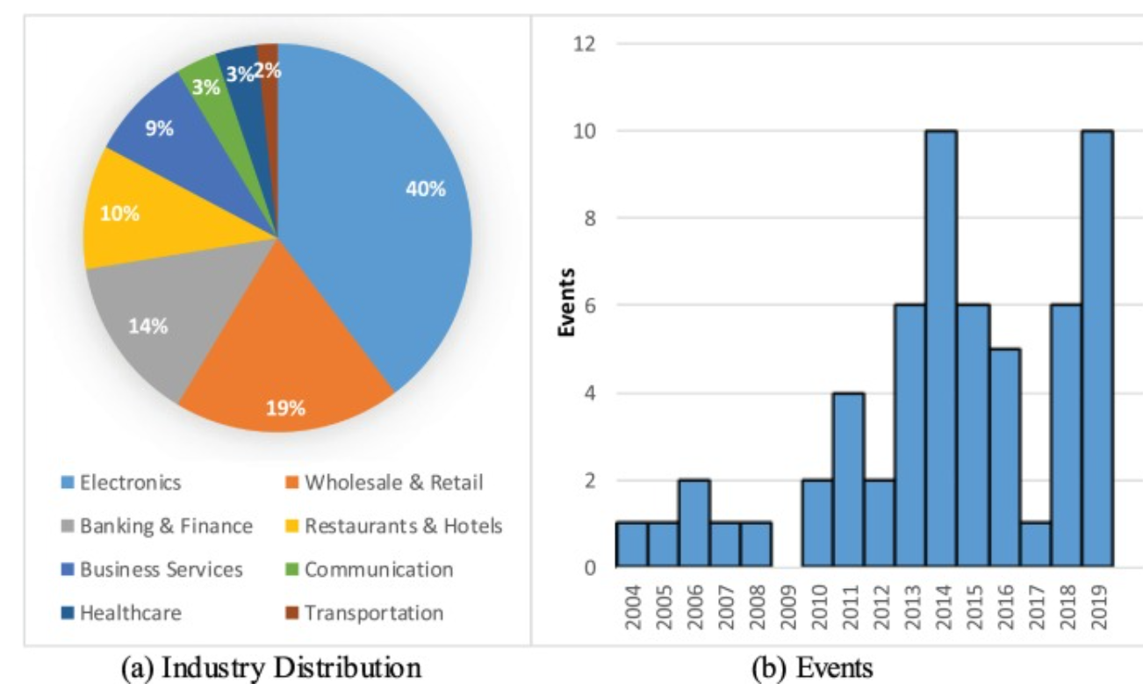
Introduction
Highest average cost in 17 years, rising YOY
United States of over $8.63 million on average
An attack on one company affect firms in that vertical
Returns drop, premiums up
Affects reputation
Market reactions
Notes:
Costs are increases, threats are increasing

Slide 6
Data as a commodity
Introduction
Notes:
Why? So what’s going on? Data has become a commodity. Used to be innocuous, all we cared about was gold / hard currency. Now, currency is digital. Digital payments, digital accounts. All information is digitized. The amount of data on a per person basis is massive, held my many different companies all over the world. So what do you do?

Slide 7
Introduction
The only way to create an impenetrable system is to never let a person use it
Notes:
Want a safer computer, don't’ put it on a network. Want a safe vault, make it so it can’t be accessed.

Slide 8
Monetary theft
Introduction
Notes:
Back when money was hard, stealing from banks is fun made good fiction. Now, however, not only can you steal money, you can also steal data.

Slide 9
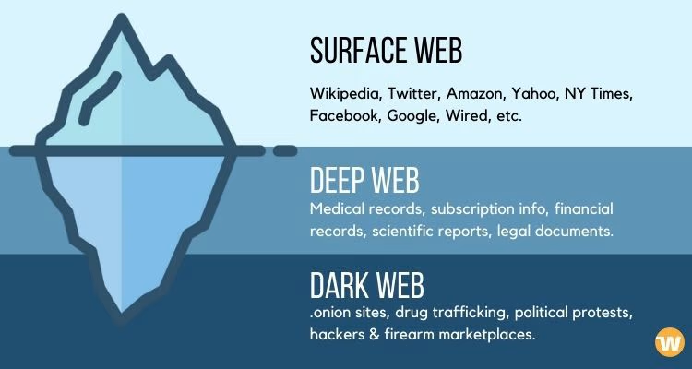
Data Black Market
Introduction
Notes:
Everyone knows or has likely been affected by now, but often data found here isn’t that valuable. You can’t always track which breach it came from, is it valuable once received - how do you leverage it? It can take time.

Slide 10
Criminals
Introduction
Notes:
Criminals usually aren’t dumb. They can be opportunistic, but not usually foolish

Slide 11
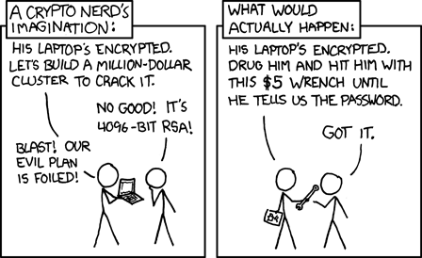
Introduction
https://xkcd.com/538/
Notes:
love this joke. The most salient thin in here is what’s called social engineering. You don’t have to necessarily have the data, you have to have a person’s access. Anyone remember the Sara Palin hack from years ago, or the celebrity iphone hack? You just have to get enough about a person to get their logon.

Slide 12
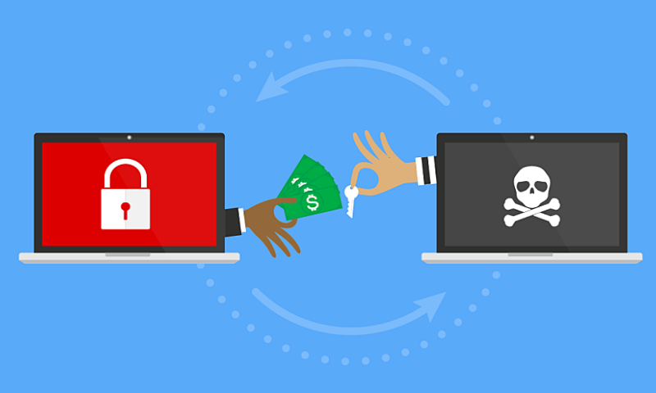
Ransomware
Introduction
Notes:
Joke turned on its head. but what about if a criminal doesn’t want a bank - ransomware. Using your own weapons against you. What if someone got your email, and made you pay to get access to it - or they delete it all? For computers, all computers - one of the best defense was a crypto wall at the bit level, lowest level. What if a hacker got control of that. Game over. What’s also interesting about this, not only is everyone a target, but so is every type of entity.

Slide 13
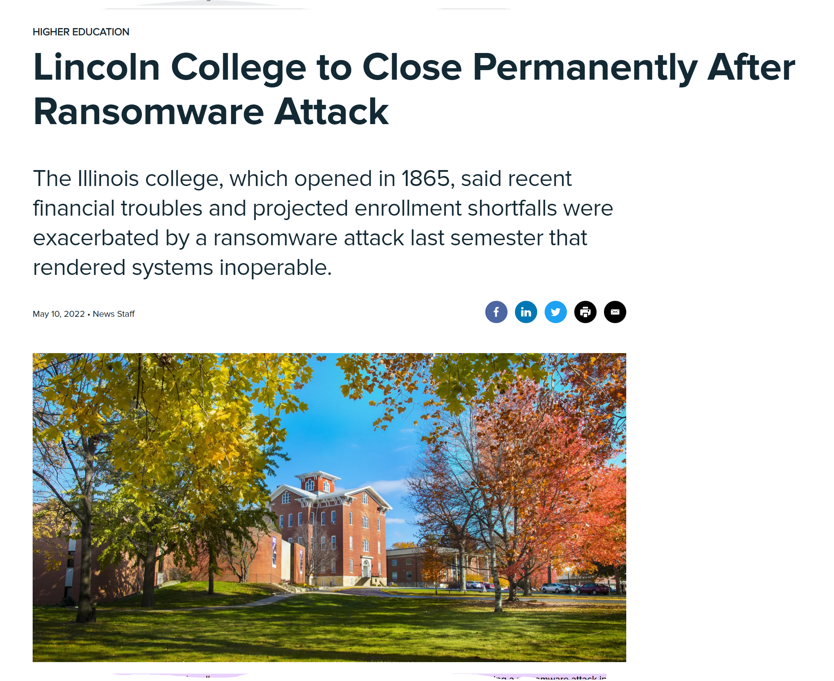
Non - Banks
Introduction
Notes:
What happens when it’s no longer a criminal.

Slide 14
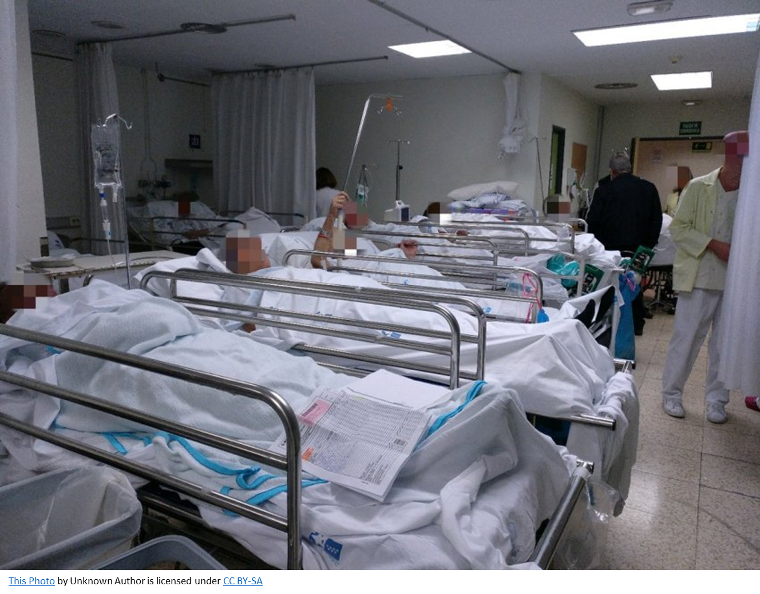
First Death from a Cyber attack
Introduction
Notes:
Gets less funny pretty quickly

Slide 15
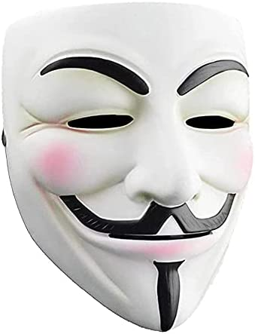
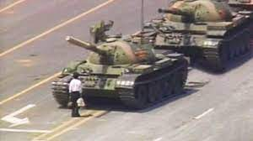
Game is changing
Introduction
Notes:
What happens when the goals change? No longer money, its espionage or strategic military advantage or exposure.

Slide 16
Introduction
Cyber attacks are showing up in larger and more critical areas, by larger and more persistent actors
Israel/Saudi and/or Russia/Ukraine
North Korea / Sony
Colonial pipeline
Log4J / Log4Net / Solarwinds
Notes:
Everyone knows or has likely been affected by now. Predicted years ago.

Slide 17
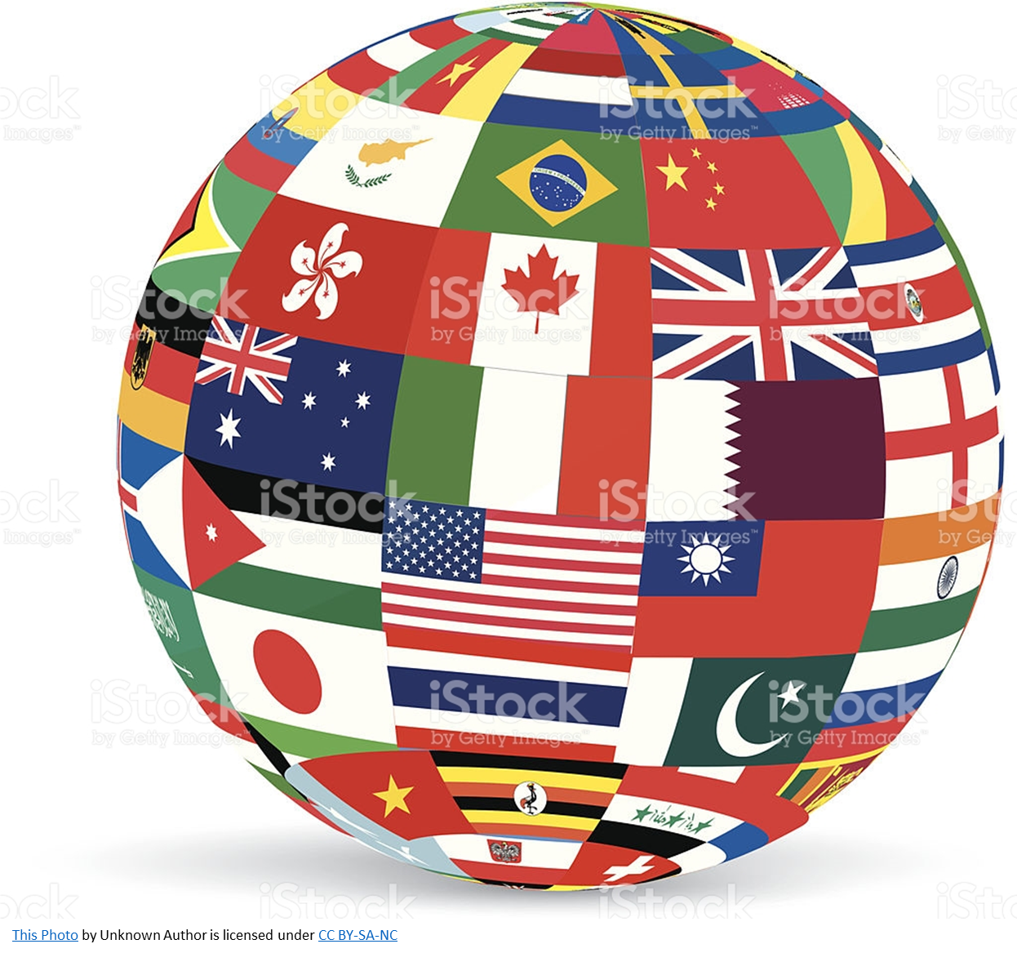
State based actors
Introduction
Persistent actors with unlimited funds
RBV or TCE?
State Paid, State Sponsored, or blind eyes?
Are they any world wide regulations?
Notes:
What if there are unlimited funds and people

Slide 18
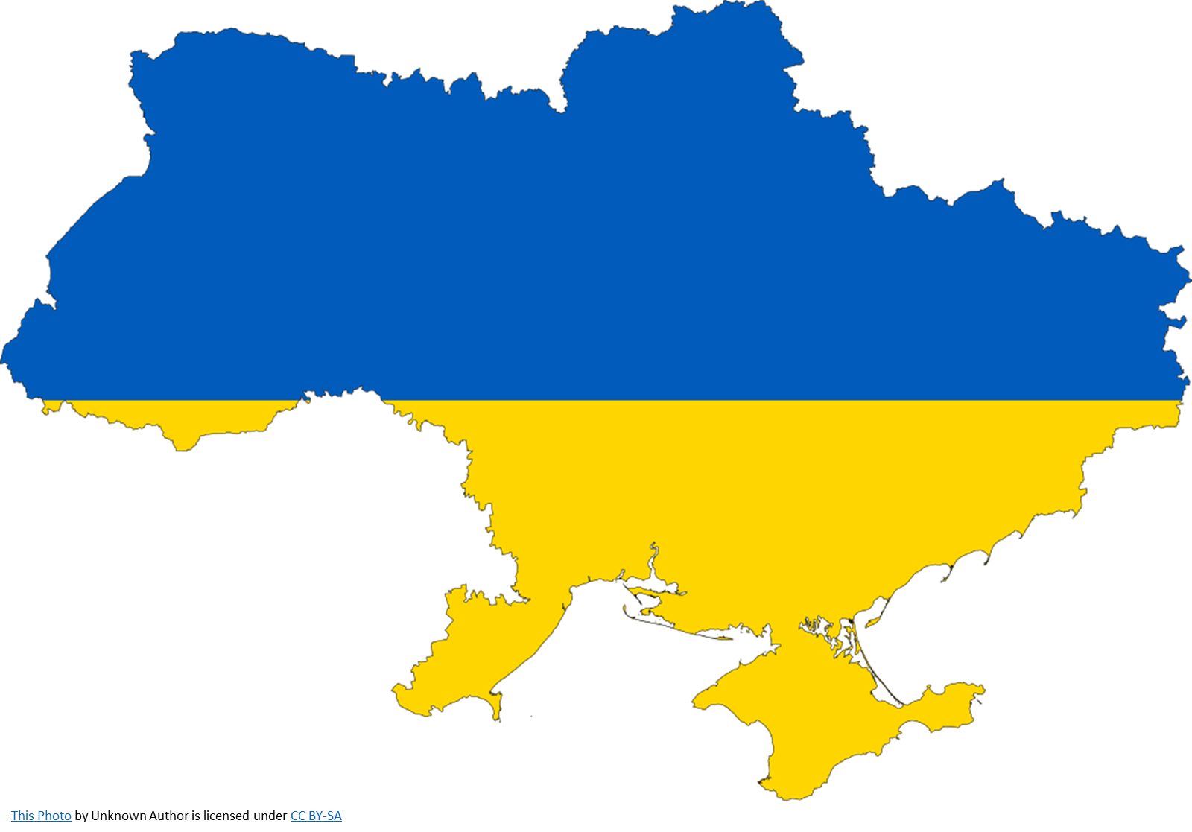
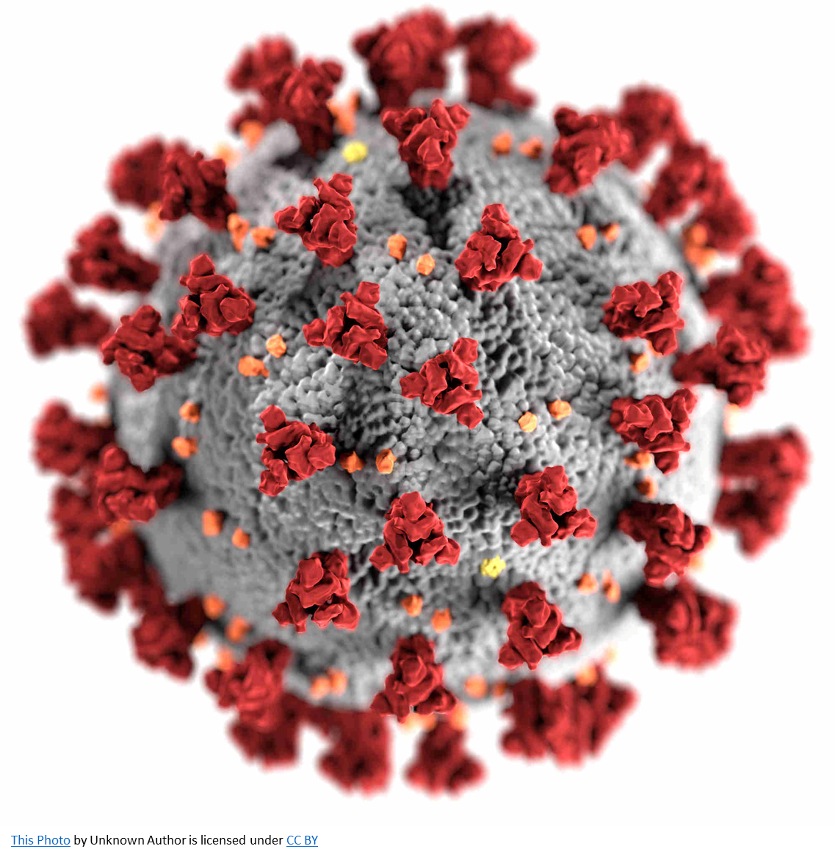
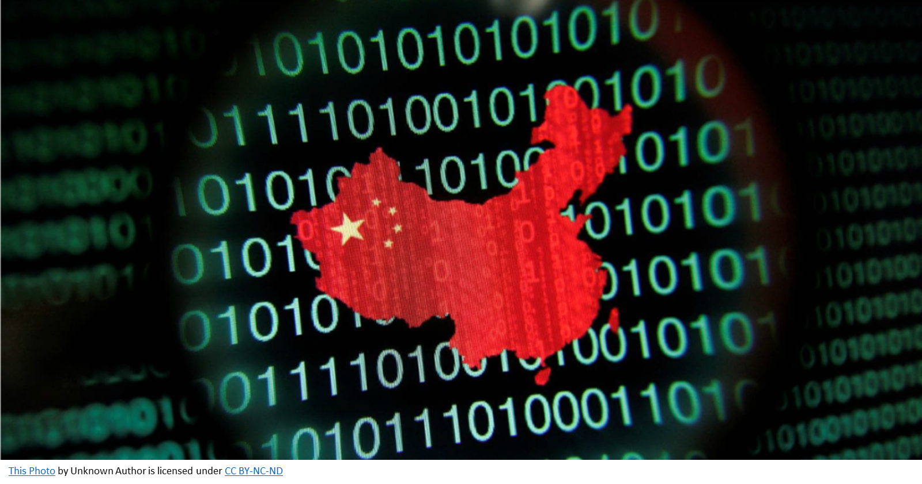
War in Ukraine, Covid, Cyber-Espionage
Introduction
Notes:
Recent examples

Slide 19
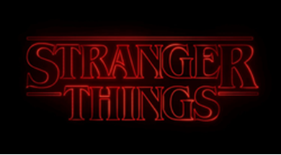
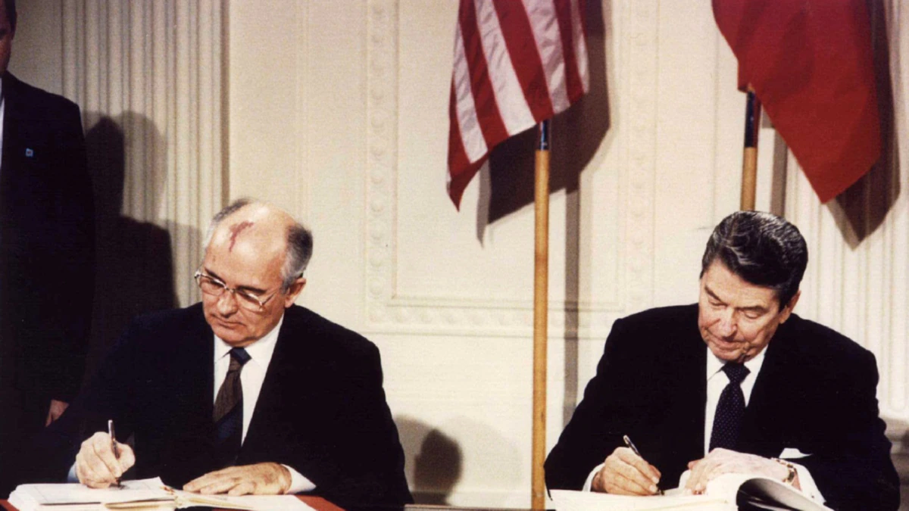
Cyber Cold War, Arms Race
Introduction
Notes:
It's like we’re back in the 80’s

Slide 20
II - Timeline

Slide 21
Timeline of the project
Introduction
Couldn’t find good data anywhere with financial information
Came up with our own categories - this has already been done by others
Found participants / hospitals were denied
Team went in different directions
2
4
6
8
1
3
5
7
9
Looked for primary system, couldn’t find good data on cost / value
Looked at ransomware (picking certain attacks is like picking cars to drive)
We decided to look at geography / state actors
Found Assessment
Looking at defenses is worst than picking an attack
Notes:
Can’t do financial at risk – this is what actuaries and insurance companies do – cost lots of money and resources
Can’t do root cause analysis – this is what consultant and security engineers do = cost lots of of money and resources

Slide 22
III - Methodology

Slide 23
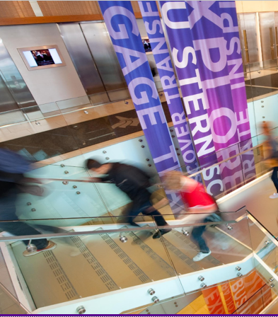
Methodology
Obtaining data
1
US based nonprofit policy research organization, whose purpose is to define the future of national security.
835 cyber-attacks
Occurred during the last 19 years
Focus
government agencies, defense, high-tech companies, or over $1M
Notes:
We implemented our research in 4 different stages to provide relevant insights.
First we obtained a 19 years dataset from CSIS a US based security research organization that collected 835 cyber attacks around the globe focused on events that have affected GOV agencies, high tech companies or cause loses above $1 US million

Slide 24
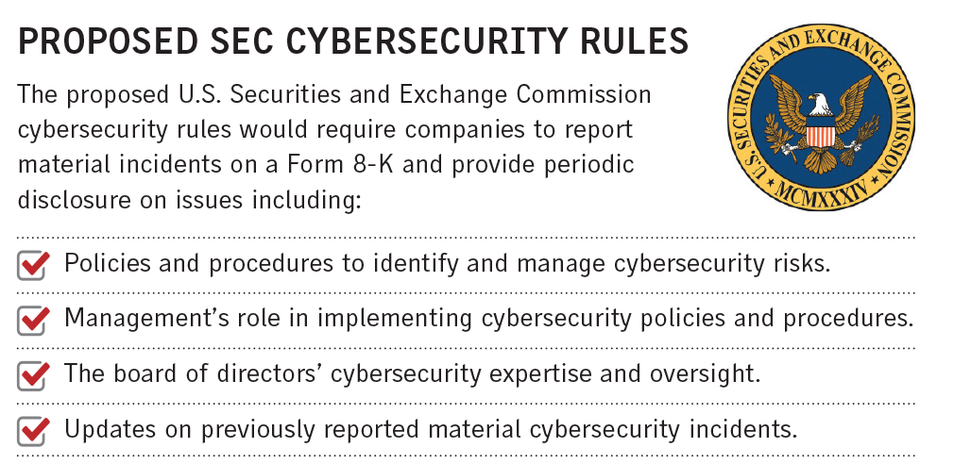
Methodology
Cleaning and searching
2
Data analysis
Researching each case in public sources
Identify
- Data
-Type of Attack
-Motivation
-Mechanism
Notes:
We knew we couldn’t get good financial data from SEC, more meta data.
However we clean the dataset, then we tabulated and star to search all information we can get from each event
We focused our efforts finding relevant information to understand cyber criminal behavior such as victim, perpetrator, type of attack and so on

Slide 25
Methodology
Categorizing
Demographics
Year
Perpetrator
Sector
3
Victim
Sponsored
Criminal
Type of Attack
Disruption
Leak
Unclear
Espionage
Sabotage
Theft
Motivation
Economic
Political
Information
Terrorism
Mechanism
Campaign
Malware
DDoS
Phishing
Ransomware
Remote Access
Notes:
Then we come up with a full dataset for the majority of cases
We focused on four cat

Slide 26
Methodology
Analyzing
Distribution
4
Correlations
Trends
Forecasts
Notes:
Finally, we all data collected we run a four level analytical approach aiming to find
Distributions, correlation, trends and forecast
To better understand the cyber war that is happening across the globe affecting multiple countries and organizations

Slide 27
IV - Results

Slide 28
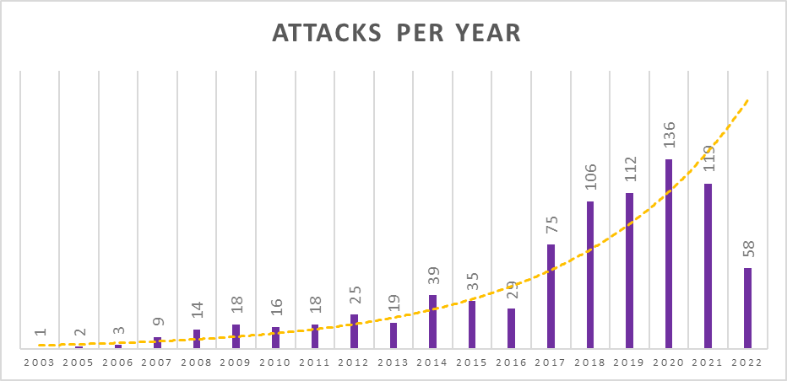
Results
835
Events
32%
Ave. Growth
87
Victim Countries
36
Perpetrator Countries
* 2022 data of Q1 (First Quarter)
Notes:
(Jason) The 19 years dataset show 835 cases with 32% average growth
87 countries were identified as victims and only 36 as perpetrators
In ten window period from 2010 to 2020 the number of attacks have increased ten times and 2020 has the highest number with119
We have access to First quarter 2022 dataset and just in that period we collect 58 cases

Slide 29
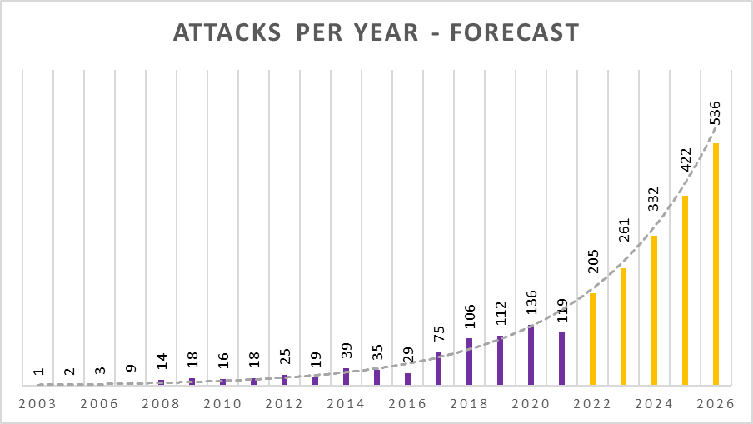
Results
2,592
Events by 2026
Double
2022 events by 2026
Events
Forecast
Notes:
(Jason) Indeed, if 2022 keep following the trend we project that will have a pick almost doubling 2020
And by 2026 we will see doble of 2022 cases around the globe
We cannot foreseen with certainty this behavior but extrapolling to five years looks that at least another additional 30 countries will be impacted

Slide 30
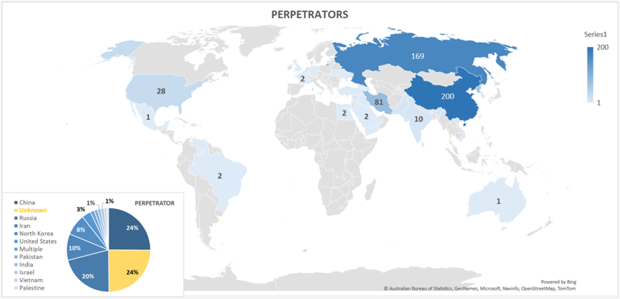
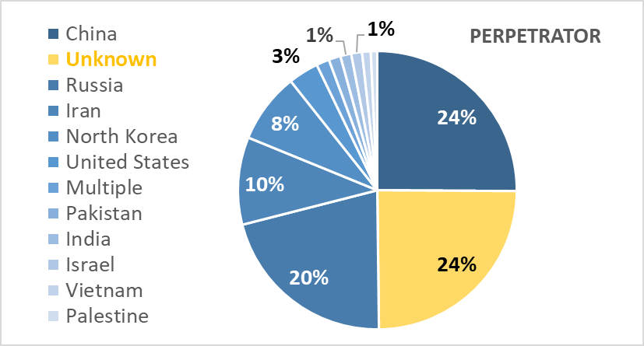
Results
Notes:
(James) Ranking of the perpetrators countries

Slide 31
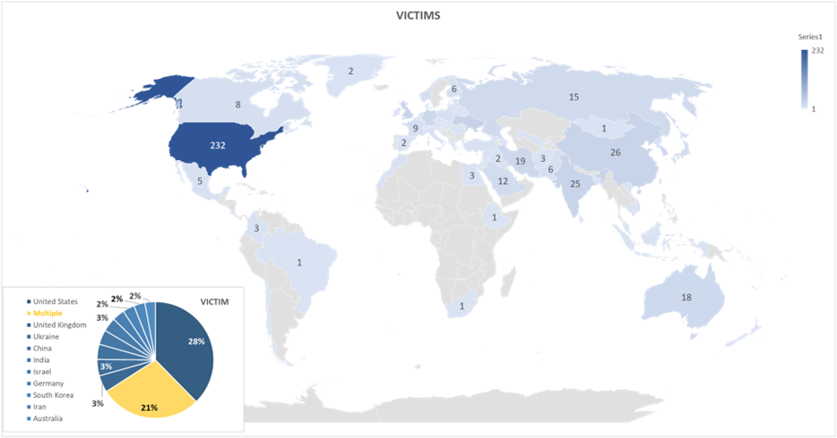
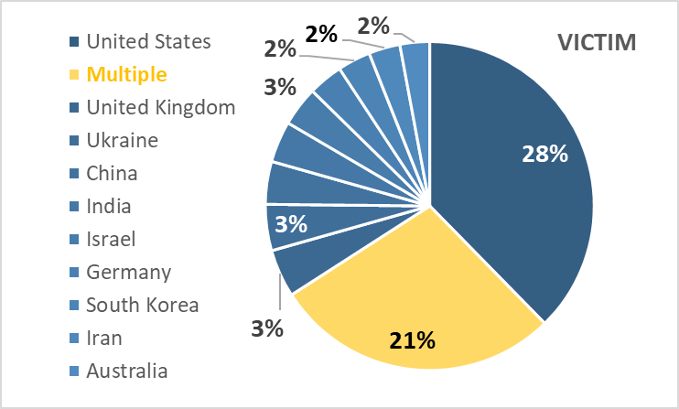
Ranking of the perpetrators countries
Results
Notes:
(James) Ranking of the victims countries

Slide 32
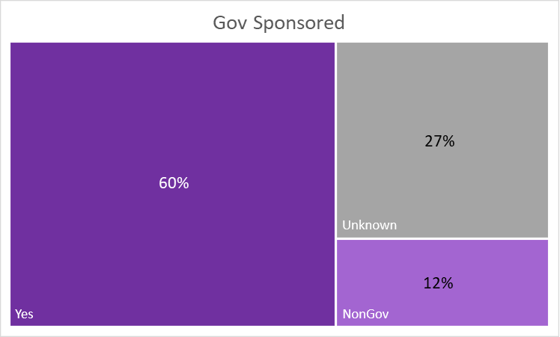
Results
60%
Gov Sponsored
12%
Non-Gov
27%
Unknown
Notes:
(Jason) When analyzing the actors behind the criminals. We have identified that 60% of events are accounted to governments
Just 12% to private organizations and 27% of the cases remained unknown an because of the lack of information
and were not possible to attributed to any GOV

Slide 33
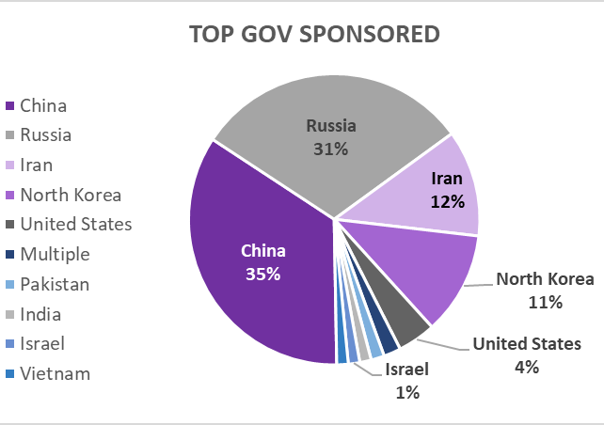
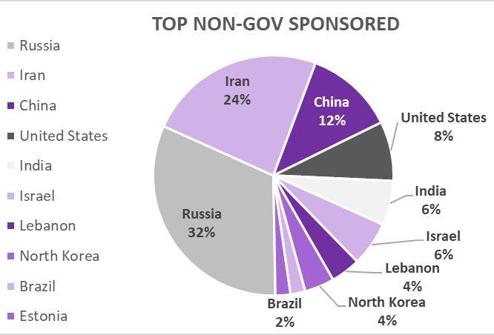
Results
Notes:
(Jason) Nevertheless with the known information, on the one hand we identified that China, russia, iran, North Korea and US are the main actors in the sponsored activity. Having China with the highest participation of 35% of cases
On the other hand, when analyzing non-gov sponsored attack the pie doesn’t change dramatically related to top five. Russia is where most of
criminal organization are located with 32% participation and India emerged as top five non gov country

Slide 34
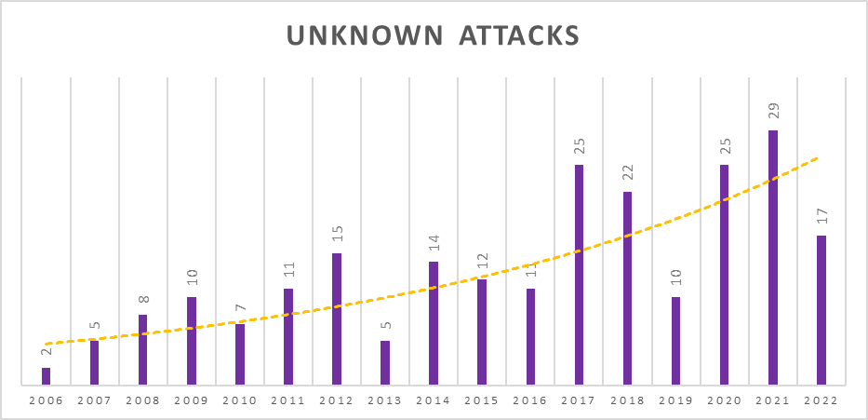
Results
228
Events
20%
Ave. Growth
Notes:
(James) 27% unknown
lowest growth rate, 20% compared to a total 32% of cases

Slide 35
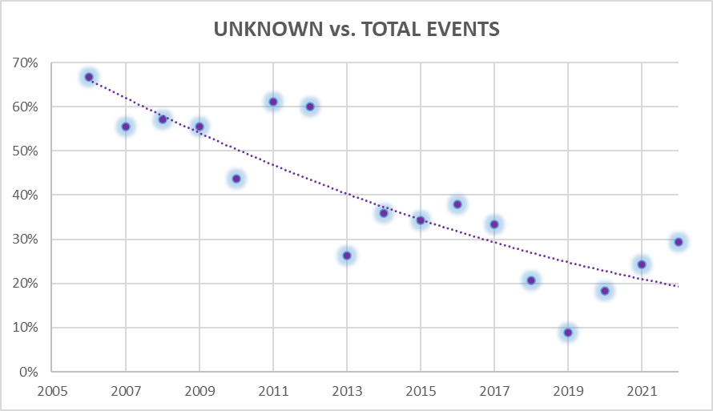
Results
67%
2006
24%
2022
Notes:
(James) It means that responsible perpetrators are now easily tracked than before. Is a clear trend of identified perpetrators and GOVs
In 2006 67% were unknown actors. Today just 24% remained as unknown
If the trend continues indeed will be more attacks but less will be unknown

Slide 36
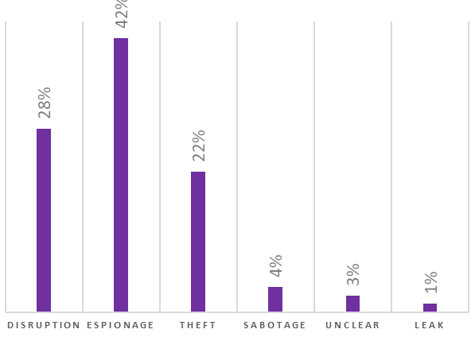
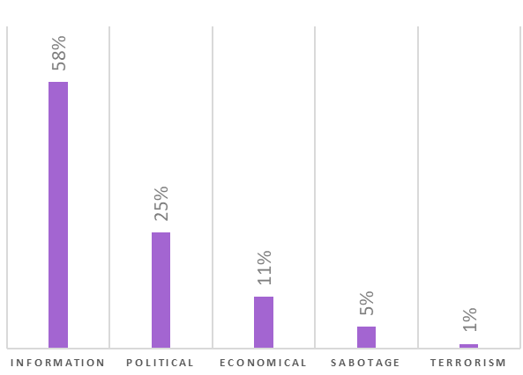
Results
MOTIVATION
48%
44%
TYPE OF ATTACK
34%
35%
Theft
Espionage
Disruption
Espionage
Notes:
(Jason) We identified 6 types of attacks. Espionage, disruption and theft were the most frequent.
68% of espionage cases are motivated to get data and 29% because of political reasons
When analyzing motivation five categories were identified. Interesting that gain money was not the main reason of the attackers, although was steal and control information that explain 82% of the attacks

Slide 37
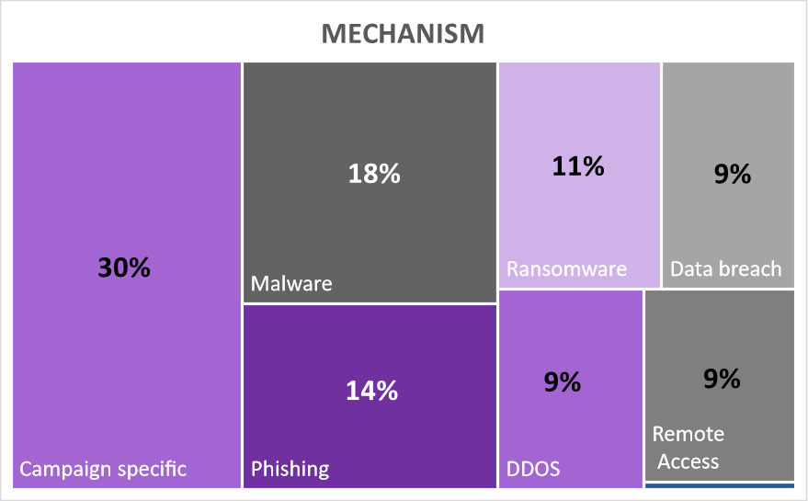
Results
60%
Phishing Average
Growth
58%
Malware Ave.
growth
126%
Ransomware Ave. Growth
Notes:
(Jason)

Slide 38
Conclusions
Summary of Results
Cyber-attacks are increasing, with not signs of slowing down. CSIS is in line with other data sets.
Attacks at least will be double by 2026
State sponsored cyber attacks are increasing and represent more than 60% of total cases
China is the largest perpetrator, followed closely by Russia. Iran is slightly ahead of North Korea for a third position, and then other nations follow more distantly behind.
Most of the attacks aim to get Information from governments and organizations by espionage and theft (64%)
Attacks are now easily tracked and just 24% are from unknown perpetrators compared to 67% in 2006
Campaigns are the common path that perpetrators are using to obtain large amount of data during prolonged periods of time
Ransomware is the type of attack with higher growth rate in the last five years (126%)
Notes:
(Both two each one)

Slide 39
V - Conclusions

Slide 40
Conclusions
More Research
Cost / benefit to countries
Gain - information, monetary value, strategic?
Cheaper than other means?
Will we see this trend continue? Will other countries commit more cyber attacks?
Why aren’t weaker cyber countries attacked?

Slide 41
Conclusions
Conclusions
Digital transformation may put at risk many businesses who may not prioritize, lead, or better manage the risk of their digital assets and dependencies against things like persistent threats.
The number of attack vectors available in the digital age has increased the number of opportunities for theft and exploitation
The digital age presents new challenges at a faster pace, and businesses and states may not be adapting quickly enough in the face of a persistent and active threat.
Risk management practices have been adopted to secure currency and commodities in the financial sector, but this is not in place in the same way for the technology sector. As data is a commodity, perhaps this type of security should be more closely addressed.
In the face of advanced persistent threats from state actors, additional regulations and state-based support may be needed until a peaceful accord can be reached globally.

Slide 42
Suggestions for what to do now
Conclusions
Add a Risk Management program to software and information technology departments
Software first, not hardware or networks
Systems engineering - DevSecOps
Audits and Standards
Operational principles like banks
Operational Risk management
Global regulation - virtual borders
Trade based risk management
Economic risk management
Regulatory risk management
Reputation risk management

Slide 43
Thank you!
MSRM Capstone Project 2022
James Tramel & Jason Rincon

