Slide 1
The History of Metrology
July 22, 2024
10:30 AM - 12:00 PM
Edward C. Otte

Slide 2
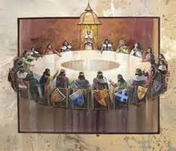
INTRODUCTIONS
Edward C. Otte, TESCO Metrologist
Background, Aerospace, Defense Contracting, Manufacturing, Quality Assurance
ISO 9001
ISO 17025
SQF
Who are you, roundtable?

Slide 3

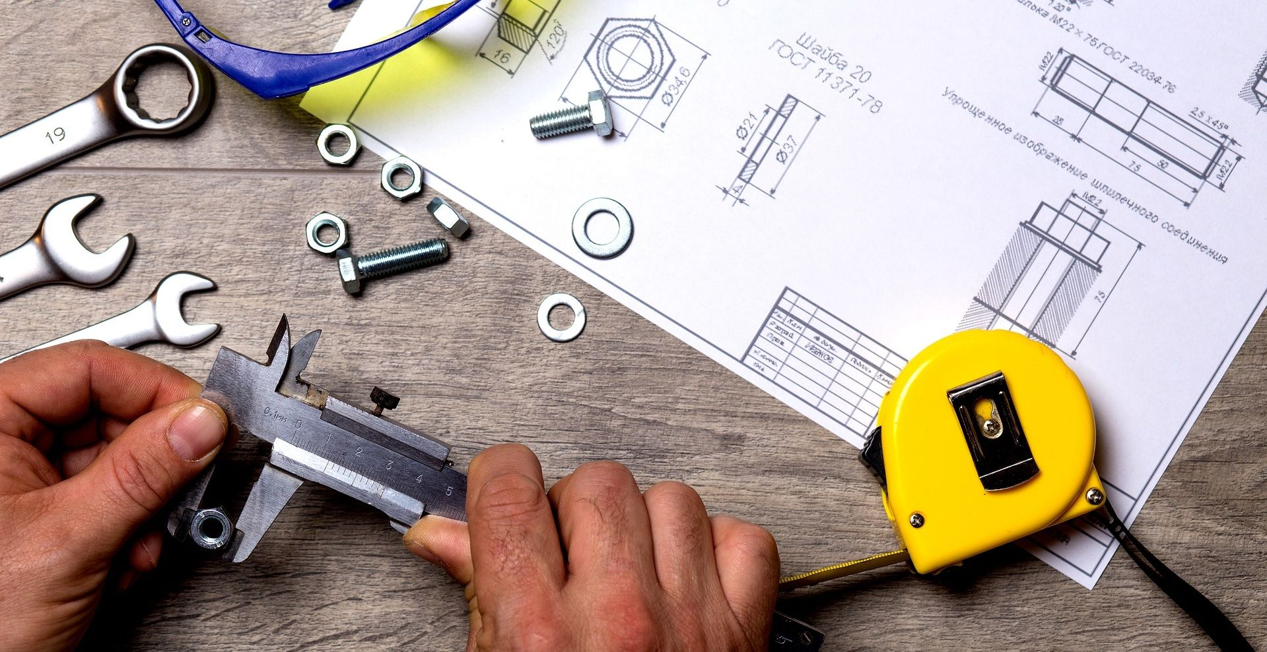
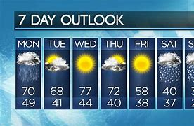
What is Metrology?
Oh, you are a meteorologist? What’s the weather going to be like today?
Simply stated, Metrology is the science of weights and measurements,
A more detail definition is given by the International Bureau of Weights and Measures (BIPM) as "the science of measurement, embracing both experimental and theoretical determinations at any level of uncertainty in any field of science and technology". Metrology establishes a common understanding of units, which is crucial to human activity.

Slide 4
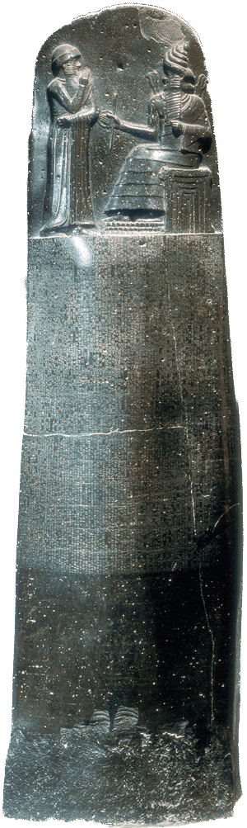

Metrology is as Old as the Hills
The history of metrology is virtually as old as civilization itself,
The need for uniformity in trade, territorial and property divisions were but a few factors that drove the engine of consistent, standards measurements,
Timekeeping is probably the oldest known documented of all the standard measurements, for example what is a day or a year, based on Babylonian 6 based number system,
Even Hammurabi’s Code has provisions about weights and measures,
Later, with more and more inventions and innovations the engine of progress demanded more and more standardizations and qualification of units of measure
This Photo by Unknown Author is licensed under CC BY-SA

Slide 5
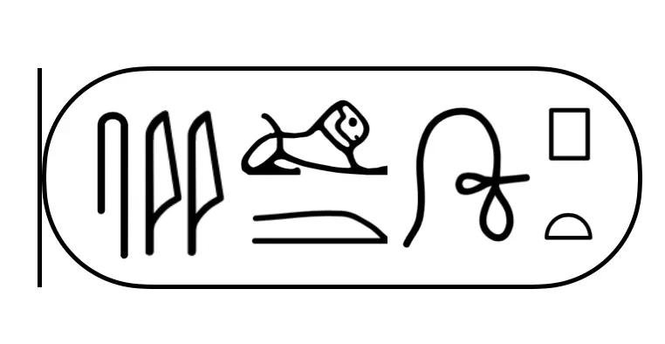
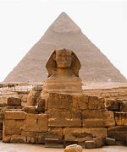

Walk Like An Egyptian
At first the Egyptians had a lunar calendar, but 12 months do not evenly fit into a solar year,
Later the Egyptian calendar was fixed to the rising of the “Dog Star” Sirius, the brightest star in the sky,
  Thus, the year is likely to have been our first standardized, uniform measurement,
A bit later the pyramids were built using the royal cubit stick, the length of the forearm to the tip of the middle finger plus the span of the pharaoh's hand,
  And even though this length unit could vary the first documented case of standardization happened when a block of granite was carved and used as the primary standard!
  Thus, a transfer standard stick was established that had to be compared to the primary at every full moon,
  Failure to do so was punishable by DEATH!
  The resultant accuracy in roughly 756 feet, or about 9096.4 inches was 0.05% or about 4-1/2 inches out of tolerance,

Slide 6
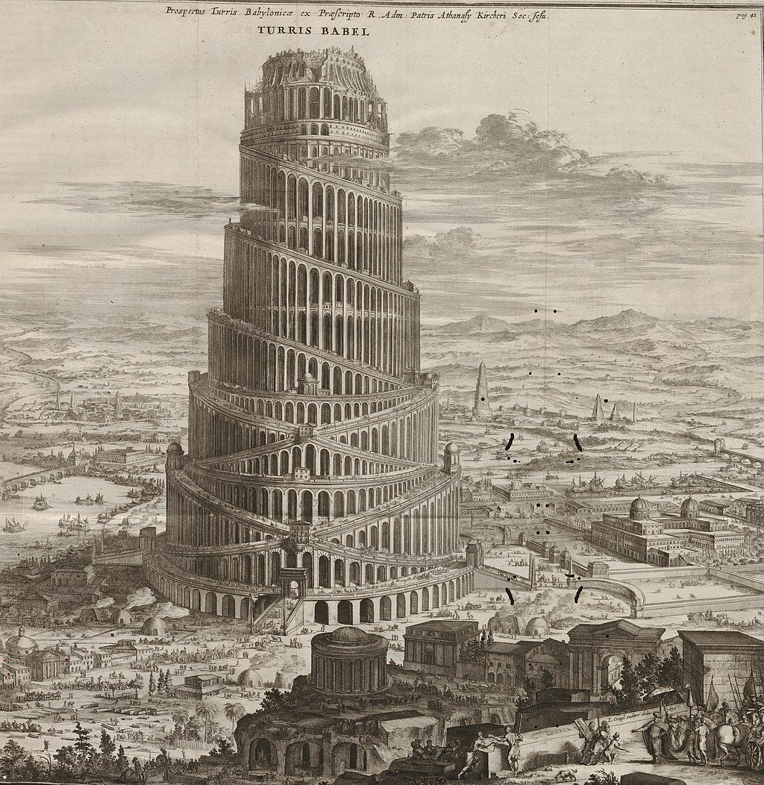
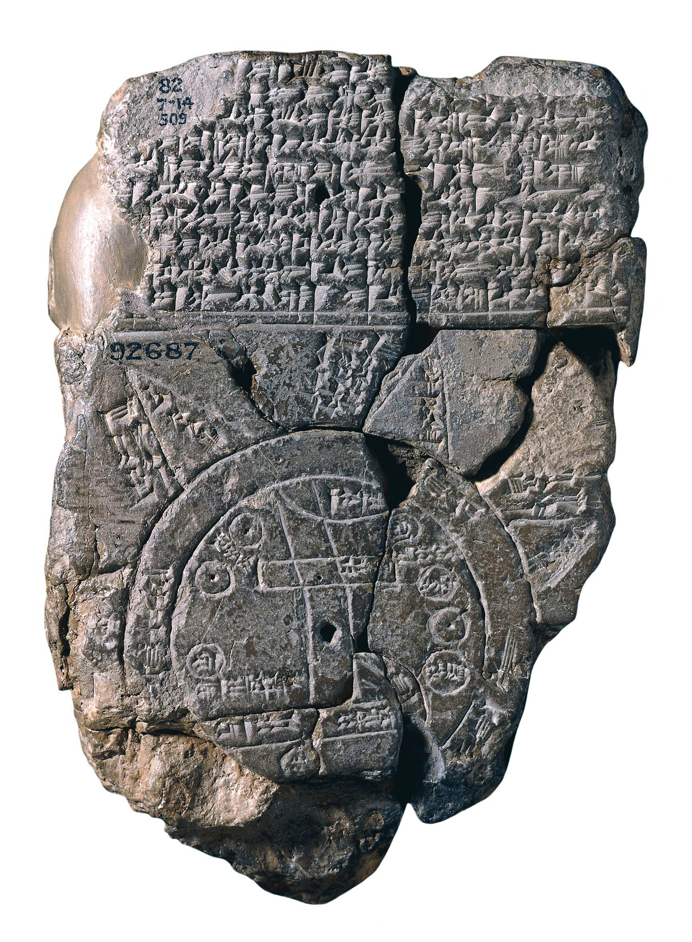
Trade Like a Babylonian
The area of trade and bartering drove the engine for the need to have defined units,
  Kush (a cubit, for length)
  Sar (a plot of land, for area & volume)
  Sila (for capacity) worth noting a liter is the same as a sila,
  Mana (for weight) worth noting 500 grams is a mana
The Babylonian number system is based on 6, not 10, even today rudiments of this is found in 60 seconds, 60 minutes, and 4 divisions of 6 hours in a day,
BUT…a Roman cubit is 17.5”, a Grecian 18.3”, and Egyptian 20.6” and this causes issues with international trade,

Slide 7
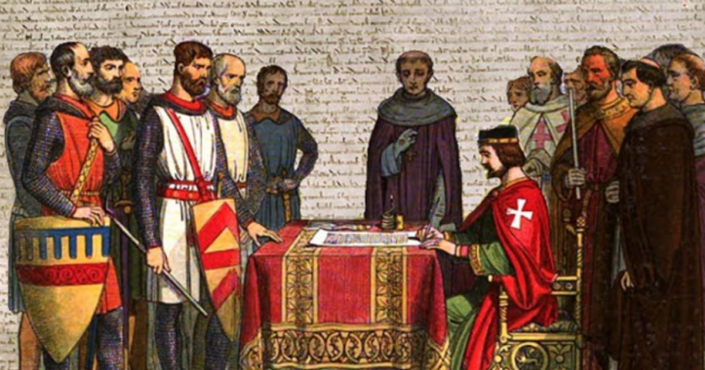
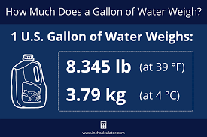
English Government Takes the Lead
752 AD, the King of Kent established the acre as a standard unit, measurement depended on “chains & links”
960 AD, Edgar the Peaceful decrees “All measurements must agree with standards kept in London and Winchester,”
1215, King John is forced to incorporated standard weights and measurements via the Magna Carta,
1266 AD, King Henry III, declares:
  A penny is 32 grains of wheat, (not exact)
  20 pennies in an ounce (still the standard today)
  8 pounds weights one gallon of wine, (how much is a gallon?)

Slide 8
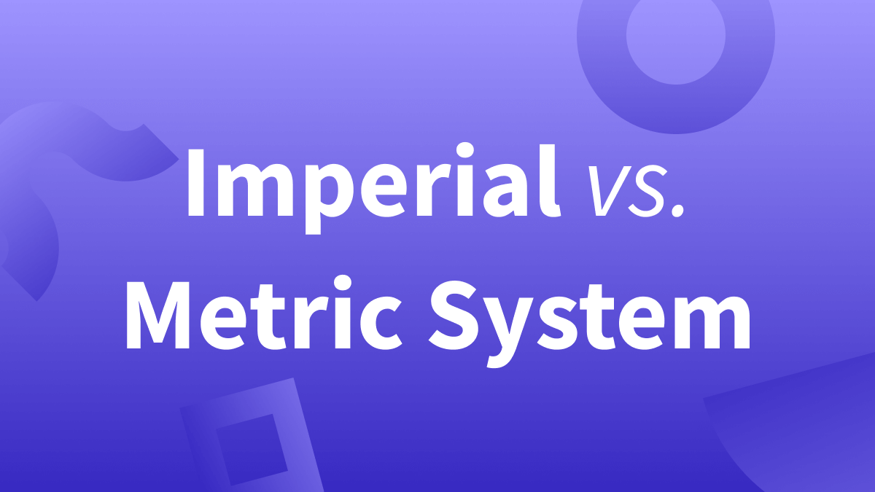
The Metric vs. the imperial System
1670, A French vicar, Gabriel Mouton develops a rudimentary metric system,
1790, Thomas Jefferson proposes a decimal based measurement system for the United States, not the English standard system, (by 1792,m n 100 cents for a dollar was adopted)
1795, France officially adopts the metric system,
1824, George IV, via the Weights and Measurements Act establishes the Imperial System of Weights & Measures,

Slide 9
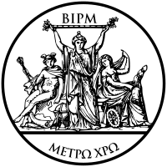
Beginnings of International Cooperation
1875, 18 nations, including the US, sign the Convention of the Metre, a significant milestone establishing the framework for & still governs today the international system of weights & measures,
As a result of being a signer of the Convention of the Metre, the US receives a prototype meter and kilogram to be used as a primary standard, in a way, this is the beginnings of NIST (think Royal Cubit Stick)
1954, the International System of Units (SI) begins it development at the 10th General Conference on Weights and Measures,

Slide 10
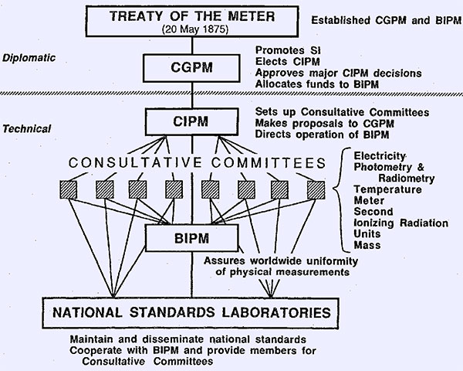
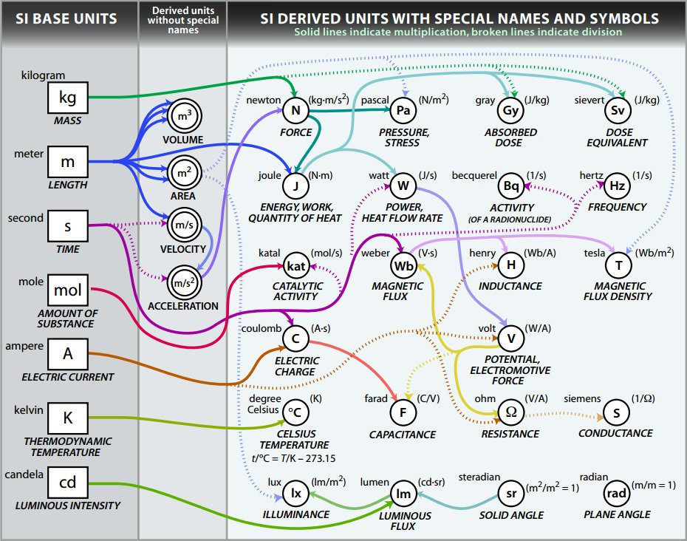
METRE CONVENTION
SI – The International System of Units
  International Bureau of Weights and Measures (BIPM)
  General Conference on Weights of Measures (CGPM)
  International Committee for Weights and Measures (CIPM)
Notes:
SI – The International System of Units. This is the internationally agreed system of measurement. On May 20th (AKA as World Metrology Day) 1875 in Paris France, the metre convention was held with representatives of 17 countries. An international treaty would be signed, often referred to as the “treaty of the meter”, ratifying the creation of the International Bureau of Weights and Measures (BIPM), under the authority of the General Conference on Weights of Measures (CGPM) and the supervision of the International Committee for Weights and Measures (CIPM).

Slide 11
Seven Well known units are defined
1714, the mercury thermometer is invented by Daniel Gabriel Fahrenheit,
1752, Benjamin Franklin proves lightening is the same as a spark from amber,
1792, Alessandro Volta invents the first electric battery, the voltaic pile, the volt is named after him,
1826, George Simon Ohm defines Ohm’s law of electrical resistance,
1831, Michael Faraday discovers how to generate electricity with motion through a magnetic field,
1882, New York City has its first street lit by electric lamps,
1883, the first practical electric meter is invented by Hugo Hirst
1887, the photoelectric effect is discovered by Heinrich R. Hertz,
1894, Oliver Shallenberger of Westinghouse invents the first modern induction disk, electromagnetic form AC meter
1897, J. J. Thomson discovers the electron

Slide 12
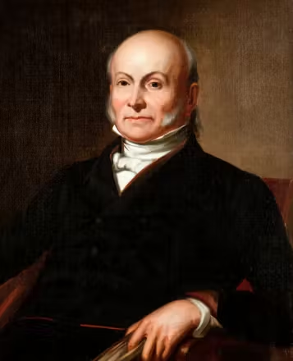
Visionary Leadership
Weights and measures may be ranked among the necessaries of life, to every individual of human society. They enter into the economical arrangements and daily concerns of every family. They are necessary to every occupation of human industry; to the distribution and security of every species of property; to every transaction of trade and commerce; to the labours of the husbandman; to the ingenuity of the artificer; the studies of the philosopher; to the researches of the antiquarian; to the navigation of the mariner, and the marches of the soldier; to all the exchanges of peace, and all the operations of war. The knowledge of them, as in established use, is among the first elements of education, and is often learnt by those who learn nothing else, not even to read and write. This knowledge is riveted in the memory by the habitual application of it to the employments of men throughout life.
John Quincy Adams, Report to the Congress 1821

Slide 13
History of the μετρέω (metreo)
The English term, meter, comes from the Greek word metreo, which means to measure or count.
The meter was originally defined by the French National Assembly in 1791 one ten-millionth the distance from the equator to the North Pole, or 40,000 km.
The prototype primary standard for the meter was established as a meter bar in 1795.
Since that time, it has been redefined to be the length of the path traveled by light in a vacuum during the time interval of 1/299,792,458 of a second, where a second is defined as a hyperfine transition frequency of cesium!
Interestingly using the modern method in understanding the meter the earth’s polar circumference actually measures 40,007.863 km, a difference of 0.022% the original 1791 value.

Slide 14
Comments, Questions, Discussion
Edward Otte
TESCO – The Eastern Specialty Company
Facilities Manager
Ed.otte@tescometering.com
215-228-0500 EXT 203

