Slide 1
Introduction to watthour meter testing
Monday, July 22, 2024
3:15 PM – 4:30 PM
John Pollard
Notes:
1

Slide 2
Questions to Answer
Why do we test & how do we test?
What types of meter tests are there?
How do utility tests differ from customer request tests?
What is In-Service Testing vs Periodic Testing?
What are regulatory tests?
How do we know meter tests are good?
What do we do with the test data?

Slide 3

Why Do We Test?
The meter is the “cash register” of the utility company and serves as a junction / interface between the utility and the customer
Meter accuracy establishes “fair” transactions / billing between the utility company and customer
Meter testing guidelines are taken from ANSI C12.1-2014 American National Standard for Electric Meters – Code for Electricity Metering
Section 5 of C12.1 covers “Standards for New and In-Service Performance”
ANSI provides guidance rather than enforces standards
Final testing guidelines are established by the governing commission, local government, or the utility

Slide 4
Why Do We Test?
Our regulatory commissions typically require us to test meters for accuracy
  Regulatory commissions typically take their lead from ANSI C12.1 American National Standard for Electricity Metering
State regulatory commissions focus on accuracy because they want electric utilities to ensure that no customer is being billed unfairly and that no subset of customers is being unfairly subsidized by the rest of the rate payers
  Some states mandate only accuracy tests and others require demand and time of use accuracy tests
Any tests beyond accuracy tests are tests that are simply good business practice
  With the advent of AMI, functional testing has taken a high priority for the utility as well
Notes:
Define functional testing

Slide 5
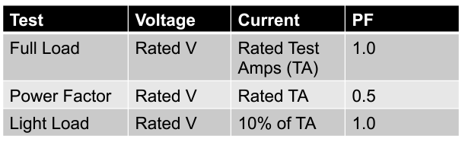
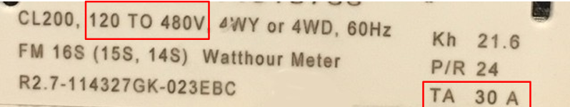
Basics of meter testing
Equipment Needed for Testing
  Reference Standard
  Test Kit or Load Box
  Test Jack or Test Switch
  Multi-Meter
  PPE & Safety Equipment
Tests Performed
Meter Characteristics - Test Amps, Class, Form, and Voltage are shown on the face of the meter as well as Kh (energy per pulse)
Notes:
Kh = energy per pulse (sometimes there is ke or kt) kh historical was wh = 1 disc revolution

Slide 6
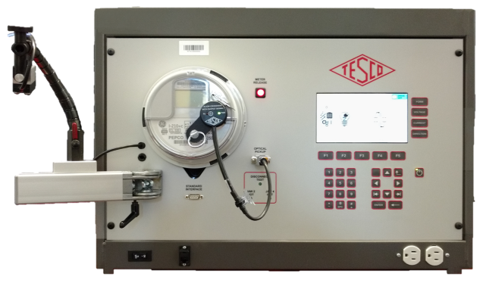
Shop Testing
Shop or lab testing is considered to be done under ideal conditions
The test machine contains the reference standard, meter
socket interface, load circuit, and electronics
The test machine is often
connected to a PC and data management system
The test machine may have an optical probe and other pickups to be able to sense a physical disc rotation, IR output, etc.
Test machines are designed to test single phase and three phase meter forms as well as solid state and electro-mechanical meters
Notes:
MTB 3200 & MTB 3050

Slide 7
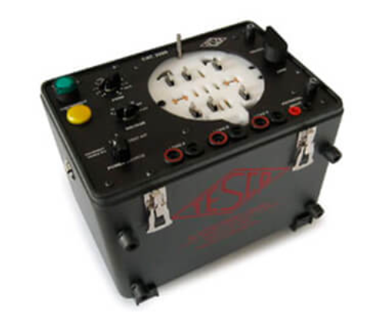
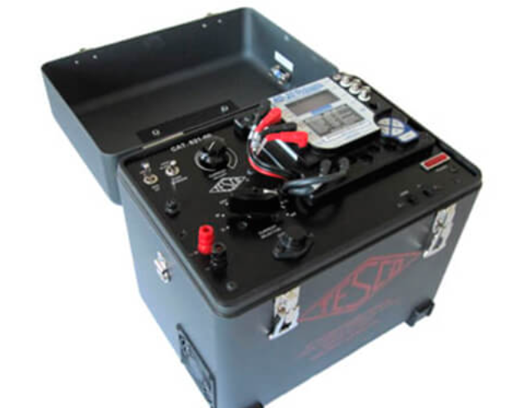
Field Testing
Field testing can be performed with an adapter and site voltage from the meter socket or by removing the meter and testing in a piece of field equipment that may be contained in a utility vehicle nearby
Voltage and current may by synthesized through electronics or the customer’s meter socket may be used as a source
Some commissions may require complaint & witness tests to be done in the field while others may allow to meter to be removed, secured(bagged), and tested in the shop with a witness
Field testing and shop testing have various benefits to a utility
  Quicker field procedure vs more back-office work
  Longer field procedure vs less back-office work
Notes:
Md referee test 10res and 20 comm, md only requires once every 18 months

Slide 8
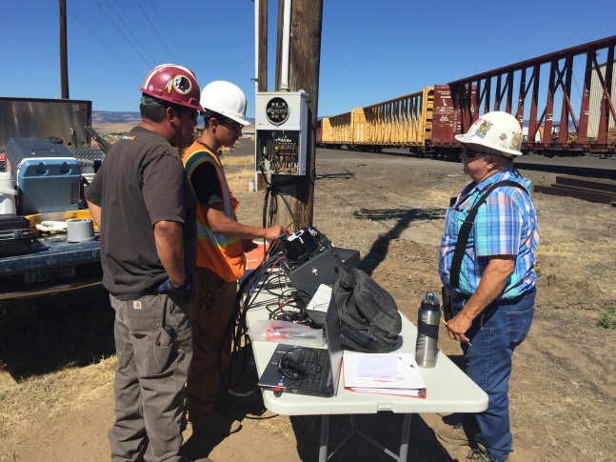
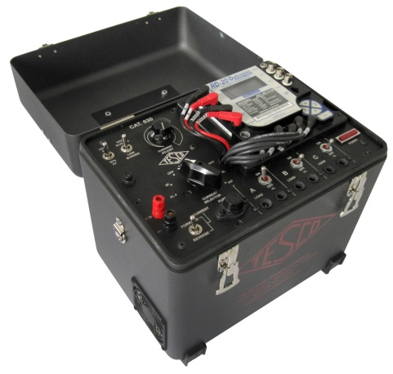
Compliant Testing
Customers always have the right to request a meter test
  There may be limits to how often a test can be requested and there may be a cost to the end customer as well
Some utilities and some jurisdictions allow for testing at the customer site(field), others require a test in a laboratory(shop) environment
Some allow the customer to witness the test and others require the utility commission to witness the test
Utilities must show that the meter tests within acceptable limits and must demonstrate that they have a test program in place to ensure the meters in service are performing well
Notes:
+/- 2%

Slide 9
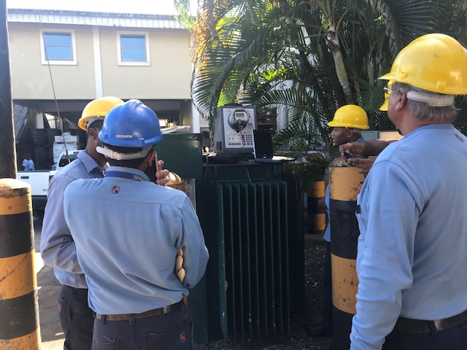
General Meter Testing Requirements
New Purchase Meters
  Manufacturers tests
  In-house tests on new
  shipments
Recycled Meters
  Return to Service Testing
In-Service Meters
  Periodic Tests
  Selective, random, or
  statistical testing
End of Life Meters
  Retirement tests
Testing of related metering equipment

Slide 10
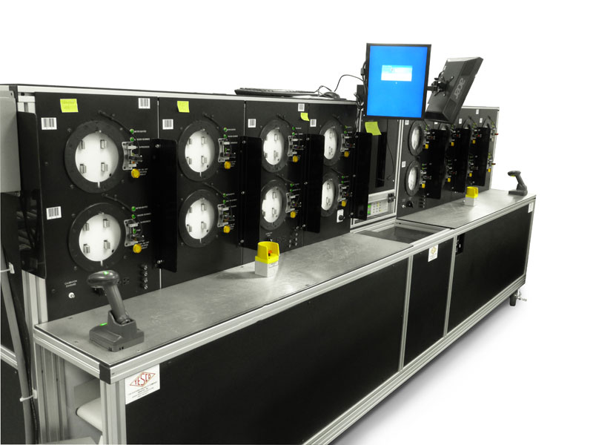
New Meter Testing Programs
Utilities generally accept the manufacturer’s test results then perform some type of test on their own
  Statistical Sample Test of an incoming shipment
  100% test of an incoming shipment
Utilities may opt for sample testing for residential and 100% testing for commercial shipments
With consistent performance and accuracy of newer solid-state meters many utilities have moved to statistical sampling for all new purchases
A utility may have more stringent guidelines than the commission
  98-102% vs 99.5-100.5% or even 99.7-100.3%
Notes:
Add note on functional tests and accuracy tests by PO for new – add note for sample pallet vs entire shipment

Slide 11
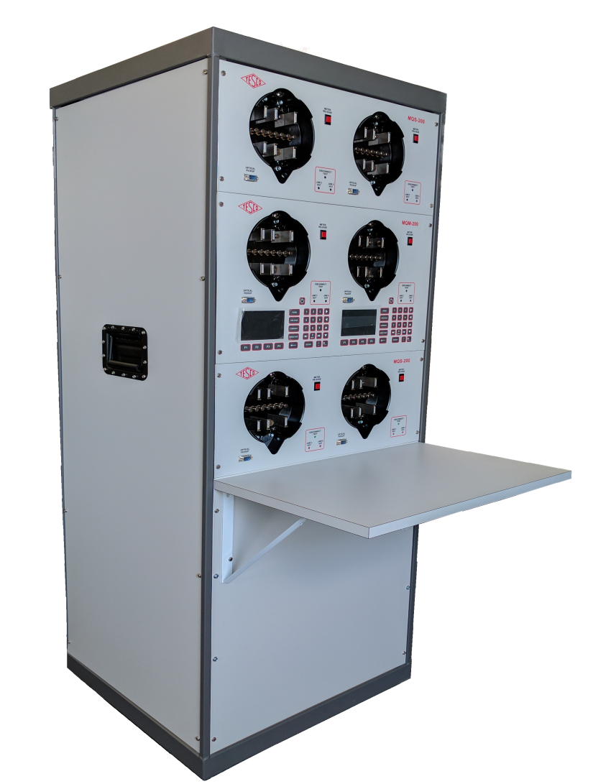
Return to Service Testing
Meters to be returned to service must always (virtually every utility commission requires this) be accuracy tested before being returned to service
Best business practices also require that the meter is functionally tested as well
With advances in AMI technology, many utilities may identify meters as End of Life (EOL) and simply “test and retire” OR they may perform accuracy testing, functional testing, and programming to return service and use in the field

Slide 12
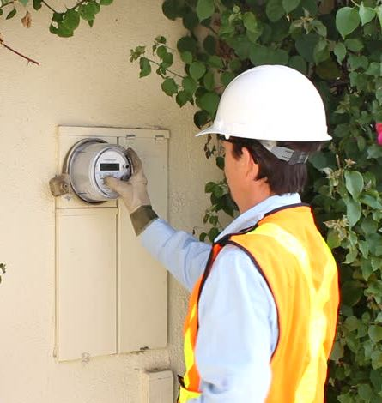
In-Service Testing
Meter Testing for new and in-service meters is specified in ANSI C12.1-2015, American National Standard for Electric Meters, Code for Electricity Metering
Most utility commissions use this Standard a reference or the basis for their meter testing requirements

Slide 13
Test Plans for Meters
The most common test plans for in-service meters include periodic and statistical plans
  Periodic plans may be based on a test every x number of years
  This is more common with commercial meters
  This may even be annually on interconnect meters and generation meters
    Example ISO/RTO - PJM and 1 vs 2 years
  Statistical plans generally are based on a subset of the population and broken out by groupings of the population
Notes:
UMPIRE is a
Universal Meter Programming and Reading System
It reads all meters and recorders
It can control all manufactures software

Slide 14
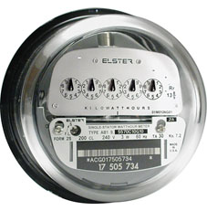
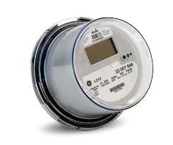
Periodic Test Plans
Periodic
  Varies by State / Jurisdiction
  Example provided by ANSI C12.1:
    Each electromechanical meter is tested once every 8 years
    All other meters are tested every 16 years
    Appendix D provides details for other meters & devices
    No guidance for AMI meters
  Generally, an average of 12.5% of the population is tested per year
  With AMI data and consistent performance, some utilities have moved their commercial populations to once every 12 or even 16 years
8 Years
16 Years

Slide 15

Why Use a Statistical Testing Plan
Focuses testing on the proper meters
Minimizes number of meters to be tested; usually requires less than 30% of what a periodic testing plan requires
Provides data and analysis tools for use in understanding what is happening with installed meters or for use in the purchasing of new meters

Slide 16
Homogeneous Population(s)
The groups or populations being sampled and tested are made up of the same or similar items, items which operate in the same way and were made in the same manner
For electric meters, this has traditionally been interpreted as being meters of a specific meter type from a manufacturer (IE AB1, J5S, MX, etc.)
AMR & AMI programs have helped to make the overall populations more homogenous. This makes a utility with AMR & AMI meters better prepared to take advantage of a statistical sampling plan
  Some utilities may only have 4-5 groups now where they used to have 20+ groups to test
  (IE Focus, i210+c, kv2c, centron, etc.)

Slide 17
Sample Test Plans
ANSI z1.4 and ANSI z1.9 are some of the more commonly accepted sampling plans
  Z1.4 is more common and may be preferred as it is a sampling procedure based on attributes
    Meters pass or fail
  Z1.9 is more granular and may be preferred for aging population as it is a sampling procedure based on variables
    Meters can fail but there is an average and statistical value calculated for the group
      One abnormal test (33%) could be enough to fail an entire group
      Utilities may denote abnormalities as “outliers”

Slide 18
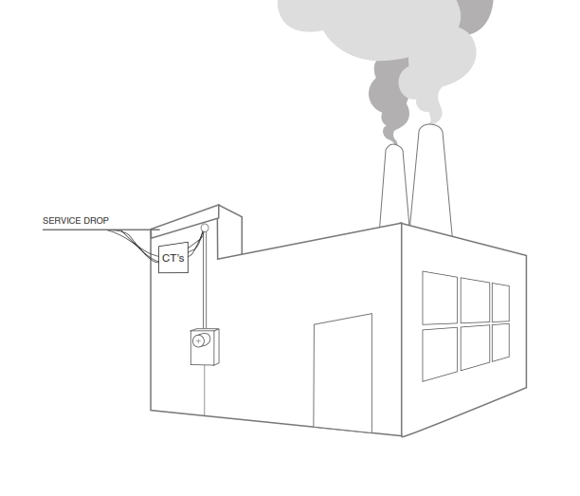
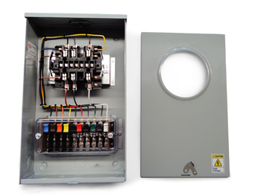
Testing of a Meter vs Testing a Site
Test an installation and site and not just the meter
  Test programs may need to involve testing and checking the meter performance as well as checking and testing the installation
  This more extensive test check list needs to be done especially for the higher revenue C&I customers

Slide 19
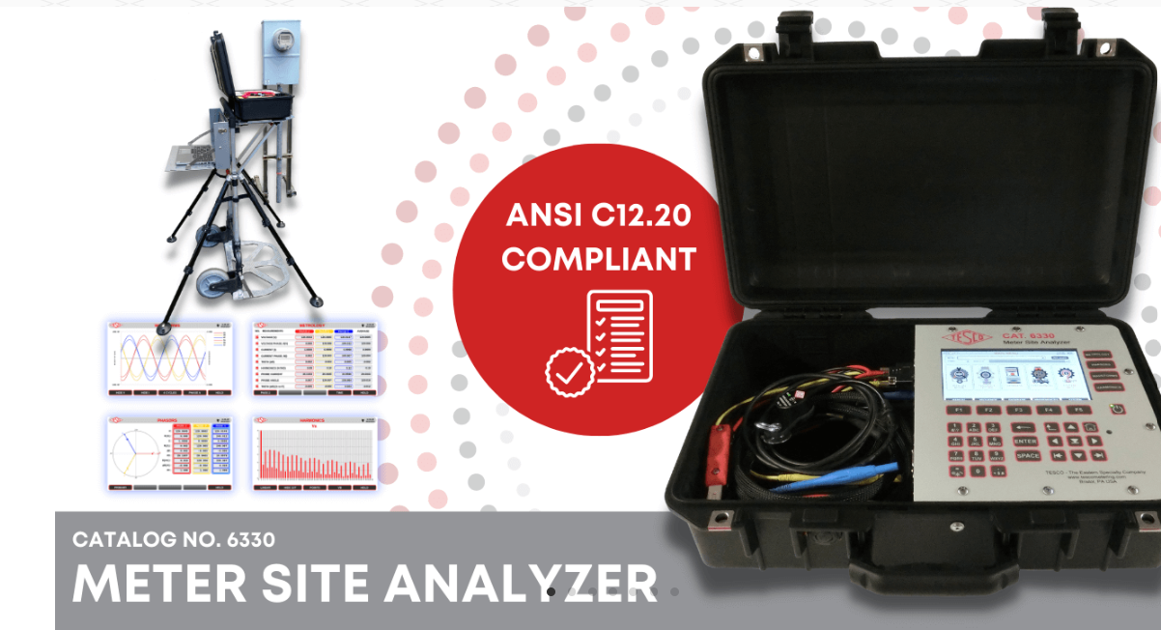
Testing of a Meter vs Testing a Site
Testing of CTs, PTs, and associated site equipment is often overlooked but many times is the key to lost revenue
  Voltage & current checks may show a condition to cause concern
    IE missing current on phase A or voltage on phase C
      Site accuracy may be 66%!
  Phase angle and phasor checks may show concern
    IE current 180 degrees off – one CT wired in reverse
      Meter tests at 100% but site accuracy is 33%!

Slide 20

Meter Testing Traceability
Test equipment to NIST standards
Tracking number of meters to be tested per State Commission requirements
Tracking meter test data
    Meter Records
    Meter Data Management
    System (MDMS)

Slide 21

Meter Testing Traceability
Traceability is defined as the ability to link the results of the calibration and measurement to related standard and/or reference (preferably national or international standard) through an unbroken chain of comparisons
Calibration is typically performed by measuring a test unit against a known standard or reference
Master standard (IE gages) are kept by National Measurement Institute (NMI) of each country
Notes:
21

Slide 22
Meter Testing Traceability
National Institute of Standards and Technology (NIST) provides internal tracking numbers, which are often used as evidence of traceability
WARNING! NIST does not certify or guarantee that calibration and measurements are correct, nor does it provide any kind of certification of accuracy and calibration
  NIST only provides certifications for the work performed by them
Notes:
22

Slide 23
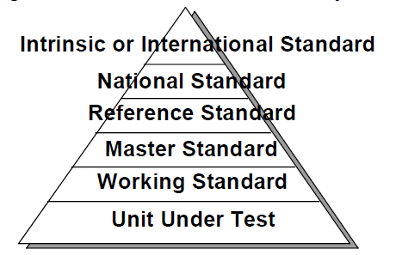
Meter Testing Traceability - Standards
Notes:
23

Slide 24
Meter Testing Traceability - Standards
National Standard
In the US, this is maintained by NIST, in Canada by NRC. Not all countries have a National Standards group and even the US does not have a group for every item of interest to a utility (IE voltage transformers)
Reference/Master Standard
Item of highest metrological quality located at a site where calibration is being conducted
Transfer Standard
Lower level of Reference Standard and used for calibration of lower-level calibration requirements measuring devices
Working Standard
  Lower level of Reference Standard and used for calibration of lower-level calibration requirements measuring devices. Should be compared to Master Standard or Reference Standard on regular basis; used for daily checks comparisons of the calibrated devices
Notes:
24

Slide 25
Test Equipment Calibration
Primary Requirement: Traceable to NIST Standards
Meter Test Boards, Field Test Kits calibrated to a known master standard maintained at Meter Shop
  Some periodicity such as monthly or quarterly
Reference or Master standard calibrated by outside vendor traceable to NIST or directly by NIST
  Usually annually
Notes:
Commission may come or audit or ask for records

Slide 26

Tracking Meter Records
AMI programs help to update and overhaul meter record systems
Having the records for the entire meter population updated allows for a better chance that test data is available to answer questions and that any meter may be selected as part of the sample for testing

Slide 27
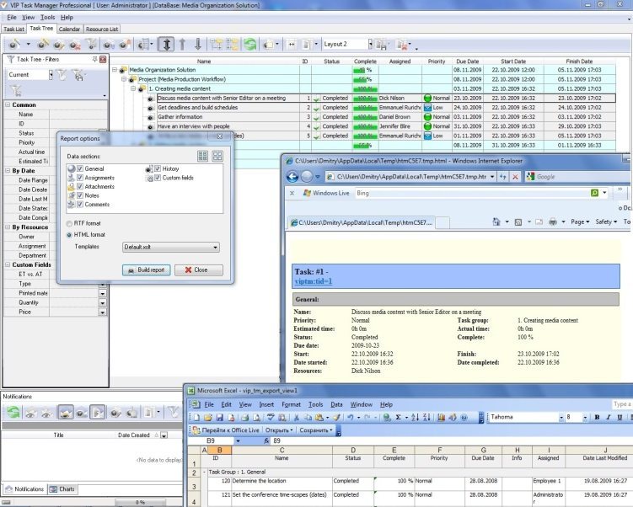
Meter Test Data Tracking
Test data should be tracked throughout meter life
  Certification testing, first article, acceptance testing, in-service (field & shop), retirement
Meter test data should be linked to meter record data such as meter form, amps, voltage, display type, etc.
Best time to start to develop the program is before the meters are being
installed
Accuracy test data is usually collected
automatically as new meters are tested
in meter shops or cross docks

Slide 28

Meter Test Data Tracking
Need to consider tracking non-accuracy functional testing (meter software configuration, service disconnect testing, voltage, etc.)
Use installation reports to determine if there is any initial concerns about the meters being installed.
Typical reports that should be available:
  Failed Meter Report, Project to Date
  Electric Meters on Network Report

Slide 29
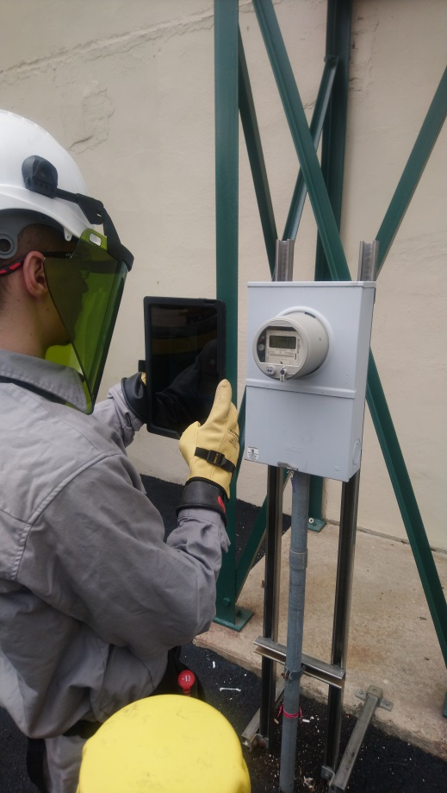
Meter Test Data Tracking System
System should track meter test results for ease of future reference or for response to public or utility commission inquiries
May be part of Meter Data Management System (MDMS) or a separate Meter Records system
Requires discipline in collecting & entering data, especially field tests

Slide 30
Questions?
Why do we test?
How do we test?
What types of meter tests are there?
How do utility tests differ from customer request tests?
What is In-Service Testing?
How do we know meter tests are good?
What do we do with the test data?

Slide 31

Questions and Discussion
John Pollard
TSTM
This presentation can also be found under Meter Conferences and Schools on the TESCO website: tescometering.com
ISO 9001:2015 Certified Quality Company
ISO 17025:2017 Accredited Laboratory

