Slide 1
Hands-On Training – Service Troubleshooting
July 23, 2024
3:15 PM – 4:30 PM
Fran White

Slide 2
Hands-On Training – Service Troubleshooting Single Phase
Prior to setting the single phase (residential) meter (new service installation).
Depending on your utility’s procedures, there may be more things to test than this, but at a minimum.
Visual inspection:
Are the wires the proper gauge and color.
Make sure that the conduit connections are secure and flush (no water leakage).
Make sure that there is enough service loop in the wires (particularly with underground installations).
DVM checks:
Check to make sure that the neutral wire is connected properly.
Make sure that the meter enclosure is properly bonded to ground.
Check for the correct voltages on the line side:
Line to line
Line to neutral (both sides)
Ensure that there is no existing voltage on the load side.
Upside down wiring
Generator or “stolen” power (Diversion).
Check for grounding faults on the load side jaws.
If all the pre-checks are good, set the meter and confirm that it is operational, and the crawler is moving in the right direction.

Slide 3
Hands-On Training – Service Troubleshooting Polyphase
Prior to setting the polyphase phase meter (new service installation).
Depending on your utility’s procedures, there may be more things to test than this, but at a minimum.
Visual inspection:
Are the wires the proper gauge and color.
Make sure that the conduit connections are secure and flush (no water leakage).
Make sure that there is enough service loop in the wires (particularly with underground installations).
DVM checks:
Check to make sure that the neutral (if used) wire is connected properly.
Make sure that the meter enclosure is properly bonded to ground.
Check for the correct voltages on the line side:
Line to line
Line to neutral (each phase)
Ensure that there is no existing voltage on the load side.
Upside down wiring
Generator or “stolen” power (Diversion).
Check for grounding faults on the load side jaws.
Check for proper phase rotation coming into the line side jaws.
If all the pre-checks are good, set the meter and confirm that it is operational, and the crawler is moving in the right direction.

Slide 4
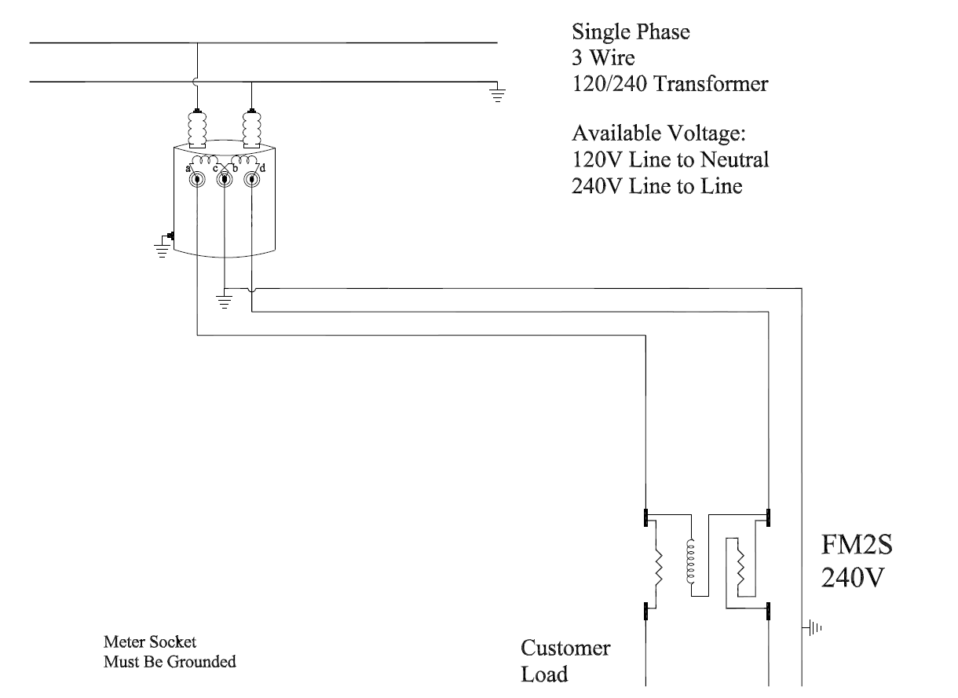
Hands-On Training – Service Troubleshooting Polyphase

Slide 5
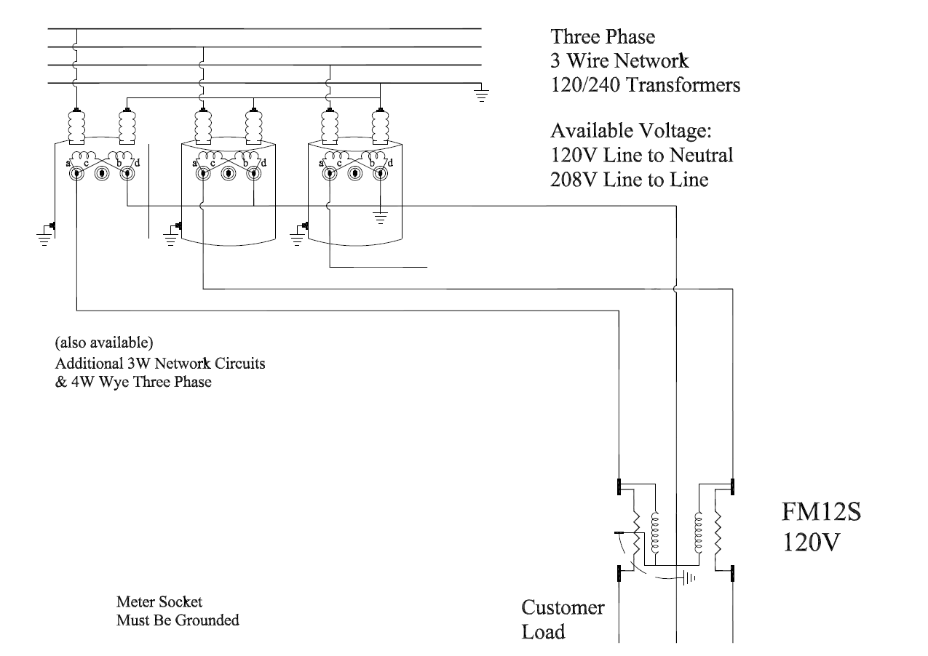
Hands-On Training – Service Troubleshooting Polyphase

Slide 6
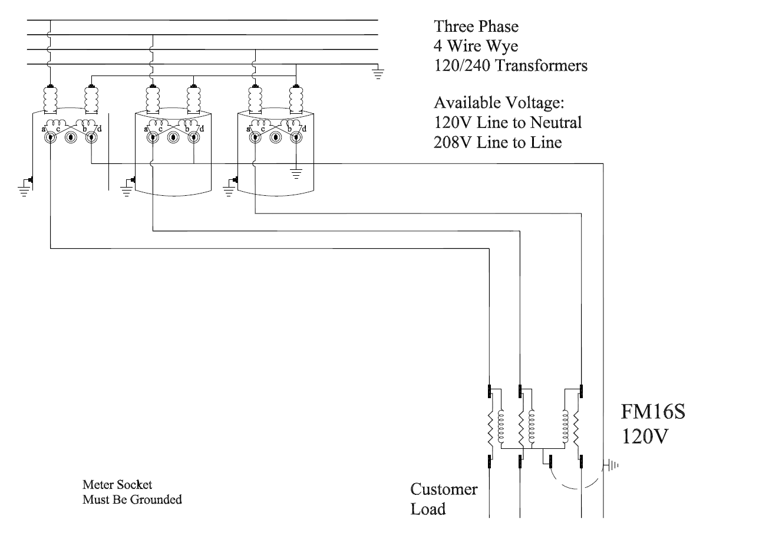
Hands-On Training – Service Troubleshooting Polyphase

Slide 7
Questions and Discussion
Fran White
Senior Meter Technician
TESCO Metering
Bristol, PA
215.228.0500
This presentation can also be found under Meter Conferences and Schools on the TESCO website: tescometering.com
ISO 9001:2015 Certified Quality Company
ISO 17025:2017 Accredited Laboratory

Slide 8
Questions and Discussion
John Williams
Vice President of Engineering
TESCO Metering
Bristol, PA
215.228.0500
This presentation can also be found under Meter Conferences and Schools on the TESCO website: tescometering.com
ISO 9001:2015 Certified Quality Company
ISO 17025:2017 Accredited Laboratory

