Slide 1

Distribution Services and Service Types
Referencing the Power Measurements Handbook
July 22, 2024
10:30-12:00
Carl Chermak

Slide 2
Service Types
North American Services
North America has a limited number of distribution services, even fewer which are common. The common services are:
Description | L-N VAC | L-L VAC | Area | Designation
1-Phase, 2-Wire 120V with Neutral | 120 | - | US | 1P-2W (120V)
1-Phase, 2-Wire 208V † | - | 208 | US | 1P-2W (208V)
1-Phase, 2-Wire 240V † | - | 240 | US | 1P-2W (240V)
1-Phase 3-Wire 120/240V | 120 | 240 | US | 1P-3W (240V)
1-Phase 3-Wire 120/208V | 120 | 208 | US | 1P-3N (208V)
3-Phase, 3-Wire 208V Delta † | - | 208 | US | 3P-3D (208V)
3-Phase, 3-Wire 480V Delta † | - | 480 | US | 3P-3D (480V)
3-Phase, 3-Wire 600V Delta † | - | 600 | US, Ca | 3P-3D (600V)
3-Phase, 4-Wire Wye 120/208V | 120 | 208 | US | 3P-4Y (208V)
3-Phase, 4-Wire Wye 277/480V | 277 | 480 | US | 3P-4Y (480V)
3-Phase, 4-Wire Wye 347/600V | 347 | 600 | US, Ca | 3P-4Y (600V)
3-Phase, 4-Wire Delta 120/208/240V | 120 208 | 240 | US | 3P-4D (240V)
3-Phase, 4-Wire Delta 240/415/480V | 240 415 | 480 | US | 3P-4D (480V)
† These services have no neutral conductor.
Most common service types have their descriptions in bold. All of these services derive from three basic transformer configurations: center tapped single-phase, three-phase delta, three-phase wye.

Slide 3
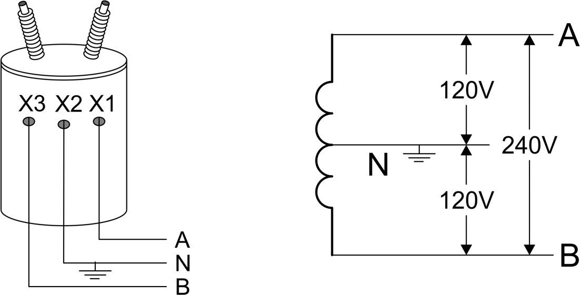
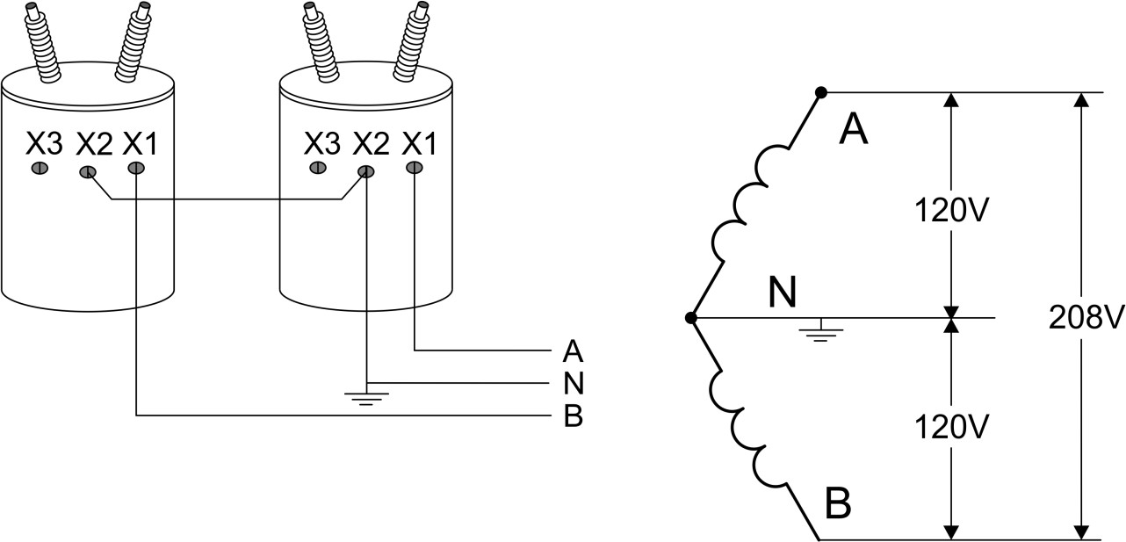
Transformer Configurations
Transformer Configurations for Single Phase Services
There are two common single-phase services. The simple single-phase center-tapped transformer is used virtually universally for residential service. The “network” configuration which consists of two legs of a 4- wire wye bank is common in light commercial installations.
1-Phase, 3-Wire 120/240V Residential
This service is generally metered with a self-contained Form 2 Class 200 or Class 320 meter. Occasionally in commercial or very large residential customers, a transformer rated meter may be used. In this situation a Form 3S or Form 4S Class 20 meter is appropriate.
1-Phase, 3-Wire 120/208V Network
This service is generally applicable to commercial customers. For self- contained applications a Form 12 Class 200 or Class 320 is generally used. For transformer-rated applications a Form 5S Class 20 meter is generally used.

Slide 4
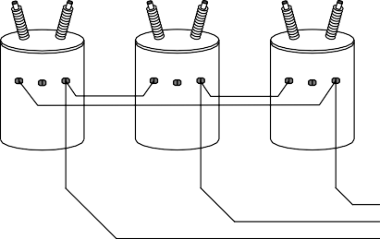
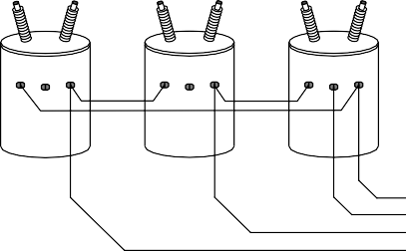
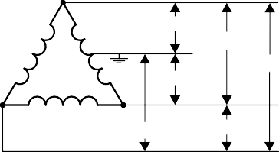
Transformer Configurations
X3 X2 X1
X3 X2 X1
X3 X2 X1
480V
480V
Transformer Configurations for Three Phase Services
There are two common families of service for polyphase: delta and wye. The two types of delta service have very different characteristics.
Three-Wire Delta
In a three-wire delta (3WD) all three phases are hot. All of the phase to phase voltages are all the same. There is no neutral. The most common voltage for three 3WD service is 480V. 3WD service is generally limited to motor loads because there is no provision for a single phase load. 3WD systems have an advantage that any phase can be grounded without affecting the loads.
Note: Some utilities ground one phase (generally B). One phase of a 3WD transformer bank can be removed without affecting the loads as long as the maximum load does not exceed 57.7 percent. Though the most common voltage for 3WD services is 480V other voltages include: 208V, 240V and 600V.
B
C
480V
A B C
Four-Wire Delta
A four-wire delta (4WD) service is similar to a three wire delta except a neutral connection is made to the center of one of the legs. This creates a service which provides a wide selection of voltages for the customer.
A
^{X3} X2 ^{X1}
^{X3 X2} X1
^{X3} X2 X1
N
120 /240 V
240 /480 V
240 /480 V
120 /240 V
B
C
A N B C
208 /415 V
240 /480 V
If the neutral is placed in the center of the A-B transformer then:
|Van| = |Vbn| = 120V which provides lighting and outlet service.
|Vcn| = 208V a “high leg” which is used by commercial appliances.
|Vab| = |Vbc| = |Vbc| = 240V which is a 3WD service for rotating loads.

Slide 5
Transformer Configurations
Four-Wire Wye
The four-wire wye (4WY) is the most common commercial/industrial service. For smaller customers the service is often 120V phase-neutral and 208V phase-phase. Larger customers often have 277V phase-neutral and 480V phase-phase. Because there is a neutral in this service voltage regulation is generally better than on delta services.
X3 X2 X1
X3 X2 X1
X3 X2 X1
A B C N
A
120/277/347V
208/480/600V
N
120/277/347V
208/480/600V
120/277/347V
B
208/480/600V
C

Slide 6
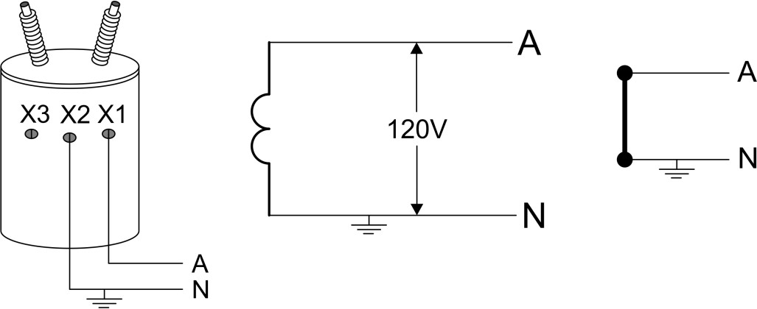
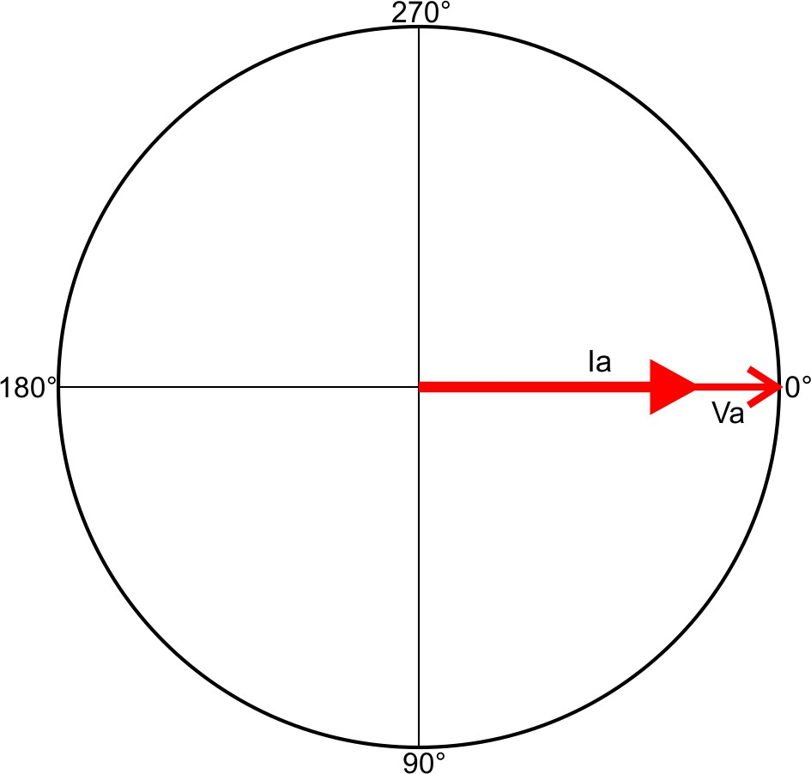
Metering Service Types
Metering Two-Wire Single-Phase Services
This service was quite common several decades ago for residential services. Today it is seen only in special cases such as metering traffic lights and other small standalone applications.
Meter Forms
 | Blondel Compliant | Non-Blondel Compliant
Self-Contained | 1S
Transformer-Rated | 3S
Single-Phase Two-Wire 1P-2W (120V)
Distribution Phasors
1P-2W
Phase | V(p-n) | V ɸ | I(x-y) | I ɸ
A | 120 | 0 | Ia | 0

Slide 7
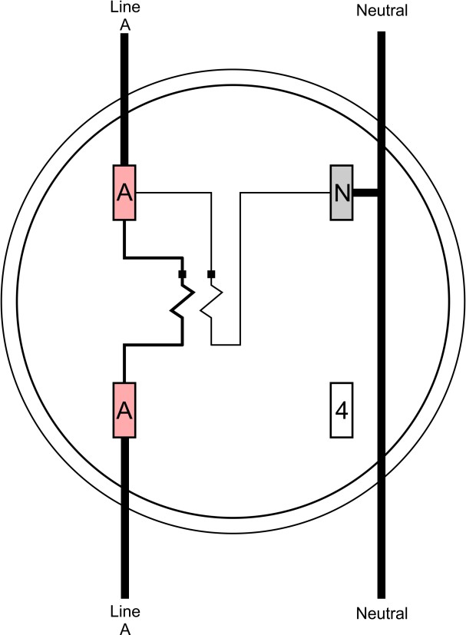
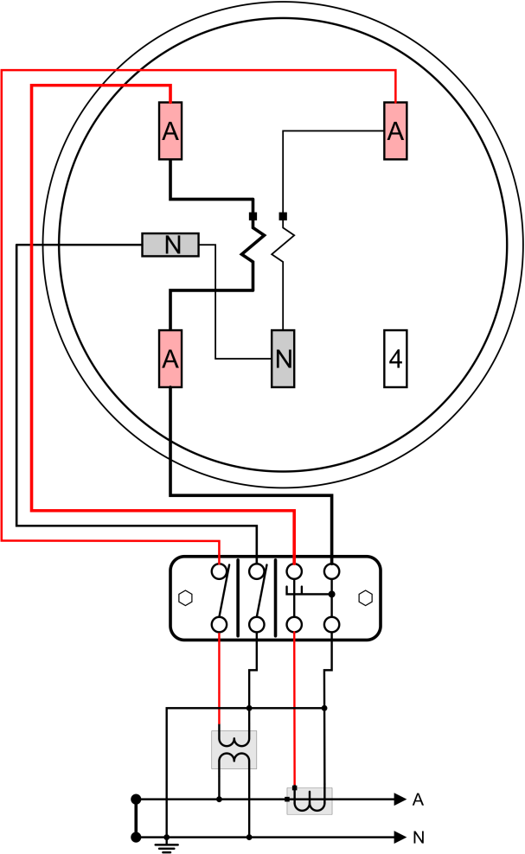
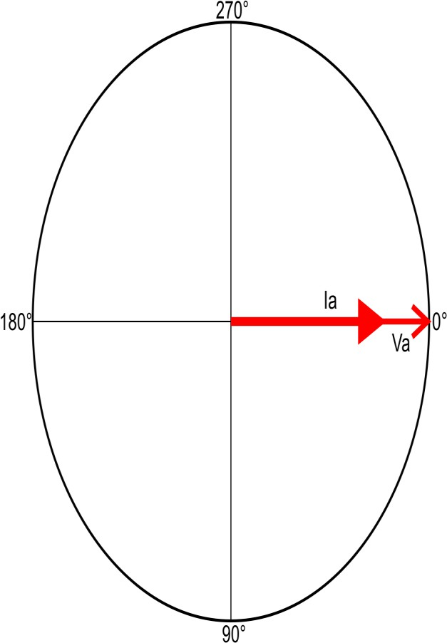
Metering Service Types
1S (Blondel 1V 1I 2W) Sel-Contained
Meter Phasors
Phase | V(p-n) | V ɸ | I(x-y) | I ɸ
A | 120 | 0 | Ia | 0
This is the self-contained meter for a two-wire service. The equation for power is:
P = Va ⋅ Ia
Note: This is the vector dot product of the voltage phasor and current phasor.
The meter phasor is identical to the distribution phasor.
3S (Blondel 1V 1I 2W) Transformer-Rated
1P-2W

Slide 8
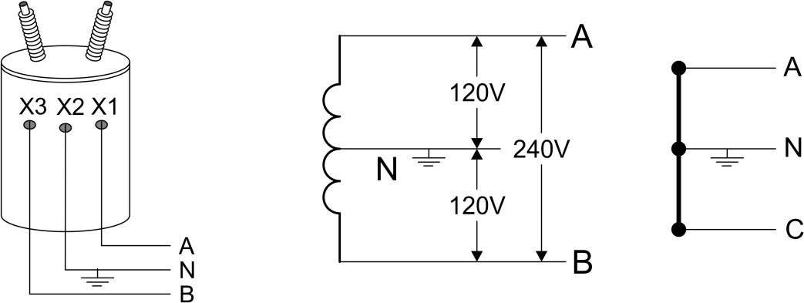
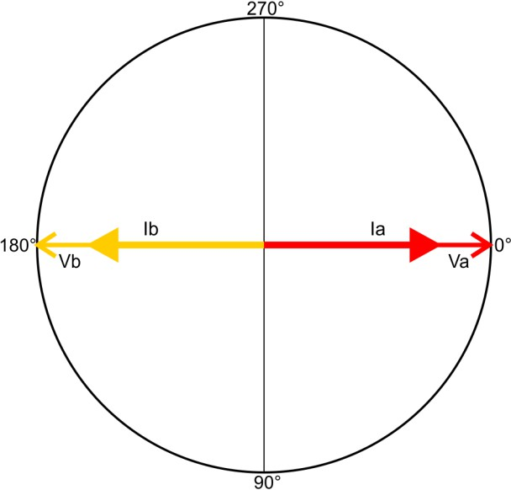
Metering Service Types
Metering Three-Wire Single-Phase Services
The three-wire 120/240V service is the most commonly used service for US residential customers. The three-wire 120/208V (network) service is commonly used in light commercial applications where the transformer bank is a four-wire wye bank. There are both Blondel and Non-Blondel meters available.
Meter Forms
Single-Phase Three-Wire 1P-3W (120V/240V)
 | Blondel Compliant | Non-Blondel Compliant
Self-Contained | 12S, 13S, 25S, 32S | 2S
Transformer-Rated | 5S, 26S, 45S, 56S, 66S | 4S
1P-3W
Distribution Phasors
1P-3W
Residential
Phase | V(p-n) | V ɸ | I(x-y) | I ɸ
A | 120 | 0 | Ia | 0
B | 120 | 180 | Ib | 180

Slide 9
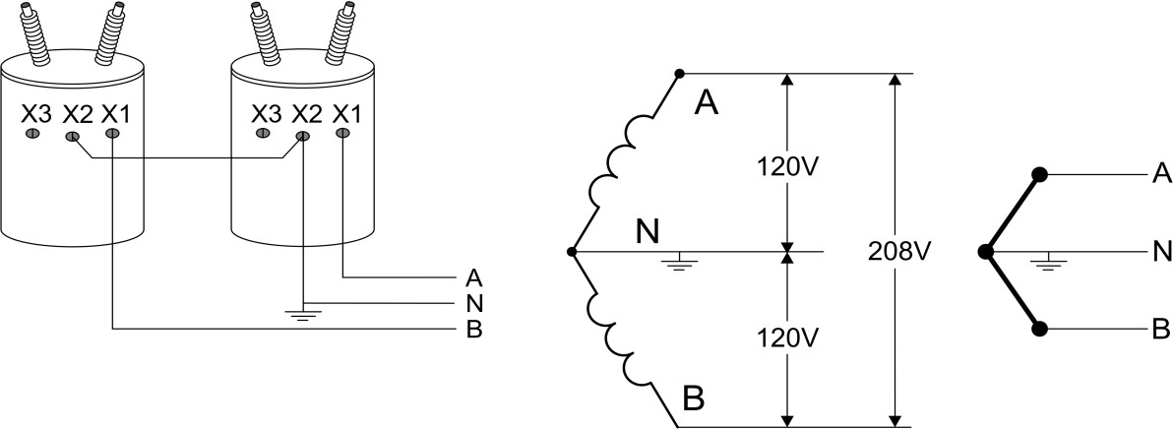
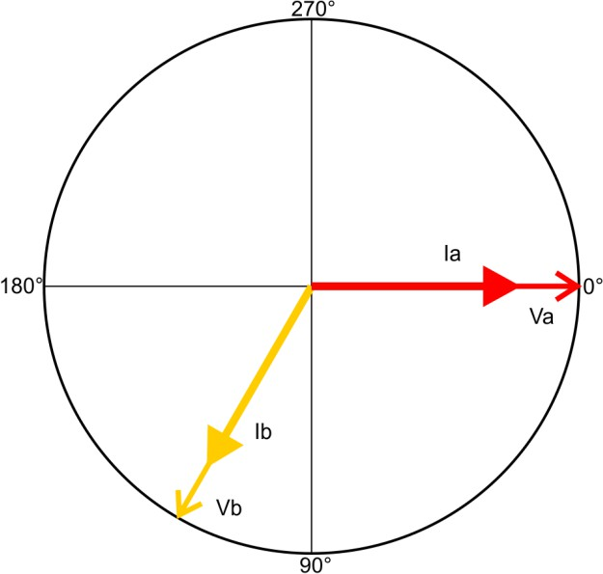
Metering Service Types
Single-Phase Three-Wire 1P-3W (120V/208V)
Distribution Phasors
1P-3W
1P-3W
Network
Phase | V(p-n) | V ɸ | I(x-y) | I ɸ
A | 120 | 0 | Ia | 0
B | 120 | 120 | Ib | 120
The non-Blondel meters which are often used for the 1P-3W Residential configuration should never be used in the network application.

Slide 10
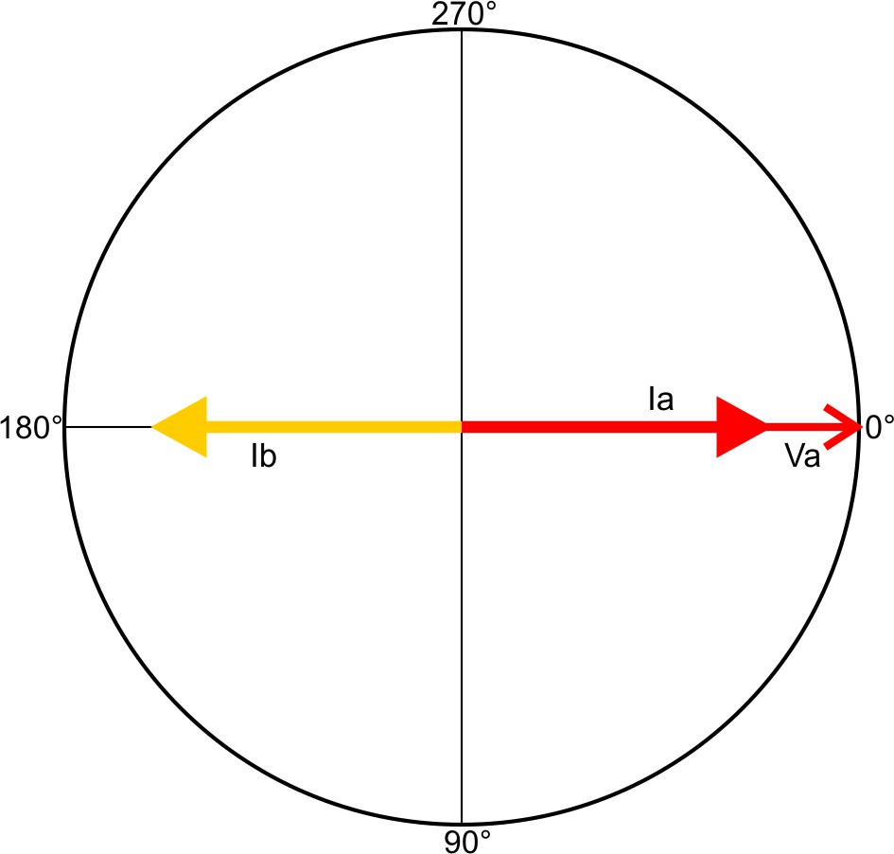
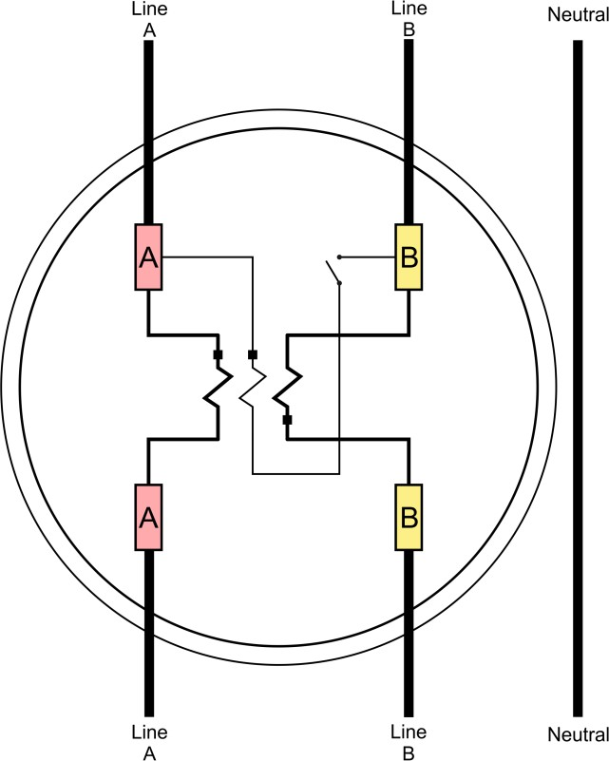
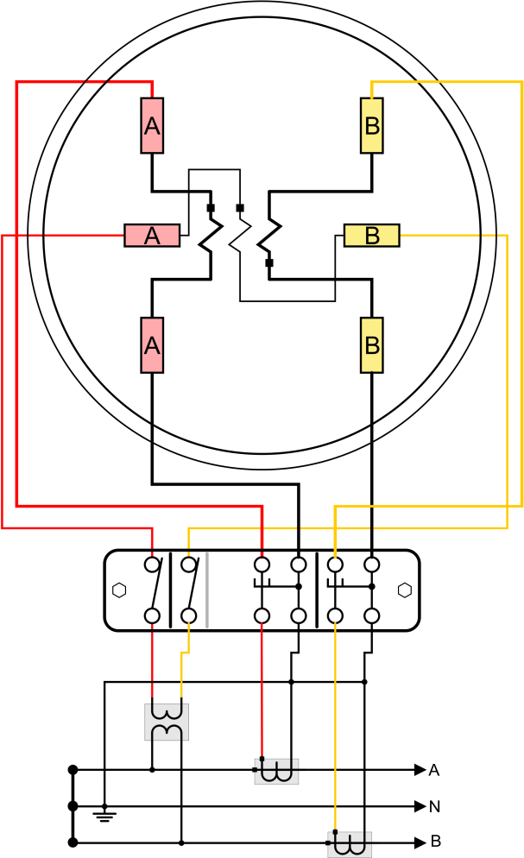
Single Phase
Meter Phasors
Phase | V(p-n) | V ɸ | I(x-y) | I ɸ
AB | 240 | 0 | Ia-Ib | 0
4S (Non-Blondel 1V 2I 3W) Transformer-Rated
2S (Non-Blondel 1V 2I 3W) Self-Contained
1P-3W
The 2S is the most widely used meter in the US. Because of the popularity of this service and it’s non-Blondel nature there is often confusion as to how accurate metering using this approach is in the real world. To help clarify this issue a complete analysis of this service is provided in appendix A. The equation for power is:
P = Vab ⋅ (Ia − Ib)
Neither the 2S nor the 4S should be used for a network configuration.

Slide 11
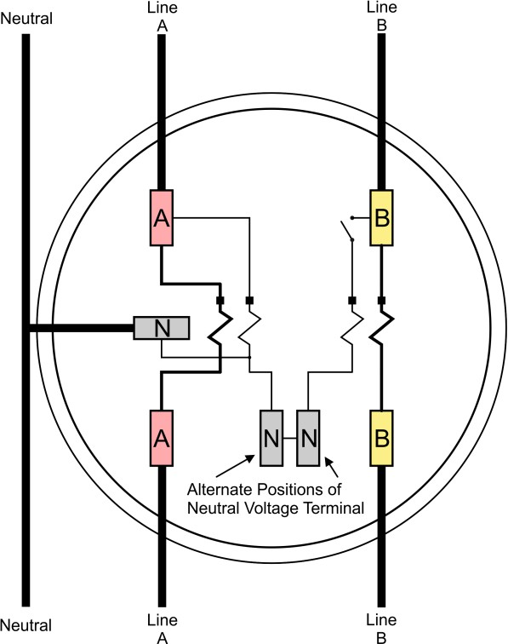
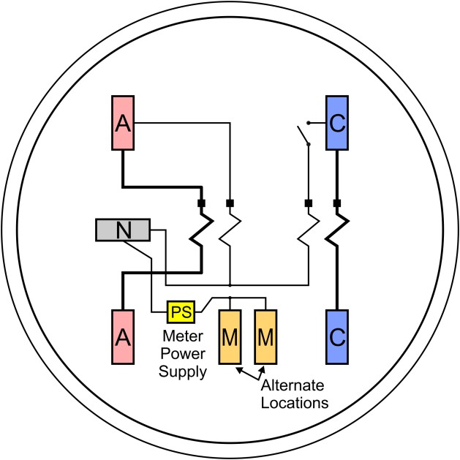
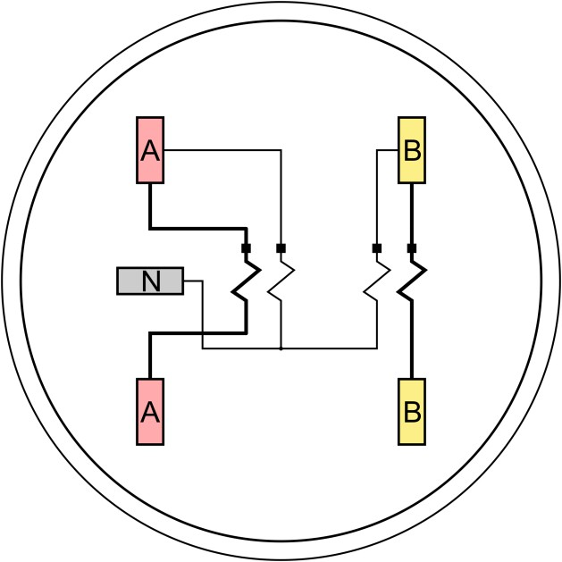
Single Phase
Meter Phasors
1P-3W
12S (Blondel 2V 2I 3W) Self-Contained
Phase | V(p-n) | V ɸ | I(x-y) | I ɸ
A | 120 | 0 | Ia | 0
B | 120 | 180 | Ib | 180
The meter phasor is identical to the distribution phasor.
The 12S is a Blondel alternative to the 2S for 1P-3W service. The 25S meter is exactly the same but does not have the alternate neutral locations or the potential jumper. The equation for power is:
P = Va ⋅ Ia + Vb ⋅ Ib
32S (Blondel 2V 2I 3W) Transformer-Rated
25S (Blondel 2V 2I 3W) Transformer-Rated

Slide 12
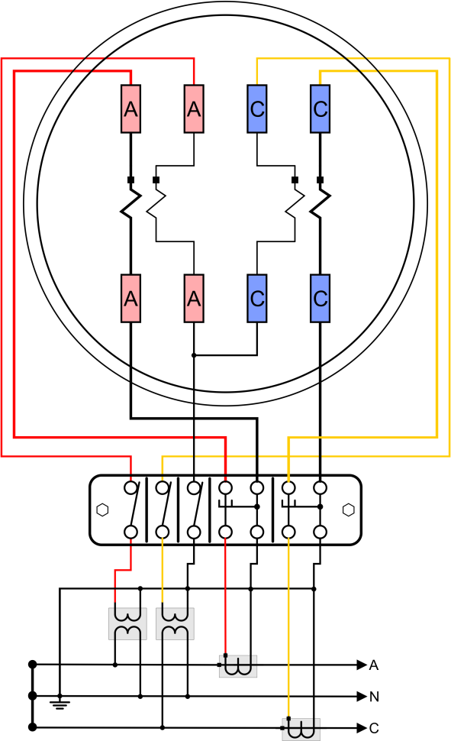
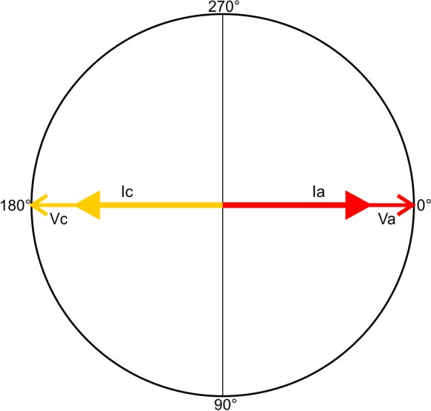
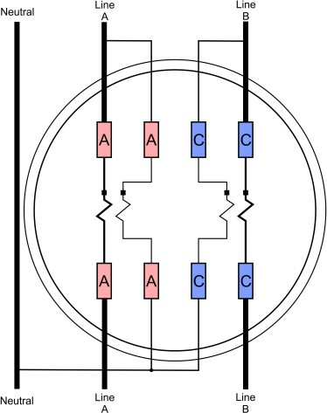
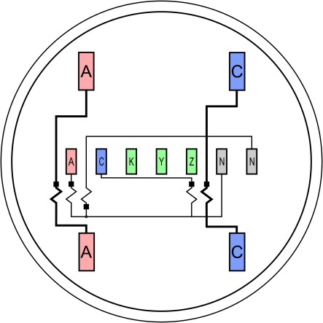
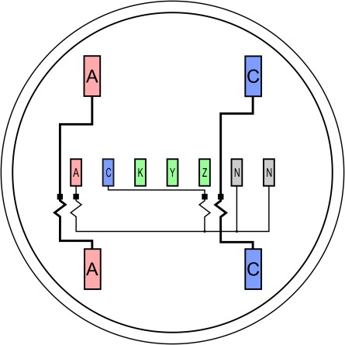
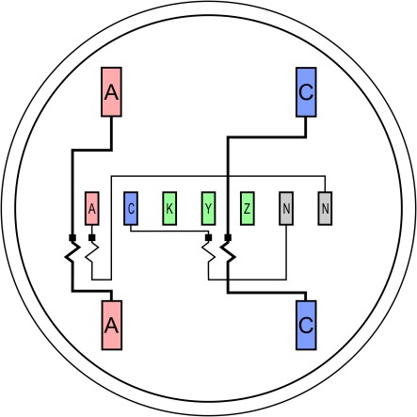
Single Phase
The 5S meter is usually used to meter three-wire delta services but can also be used on a single- phase three-wire service to provide Blondel compliant metering. The equation for power is:
5S (Blondel 2V 2I 3W) Transformer-Rated
P = Va ⋅ Ia + Vc ⋅ Ic
1P-3W Residential
Form 13S is a socket compatible alternative to the 5S. Other meters which have the same power equation but different socket configurations are forms 26S, 56S and 66S.
13S (Blondel 2V 2I 3W) Transformer-Rated
56S (Blondel 2V 2I 3W) Transformer-Rated
66S (Blondel 2V 2I 3W) Transformer-Rated
26S (Blondel 2V 2I 3W) Transformer-Rated

Slide 13
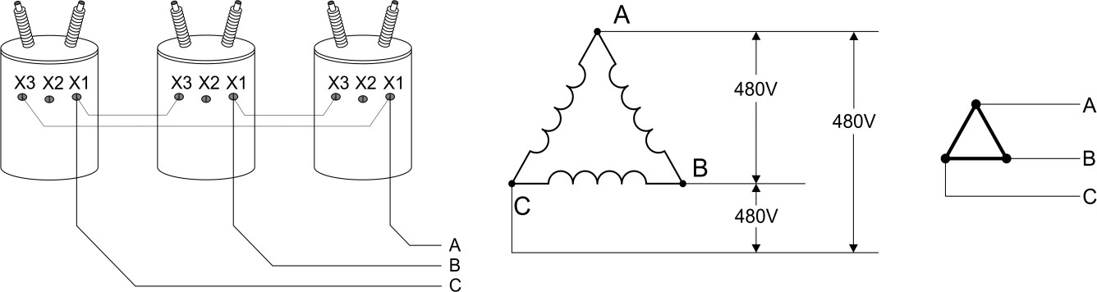
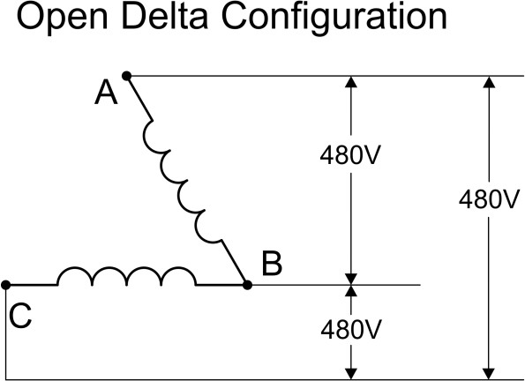
3 Wire Delta
Metering Three-Wire Delta Services
This service is most often used for heavy three phase motor loads. Zero sequence harmonics such as the 3rd which are created by motor loads circulate inside the distribution transformer and are not transmitted back onto the distribution network. The service has no neutral connection. All of the meters designed for this service are Blondel compliant.
Meter Forms
 | Blondel Compliant | Non-Blondel Compliant
Self-Contained | 13S, 25S, 32S | none
Transformer-Rated | 5S, 26S, 35S, 45S, 56S, 66S | none
All diagrams for the three-wire delta are shown as completely isolated, however one leg of the service is sometimes grounded. When a leg is grounded it is usually considered the B leg.
A delta transformer configuration has one unique advantage. One leg of the delta can fail and be removed without affecting the delivered voltages.
However, the current the transformer bank can deliver is reduced to 57.7% of normal. The benefit of trapping 3rd harmonic currents is lost.

Slide 14
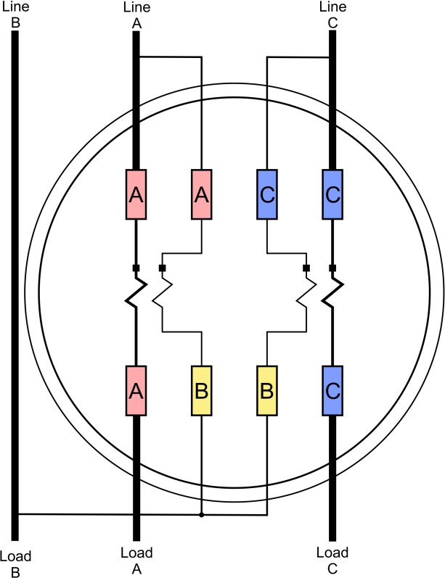
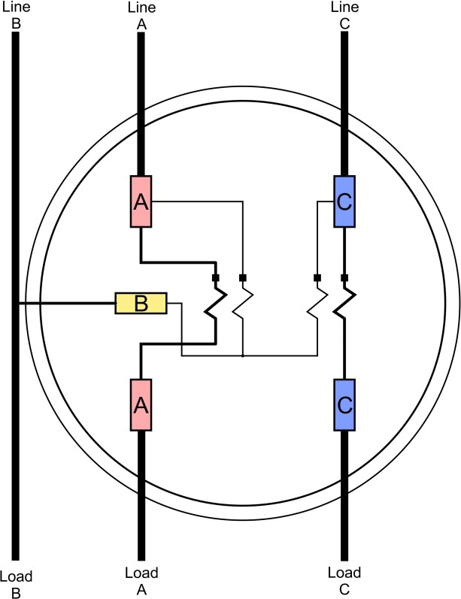
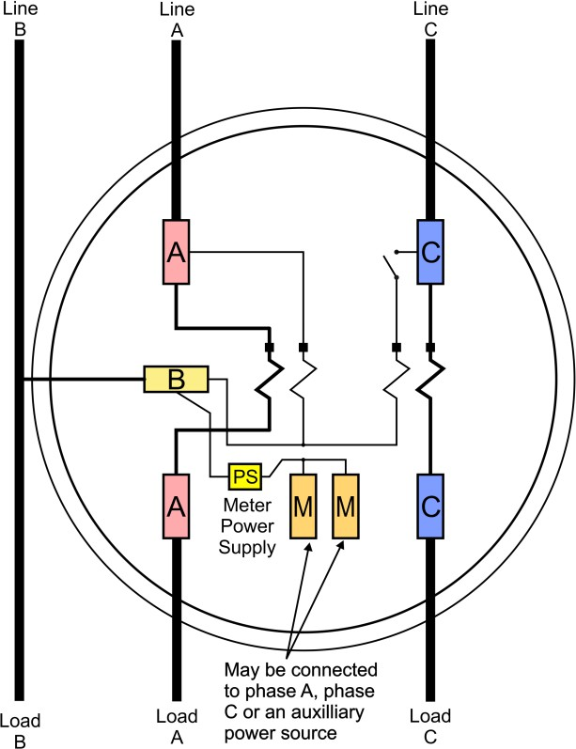
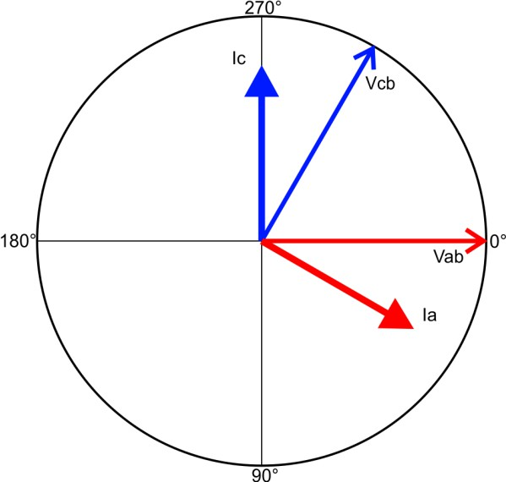
3 Wire Delta
13S ( Blondel 2V 2I 3W )
25S ( Blondel 2V 2I 3W )
Self-Contained Applications
Distribution phasors
25S ( Blondel 2V 2I 3W )
Phase | V(p-p) | V ɸ | I(x-y) | I ɸ
A | 480 | 0 | Ia | 0
B | 480 | 120 | Ib | 120
C | 480 | 240 | Ic | 240
Meter phasors
Phase | V(p-p) | V ɸ | I(x-y) | I ɸ
Vab | 480 | 0 | Ia | 30
Vcb | 480 | 300 | Ic | 270
The 13S, 25S and 32S self- contained meters are Blondel compliant solutions for metering the three-wire delta service. Because most three-wire delta services are heavy industrial most are metered with transformer-rated meters.

Slide 15
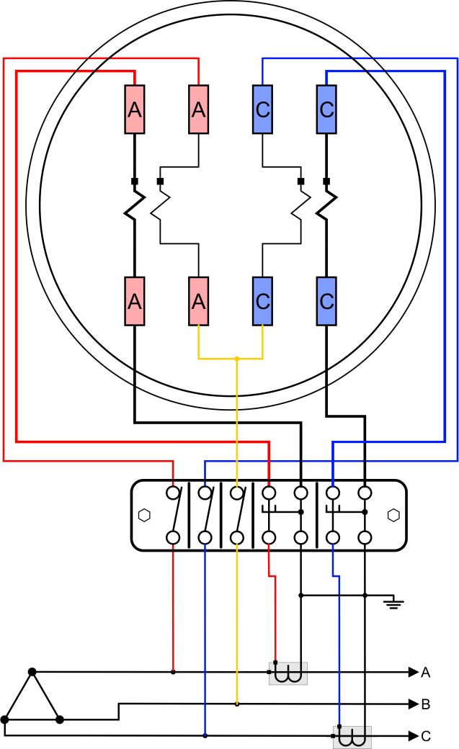
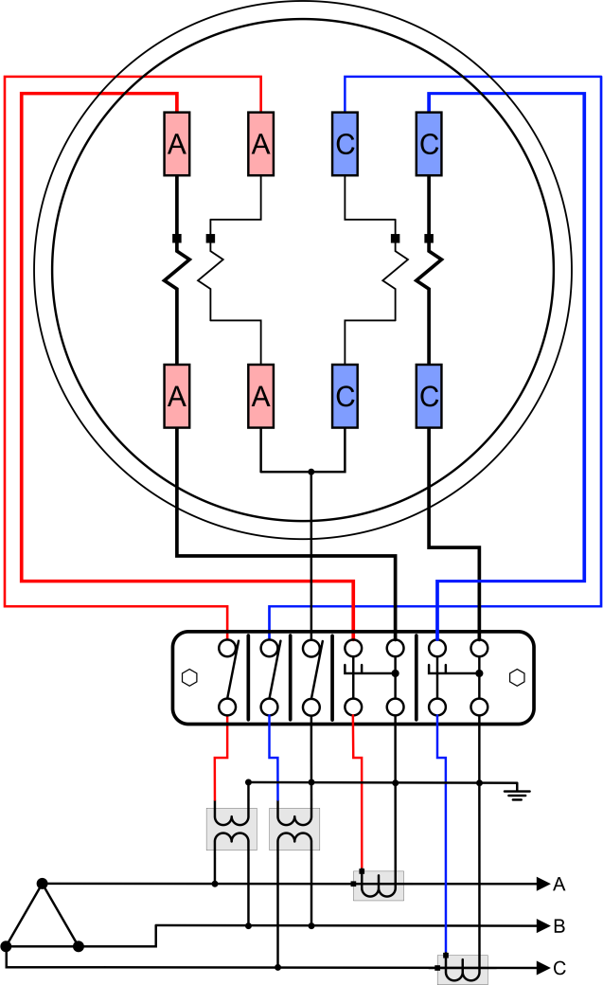
3 Wire Delta
Transformer-Rated Applications
5S ( Blondel 2V 2I 3W )
0 PT, 2 CT
2 PT, 2 CT
When there are no PTs extreme care must be used, especially on 480V services since high potentials exist within the meter enclosure. Test equipment should have its ground connected to a bonded earth at the enclosure. Note that no real earth may be present even in configurations with both PTs and CTs. Some utilities may ground phase B.
The equation for power is:
P = Vab ⋅ Ia + Vcb ⋅ Ic

Slide 16
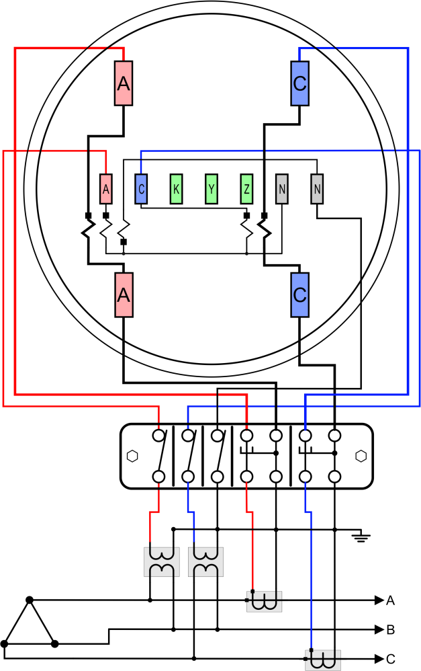
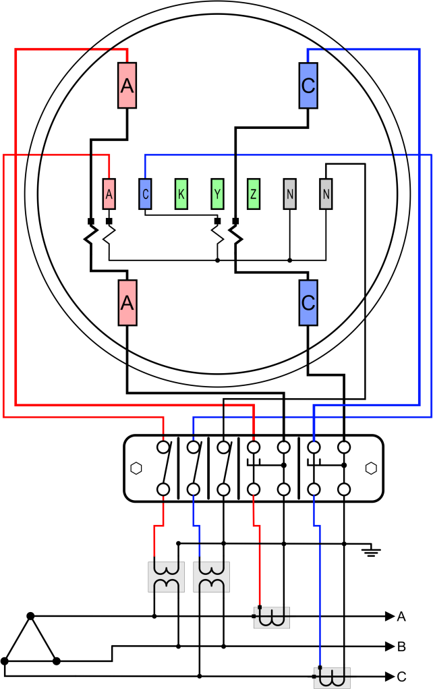
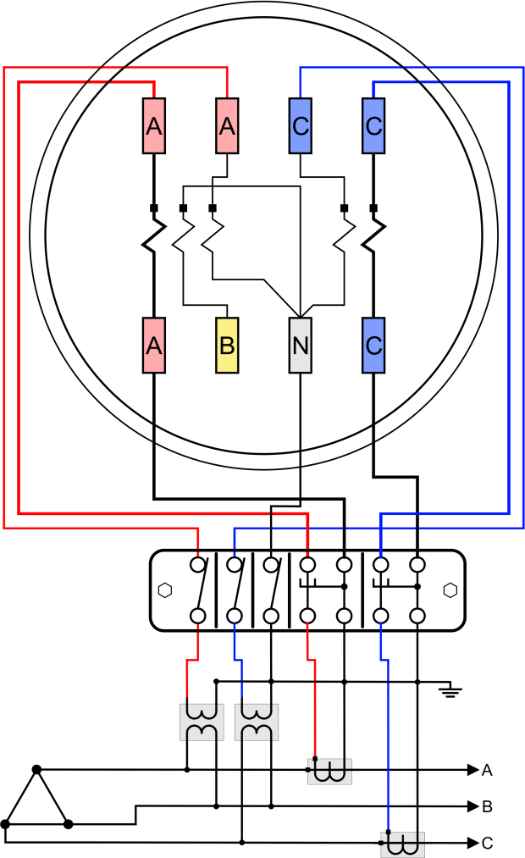
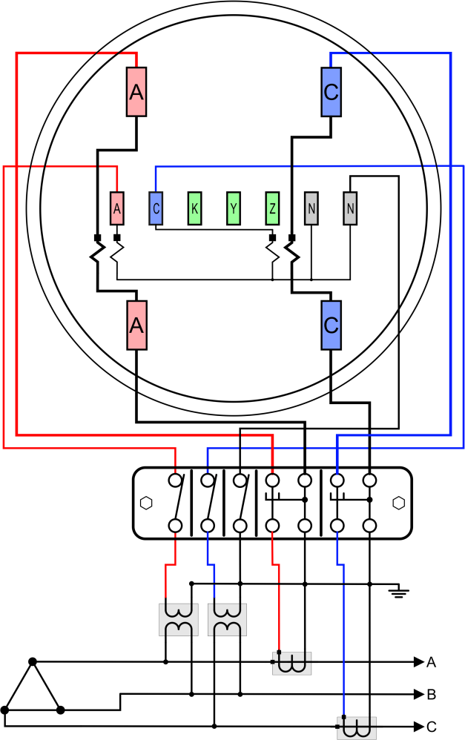
3 Wire Delta
Transformer-Rated Applications (cont.)
26S ( Blondel 2V 2I 3W ) 45S ( Blondel 2V 2I 3W )
56S ( Blondel 2V 2I 3W )
66S ( Blondel 2V 2I 3W )

Slide 17
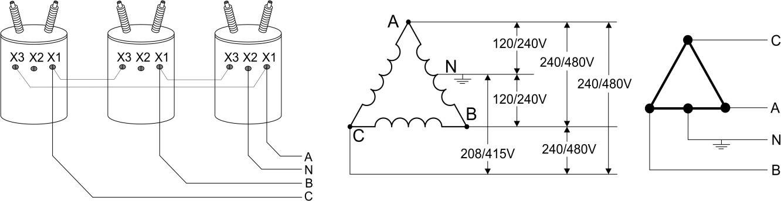
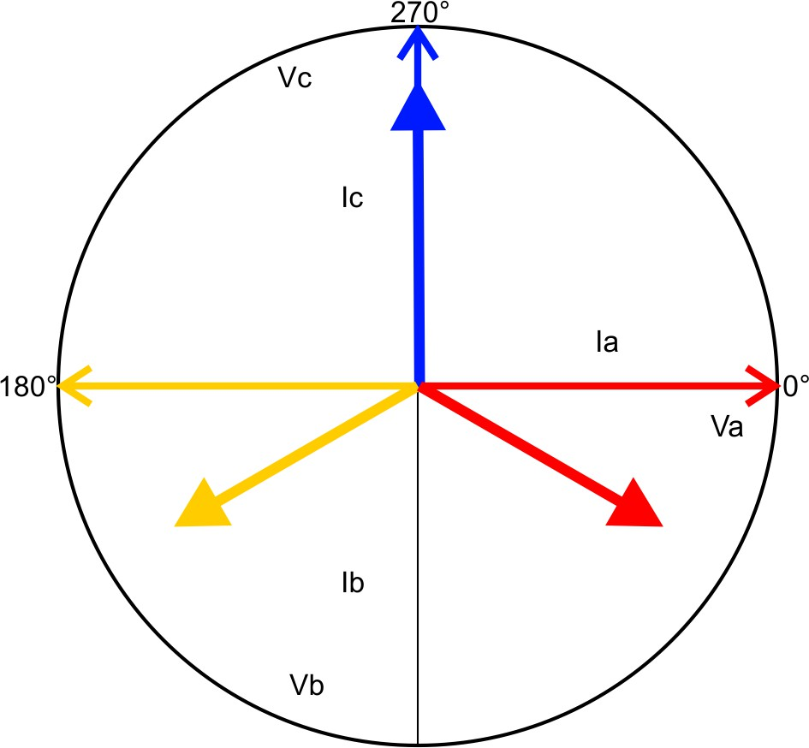
4 Wire Delta
Metering Four-Wire Delta Services
The four-wire delta service is only found in North America. At one time it was very common as the service of choice for light industrial and commercial applications. The attraction of this service is that it provides a wide selection of voltages from a single transformer bank. The center- tapped A-B leg provides 120V service identical to residential service. The “Hi-leg” (C to neutral) provides 208V which was widely used for single- phase motors. The delta connection is ideal for driving three-phase motors at phase-to-phase voltages of 240V.
Meter Forms
 | Blondel Compliant | Non-Blondel Compliant
Self-Contained | 16S, 17S | 15S
Transformer-Rated | 9S, 10S, 11S, 39S, | 8S, 24S,
Distribution Phasors
Meter Phasors
Phase | V(p-n) | V ɸ | I(x-y) | I ɸ
A | 120 | 0 | Ia | 0
B | 120 | 180 | Ib | 120
C | 208 | 270 | Ic | 240
This is basically a delta service where the three phases are 120 degrees apart. However, by grounding the center tap of one side of the delta we move the reference so that the phasors look quite different.
For Blondel applications the
service and meter phasors are the same.

Slide 18
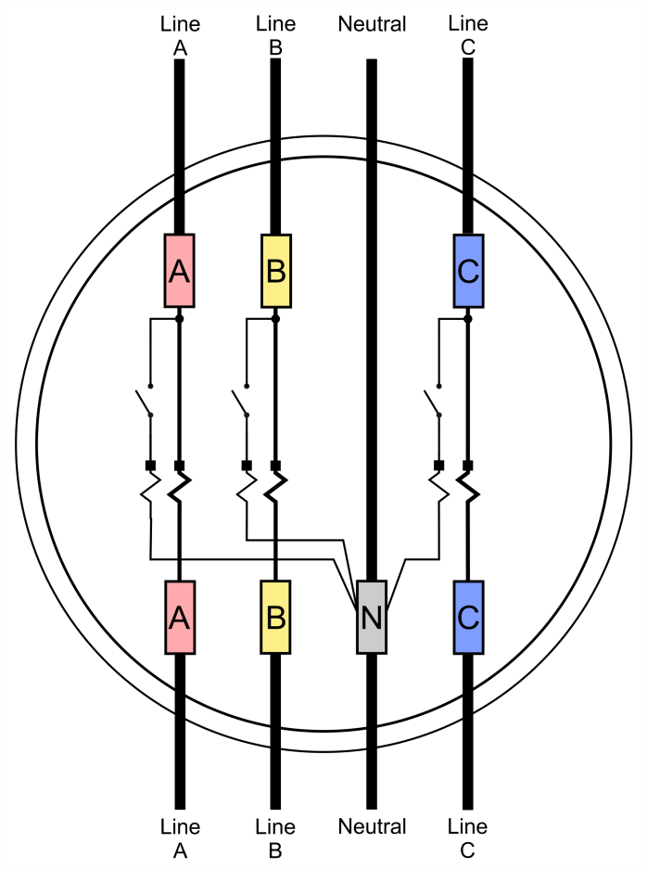
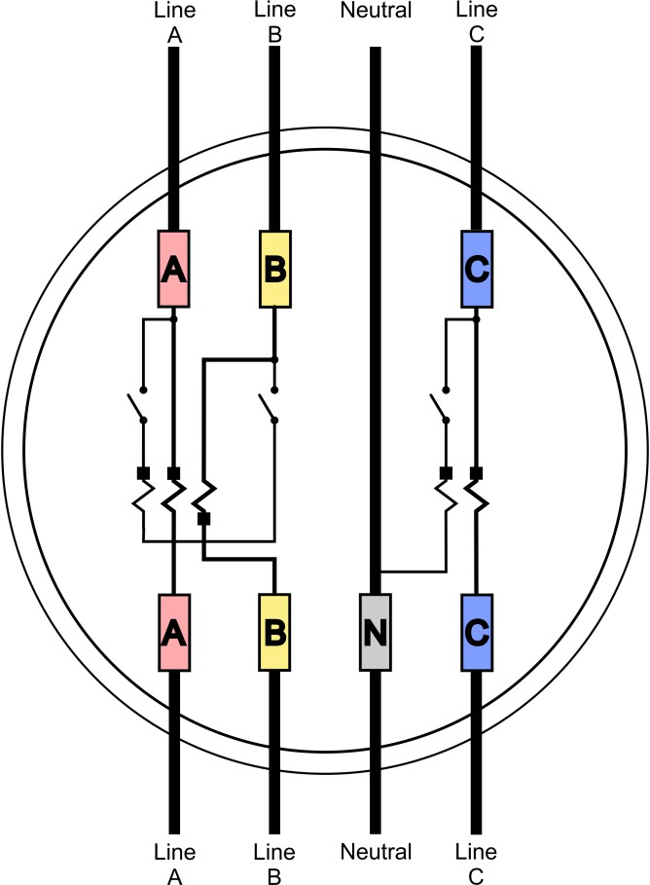
4 Wire Delta
The 16S and 17S are essentially identical meter forms. They provide Blondel compliant self- contained metering of the four- wire delta service. The equation for power is:
P = Va⋅ Ia + Vb⋅ Ib + Vc⋅ Ic
Self-Contained Applications
16S and 17S ( B londel 3V 3I 4W )
15S ( Non-Blondel 2V 3I
The 15S fits in the same socket 16S and 17S but is only has two stators. It is a non-Blondel application.
Therefore it has a different equation for the power computation.
P = 0.5*Vab ⋅ (Ia − Ib) +Vc ⋅ Ic
Because the 15S is a non-Blondel meter it is not accurate under all circumstances. Appendix A has a detailed analysis of the metering computations and potential errors.

Slide 19
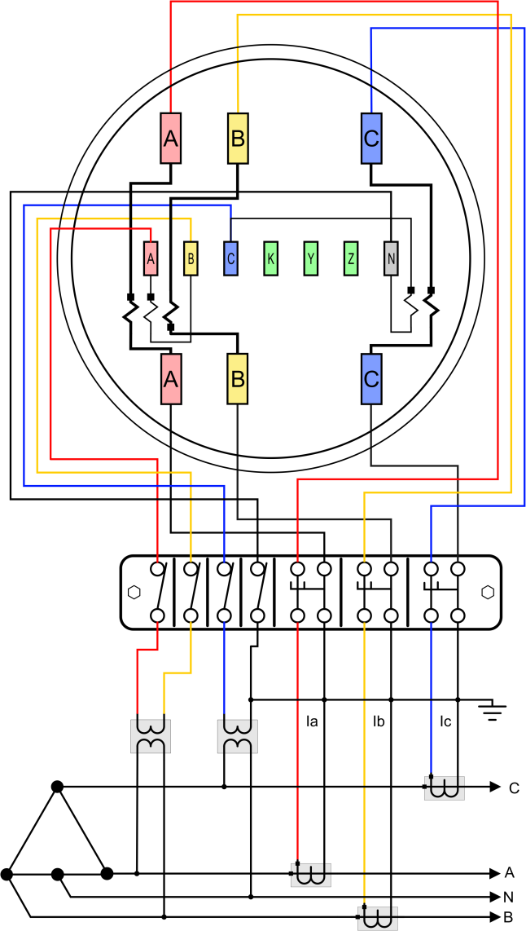
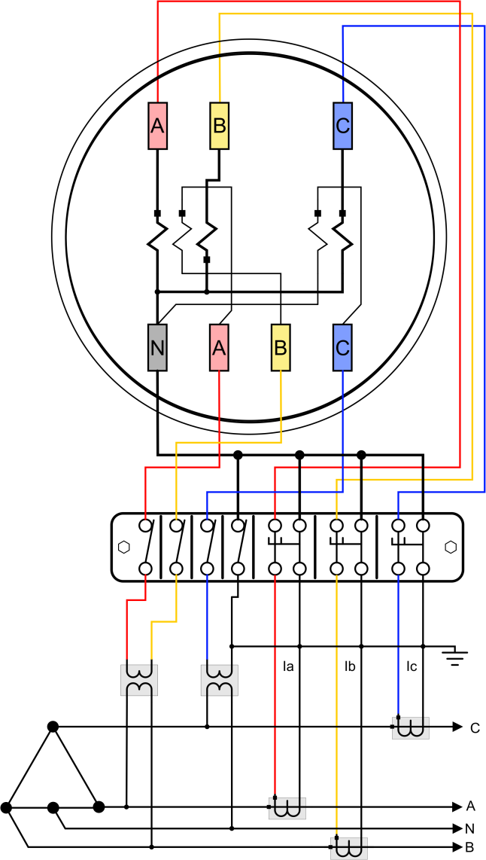
4 Wire Delta
Transformer-Rated Applications
8S ( Non-Blondel 2V 3I )
24S ( Non-Blondel 2V 3I)
The 8S and 24S both provide the same metering capability. The 24S allows use of a less expensive 8 pin socket. They provide non-Blondel compliant transformer rated metering of the four-wire delta service. The equation for power is:
P = 0.5*V_{ab} ⋅ (I_{a} − I_{b} ) +V_{cn} ⋅ I_{c}
Because this is a non-Blondel application there are assumptions about the service. Here the assumption is similar to the assumption for the 2S residential meter: that the voltages V_{an} and V_{bn} are balanced. See Appendix A for details about errors when this assumption is not met.

Slide 20
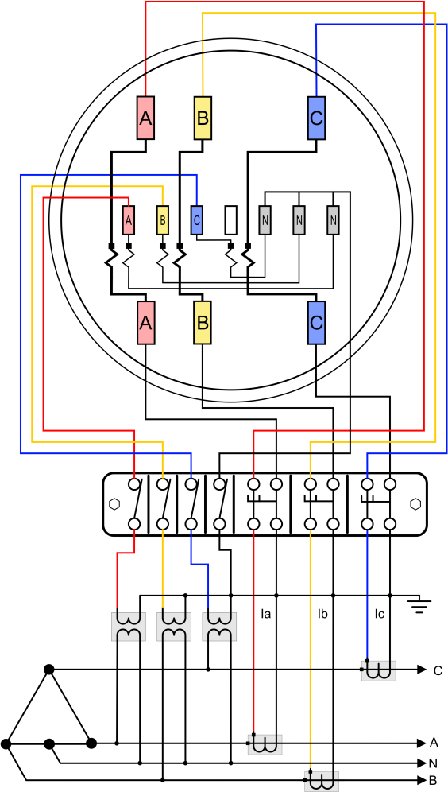
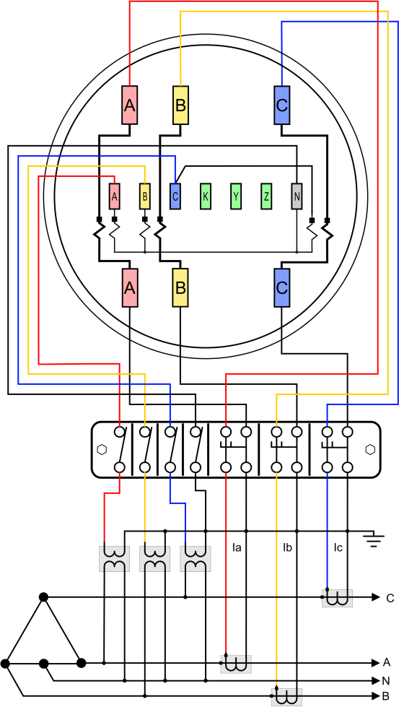
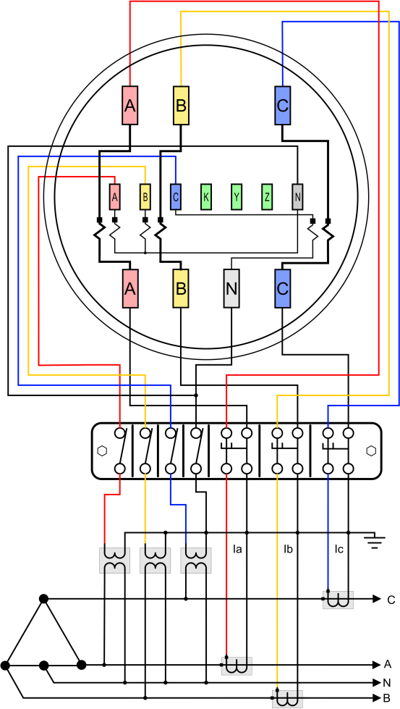
4 Wire Delta
Transformer-Rated Applications (cont.)
10S ( Blondel 3V 3I 4W )
4-9S, 39S ( Blondel 3V 3I 4W
11S ( Blondel 3V 3I 4W )
The 9S, 10S, 11S and 39S function identically. They simply differ in the wiring. They provide Blondel compliant transformer-rated metering of the four-wire delta service. The equation for power is:
P = Va ⋅ Ia + Vb ⋅ Ib + Vc ⋅ Ic

Slide 21
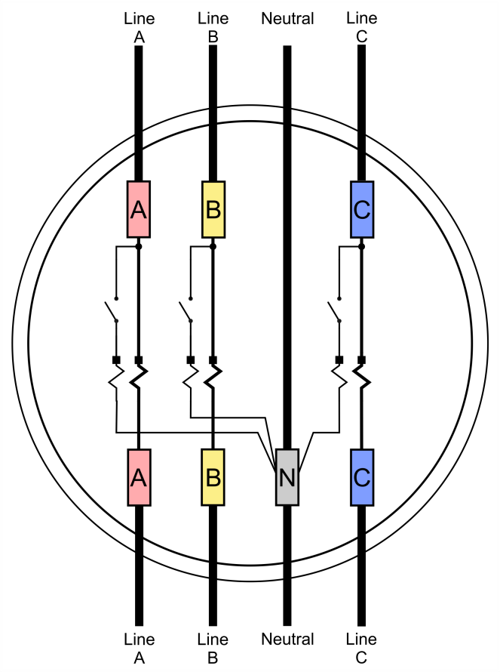
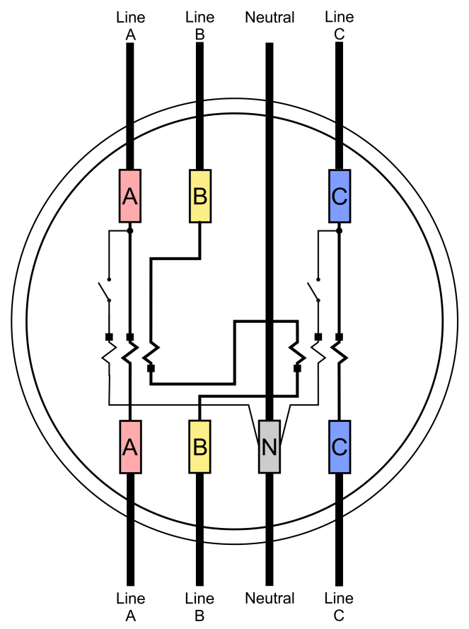
4 Wire Wye
Self-Contained Applications
Metering a Four-Wire Wye Service (3P-4Y)
This is the most commonly used service for US heavy commercial and industrial customers. There are both Blondel and non-Blondel meters available.
16S ( Blondel 3V 3I-4W )
14S ( Non-Blondel 2V 3I – 4W )
Meter Forms
 | Blondel Compliant | Non-Blondel Compliant
Self-Contained | 16S | 14S
Transformer-Rated | 9S | 5S, 6S, 7S, 8S, 10S, 29S, 36S, 39S, 45S, 46S, 76S
Note: After 2010 these meters may not have voltage links. Use extreme caution when testing these meter forms since some test equipment may assume they have open links. For the Blondel application the equation for power is:
P = V_{a} ⋅ I_{a} +V_{b} ⋅ I_{b} +V_{c} ⋅ I_{c}
For the non-Blondel Form 14S application the equation for power is:
P = V_{an} ⋅ (I_{a} − I_{b} ) + V_{cn} ⋅ (I_{c} − I_{b} )

Slide 22
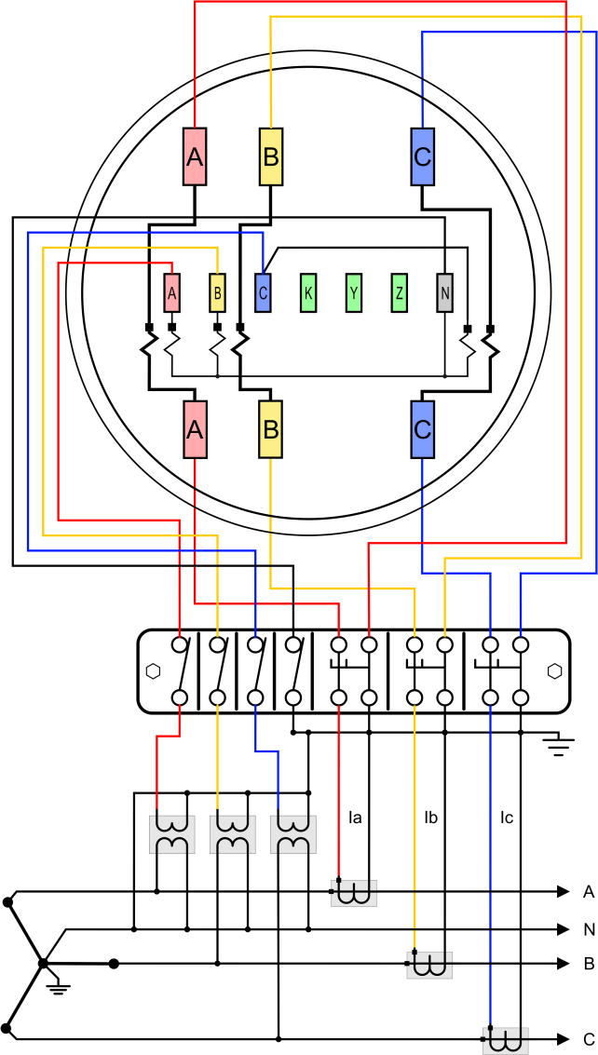

4 Wire Wye
9S ( Blondel 0PT 3CT )
9S ( Blondel 3PT 3CT )
Transformer-Rated Applications
The preferred method of metering the four-wire wye service uses the 9S meter as configured above. For services with the phase-neutral voltage over 120V but below 600V low ratio PTs are now commonly used.
270°
Vc
Phase | V(p-n) | V ɸ | I(x-y) | I ɸ
A | 120 | 0 | Ia | 0
B | 120 | 120 | Ib | 120
C | 120 | 240 | Ic | 240
Ic
180°
Ia
0°
Va
Ib
Vb
90°
Vector diagram shown with ABC rotation. For CBA rotation phase B and C are exchanged.

Slide 23


4 Wire Wye
Non-Blondel Transformer-Rated Applications
There are wide variety of non-Blondel metering applications for the four- wire wye service. They can be grouped by the number of voltages and currents used.
2V 2I
2V 3I
5S, 26S, 45S, 66S
6S, 7S, 29S, 36S, 46S
5S ( Non-Blondel 2PT 2CT ) 45S ( Non-Blondel 2PT 2CT )
Only the wiring diagrams for services using PTs are shown below. In all cases the PTs may be omitted and the voltage inputs connected directly to the meter if the meter is rated for the full line to neutral voltage.
The 2V2I style meters like the 5S are inherently Blondel compliant, however when used as described below the application becomes non- Blondel because we are running multiple phases through the CTs and are only measuring two not three voltages. For 2V3I style meters the meters are inherently non-Blondel. The combining of the currents vectorally is done internal to the meter. Both style meters have the same assumptions and the same non-Blondel error functions. For details of the errors in these applications see Appendix A.

Slide 24


4 Wire Wye
26S ( Non-Blondel 2PT 2CT ) 66S ( Non-Blondel 2PT 2CT )
Note: Some “universal” type 66S meters may require both pins 16 and 17 to be connected to neutral.
270°
Phase | V(p-n) | V ɸ | I(x-y) | I ɸ
A | 120 | 0 | Iab | 330
C | 120 | 240 | Icb | 270
Vc
Icb
Iab
180°
Va
0°
90°

Slide 25




4 Wire Wye
6S Family ( Non-Blondel 2PT 3CT )
6S
The 6S, 36S, and 46S only differ in
connections to pins 16 and 17. All three forms can be used interchangeably if pins 16 and 17 are connected to neutral.
⬅ 7S ( Non-Blondel 2PT 3CT )
The 7S meter has the same assumptions as other non-Blondel forms. It is distinguished by using a 8 pin socket instead of the 15 pin used by most of the CT rated meters for this service.
The 29S is similar except that the KYZ and Neutral use different pins.

Slide 26
TOU and Demand Metering
Thank you
Carl Chermak
315-436-8696

