Slide 1
DER Connections and Adapters
DERS to EVs to Grid Modernization
July 23, 2024
3:15 PM – 4:300 PM
Dan Falcone

Slide 2
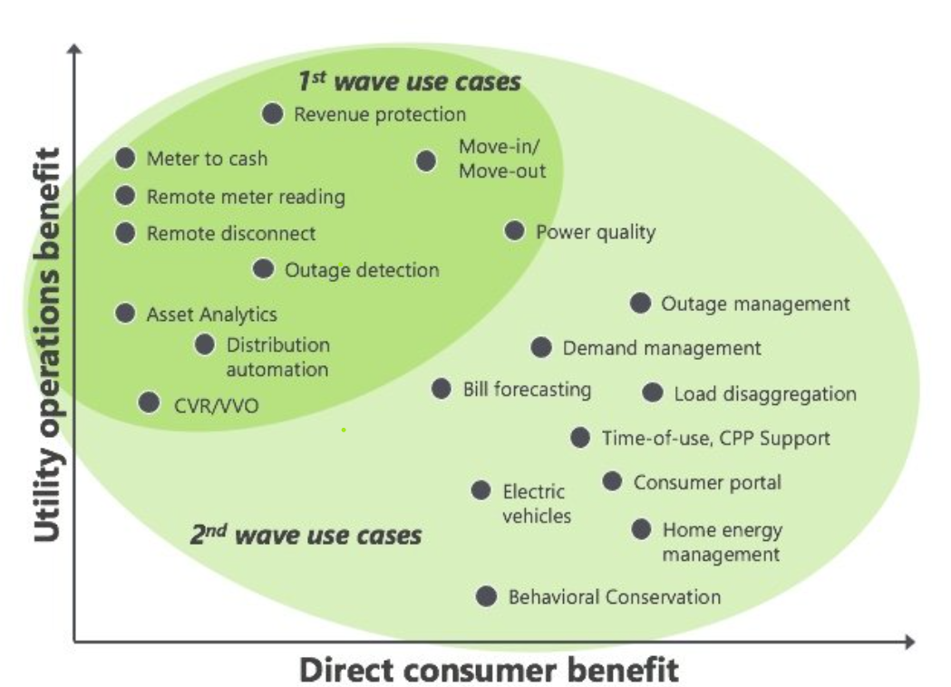
Presentation Goals
Provide a high-level overview of technology innovations and related market influences for meter operations departments in electric utilities
Offer an industry review of AMI technologies past and present with insight into next generation technology and impacts
Look ahead at ongoing and expanding DER penetration, preparation for VPPs, and Electrification Initiatives
*https://www.greentechmedia.com/squared/dispatches-from-the-grid-edge/how-to-ensure-the-next-generation-of-smart-meters-are-smart-enough-for-the-grid-edge

Slide 3
Evolution of Meter Operations Workload
History focused on billing accuracy, measurement, and consumption
Evolution from mechanical meters to solid state to AMR to AMI
Expansions of AMI use cases and reduced truck rolls
Advent of advanced analytics, customer access to data, and interval billing
Evolution to automated systems that are now a hub for everything from DER integrations to electrification planning
Expertise with data management and large data sets
Expertise with regulatory driven initiatives
Evaluations of competing new technologies
Physical Post Installation Inspections to Over the Air inspections via power quality reads
Meter exchanges for rate changes to Over the Air Reprogramming
Meters now see an Expected Useful Life (EUL) of 10-15 years instead of 20 years
Less than 3% of the 125M+ Smart Meters installed across the US fulfill the initial 2009 promise of customer savings*
*https://www.utilitydive.com/news/97-of-smart-meters-fail-to-provide-promised-customer-benefits-can-3b-in/632662/

Slide 4
Evolution of AMI Technologies
Power Line Communication – leverages existing infrastructure
  Cost effective, less bandwidth, interference
Radio Frequency – unlicensed and licensed spectrums, mesh or point-to-point
  Licensed vs Unlicensed
  Base stations vs Collectors and Repeaters
  Fixed pathway vs self-forming and self-healing
Cellular Endpoints
  Faster deployments, network reliability, cost, obsolescence concerns
Hybrid Communications
  Multiple communication methods on a single radio – Wi-Fi, Zigbee, PLC, Mesh, Cellular
“Future – Proof” Meters with software updates and “apps”
  Reduced restrictions from memory capacity and firmware prohibited upgrades

Slide 5
Evolution of AMI Analytics & Use Cases
AMI with Alarms, Flags, Events, & Intervals
Outage Reporting
Theft and Tamper Events
Interval Data Analysis
Voltage Monitoring
Temperature Monitoring
Load Disaggregation
RCDC for Credit, Move – In / Move – Out, PrePay
Analytics Platforms
AMI 2.0 with Distributed Intelligence & Edge Computing
Location Awareness
Bypass Detection & Magnetic Tamper
8+ Channels of Interval Data
Impedance Detection
Temperature Trending
EV and Solar Detection
Smart Prepay
App Platforms

Slide 6
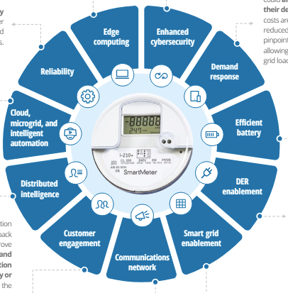
AMI 2.0
AMI 1.0 operational benefits have been captured
A second round of capital replacement is under way
Costs are harder to justify as labor resources and reduced truck rolls have been already offset
Consumers want benefits that are automated and easy to acquire
Meters can now be paired to Apps via Wi-Fi
*https://www2.deloitte.com/us/en/pages/energy-and-resources/articles/next-gen-advanced-metering-infrastructure.html?nc=42
*“Any electric utility that deployed AMI prior to 2010 or which has not yet deployed AMI should be in the planning phases to replace their aging AMI assets today”

Slide 7






Strategic Partnerships
Many hardware-based providers are finding value leveraging relationships by shifting to software and loading into existing hardware with market fit (smart meters)
Landis+Gyr and Sense (from CTs and modules to meters)
  In-home high resolution energy monitoring and machine learning via app
Landis+Gyr and SPAN (from smart panels to utility connection via meters)
  Sub-metering at circuit level, prep for VPPs, and DER control
Aclara and Utilidata (from adapters to meters)
  Distributed AI with NVIDIA module and KARMAN platform
Itron and Schneider
  ADMS, IOT Solutions, VPP prep
Notes:
Itron and Microsoft Azure OpenAI – IEE and AI in middle of stack

Slide 8
Distributed Energy Resources (DERs)
Small-scale units of local generation connected to the grid at the distribution level. These resources can include renewable energy systems, energy storage, demand response technologies, and electric vehicles.
Benefits
Grid Reliability and Resilience
Environmental
Economic Efficiency
Energy Independence
Customer Empowerment
LMI & REC Programs
Challenges
Grid Integration
Regulatory and Policy
Economic Barriers
Technical Challenges
Customer Satisfaction
Dated Infrastructure & Installation Cost
Notes:
Backup power, improve resilience
Reduced GHG emissions, climate goals
Reduce expensive grid infrastructure and lower ops costs, less generation – plants
Enhances energy security and vulnerability to threats
Increased customer satisfaction and cost savings
Blocked feeders, lengthy processes
Policies are changing, may or may not support full integration
High upfront costs – LMI?
Compatibility and communication, utility behind market
Negative customer perceptions and long wait times

Slide 9
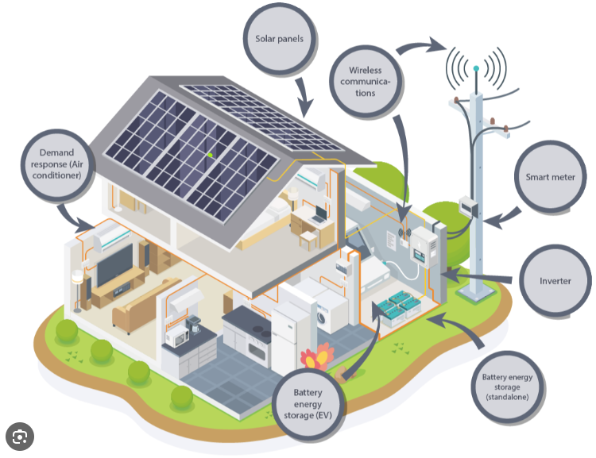
DERs
*https://www.cummins.com/news/2021/11/04/what-are-distributed-energy-resources-and-how-do-they-work
Notes:
Backup power, improve resilience
Reduced GHG emissions, climate goals
Reduce expensive grid infrastructure and lower ops costs, less generation – plants
Enhances energy security and vulnerability to threats
Increased customer satisfaction and cost savings
Blocked feeders, lengthy processes
Policies are changing, may or may not support full integration
High upfront costs – LMI?
Compatibility and communication, utility behind market
Negative customer perceptions and long wait times

Slide 10
Virtual Power Plants (VPPs)
A system that integrates various Distributed Energy Resources (DERs) such as solar panels, wind turbines, energy storage systems, electric vehicles, and demand response units, using advanced software to manage and optimize their collective output as if they were a single power plant.
Functions and Capabilities
Combine multiple DERs into a single manageable entity
Real time monitoring and control
Demand response via load shifting and peak shaving
Energy trading – participate in energy markets to sell excess or provide services like frequency regulations
Regulatory involvement, AI and software integration, and cyber security pose risks but also offer opportunities
Notes:
Grid stability, cost, peer to peer, marketplace, lack of incentives for DER owners
Can solve a lot of utility problems

Slide 11
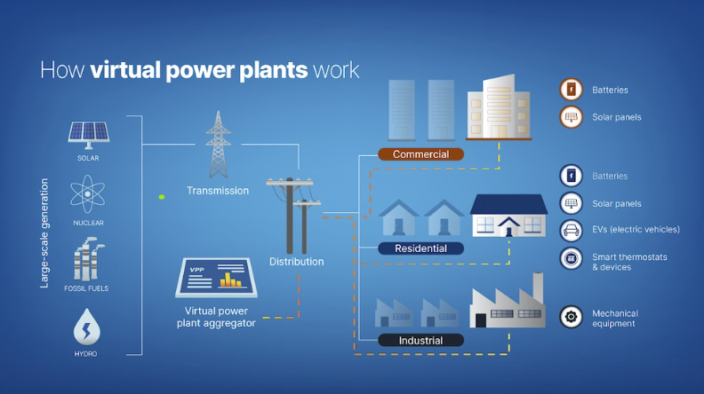
VPPs
*https://www.solarreviews.com/blog/virtual-power-plants
tescometering.com
11

Slide 12
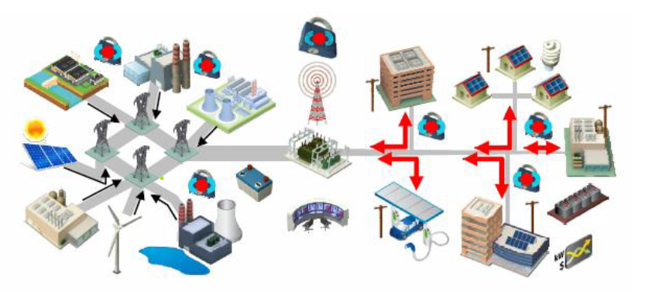
Grid Modernization
AMI
  DI, Edge Computing, Monitoring, 2-Way Comms
Grid Automation and Control
  SCADA, ADMS
Integration of DERs
  Microgrids, Control
Enhanced Communications
  High speed, reliability
Advanced Data Analytics
  AI and Machine Learning
Cybersecurity
  Encryption, Firewalls, Intrusion Detection
This is the process of updating and enhancing the traditional electric grid to improve its reliability, efficiency, resilience, and ability to integrate with new technologies. It involves implementation of advanced technologies and practices to meet the changing needs and challenges of the energy landscape.
Notes:
Outages
Efficiency
Reliability
Renewable penetration
Decentralized generation
Improved customer enagegemtn
Reduced ghg emissions
Demand response
High upfront cost, technical complexity cybersecurity risks
Smart citites

Slide 13
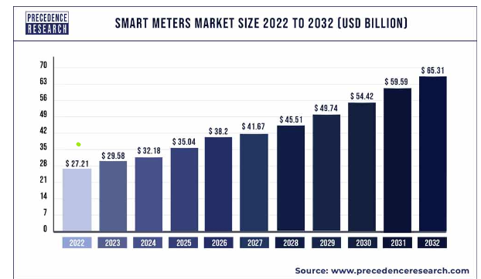
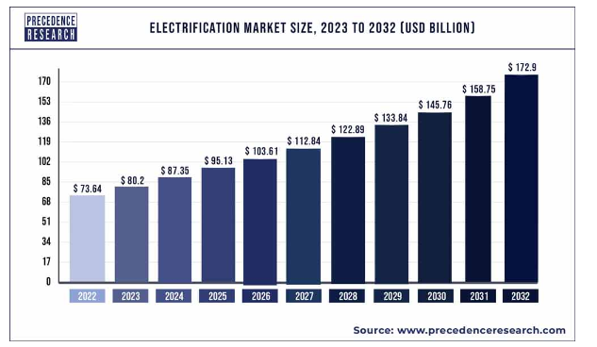
Electrification
This is replacing fossil fuel-based technologies with those that are powered by electricity. This shift aligns to sustainability goals, reduces greenhouse gas emissions, and enhances energy efficiency.
Electric Vehicles
Appliances
Electric Hot Water
Air Source Heat Pumps
Regulatory Frameworks, subsidies, rebates, and pricing initiatives all drive increases.
Many of these changes require added home wiring, service panel upgrades, and challenges with location of assets and availability of circuits.
3X Market Size of Smart Grid >$100B in next 2 years
Notes:
Renewable Portfolio Standards
7500 EV credit
ZEV – zero emission vehicle goals
GHG emissions goals
2k heat pump rebate
Local iou appliance rebates – energy star
Building codes – solar ready, no more natural gas
Electrification Market Size and Manufacturers
The global electrification market size was reached at USD 73.64 billion in 2022 and it is expected to hit around USD 172.9 billion by 2032, growing at a CAGR of 8.91% between 2023 and 2032.

Slide 14
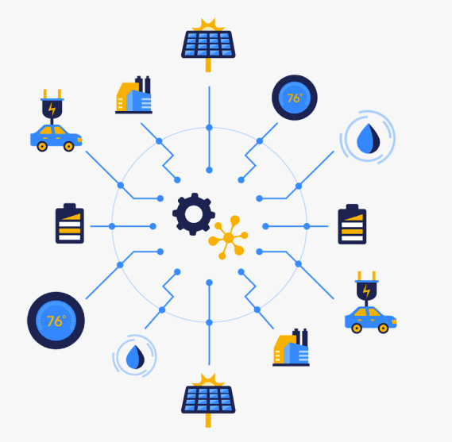
Solutions for Electrification & DER Integration
Many competing systems and technology solutions exist to solve the crux of the electrification problem – growing demand, aging infrastructure, cost avoidance and load / source limitations for both the utility and consumer.
Consumers can adopt some solutions independently via a DER application while others require varying levels of utility interaction and/or approval.
Meter Socket Adapters (MSAs)
New DER ready ANSI form 42S / 43S meter / sockets
Smart Panels
Load And Energy Management Systems
Power Control Systems (PCS)
Notes:
Renewable Portfolio Standards
7500 EV credit
ZEV – zero emission vehicle goals
GHG emissions goals
2k heat pump rebate
Local iou appliance rebates – energy star
Building codes – solar ready, no more natural gas
Electrification Market Size and Manufacturers
The global electrification market size was reached at USD 73.64 billion in 2022 and it is expected to hit around USD 172.9 billion by 2032, growing at a CAGR of 8.91% between 2023 and 2032.

Slide 15

What Does it all Mean for Meter Operations?
Education and Training
Resource Allocation
Funding for AMI 2.0
  How to EOL current hardware & software
  Trending equipment failure rates
  Replacement schedule
  New vs existing networks
Standardization and Interoperability
Customer Driven Programs
Ultimately, this will result in the evolution of the
Meter Operations practice!

Slide 16
Updated 30A Back Up Power Transfer Meter Design
Requirement for the user to shut off the main disconnect to the house is now eliminated.
Requirement for the user to unplug the generator is removed.
More robust voltage sensing.
Increased the robustness of the disconnect contact sensing.
Increased power for the disconnect motor drive to enable the BPTM to overcome sticky motor shafts with greater ease as well as to allow it to be used with Aclara meters with relay disconnects.
tescometering.com
16

Slide 17

Questions and Discussion
Dan Falcone
ConnectDER
This presentation can also be found under
Meter Conferences and Schools on the TESCO website: tescometering.com
ISO 9001:2015 Certified Quality Company
ISO 17025:2017 Accredited Laboratory

